Slide 1
Administrative Practices Outcome 1.1 Tasks, Skills and Qualities of an Administrative Assistant Administration and IT
National 4 and National 5

Slide 2

Tasks
Word Processing: Business Documents
Databases: Storing Information
Spreadsheets: Performing Calculations
Preparing and Presenting Information
Organising Events
Telephone Management
Reprographics
Emails and Managing eDiaries
Internet and Emerging Technologies
Administrative Assistant

Slide 3
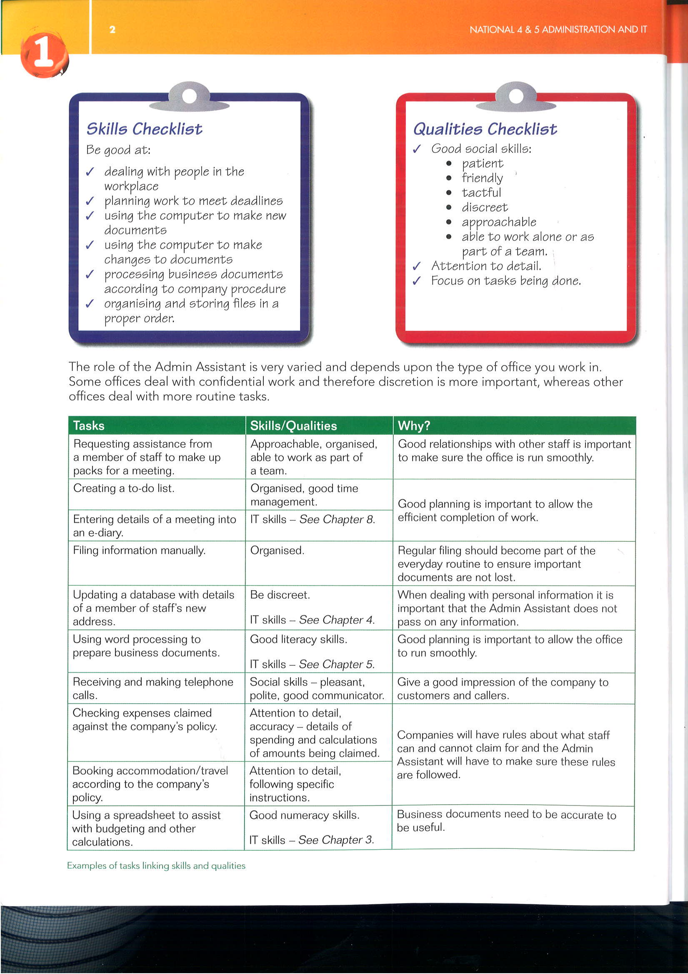
Skills
A skill is something that you can learn and become better at with practice.
Customer care
Literacy
Numeracy
Communication
IT
Organisation eg meet
deadlines
Administrative Assistant

Slide 4
Qualities
A quality describes the type of person the job applicant is (a personal characteristic):
Personal Organisation
Initiative
Dependable and Reliable
Patient
Calm
Tactful
Administrative Assistant

Slide 5
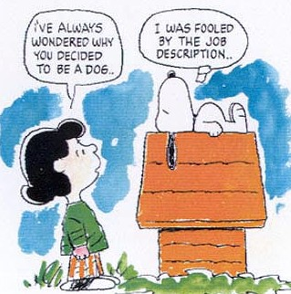
Job Description
A job applicant will use this to decide if the job is right for them:
Job Title
Duties and Tasks
Responsibilities
Line Manager
Hours Worked
Salary
Holiday Entitlement
Administrative Assistant

Slide 6

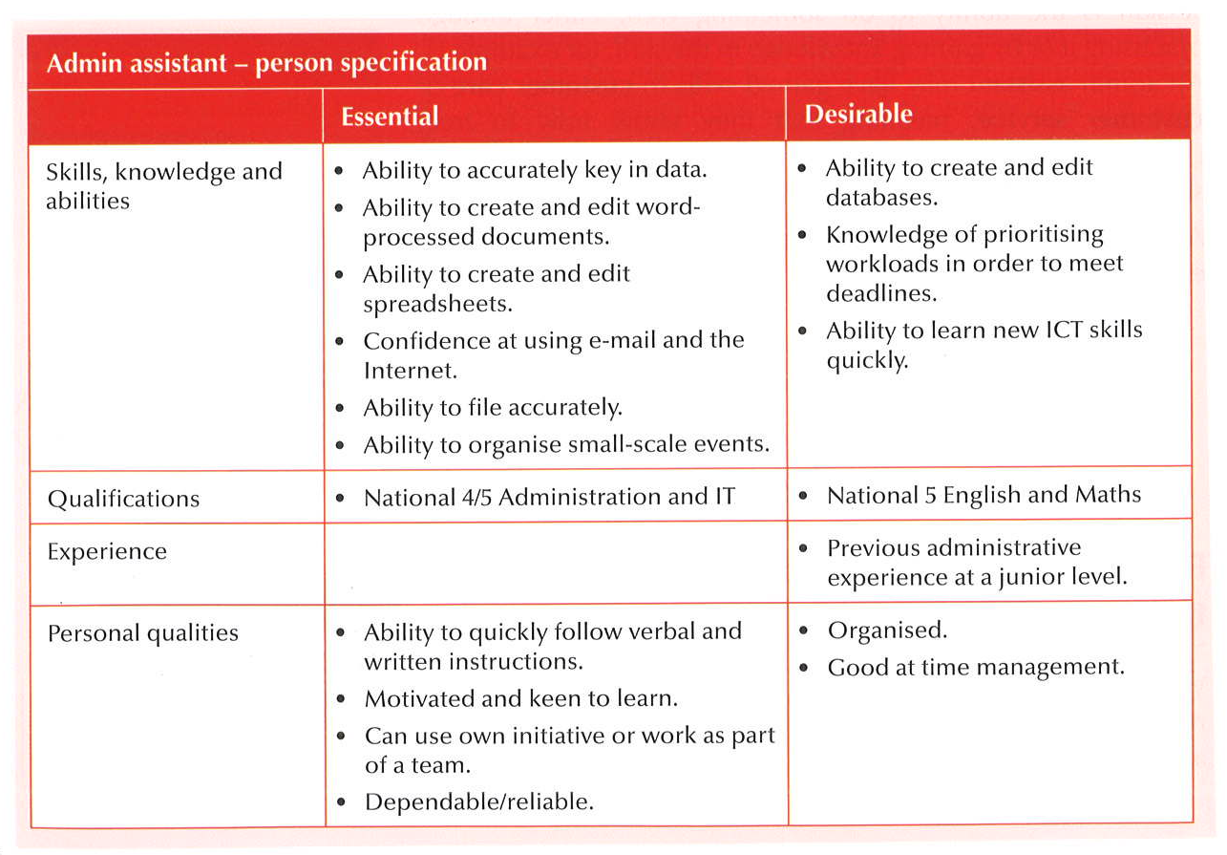
Person Specification
This is a profile of the ideal candidate and can be prepared and used to assist in the selection process:
Does the candidate have the skills and qualities required – which can be essential or desirable.
Skills
Qualities
Qualifications
Experience
Administrative Assistant

Slide 7
Person Specification
Administrative Assistant

Slide 8


Task: Research Vacancies
Research Current Vacancies
Use local/national newspapers or the Internet to carry out research on 3 current vacancies available for Admin Assistants.
Identify:
Current salary
Location
Working hours
Tasks/duties
Qualities and skills required
Administrative Assistant

Slide 9

Task: Discussion
Class Discussion
Discuss how the information from the job adverts differs for Admin Assistants working in different types of organisations.
Administrative Assistant

Slide 10

Task: Person Specification
Create a Person Specification
After discussion with your teacher create a person specification for an Administration Assistant.
You can use the template provided, or create your own based on the layout given.
Administrative Assistant

Slide 11
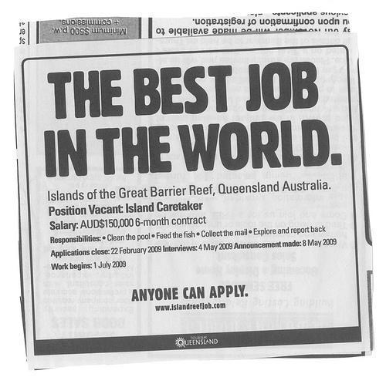
The Job Advert
Information from the Job Description and Person Specification will be used to create a job advert.
This may be advertised internally eg staff newsletter, council intranet
Alternatively an external advert eg MyJobScotland or a local newspaper
Administrative Assistant

Slide 12
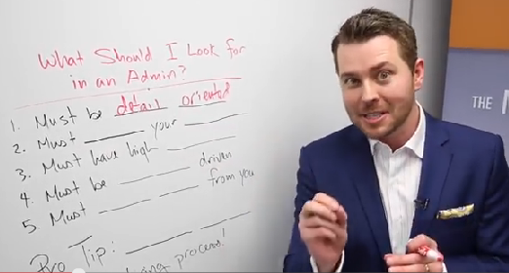
What I Look For…. Video
Administrative Assistant

Slide 13
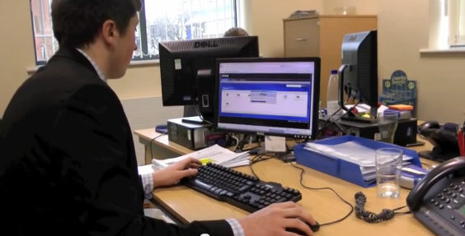
Business Administration Apprenticeship Video
Administrative Assistant

Slide 14
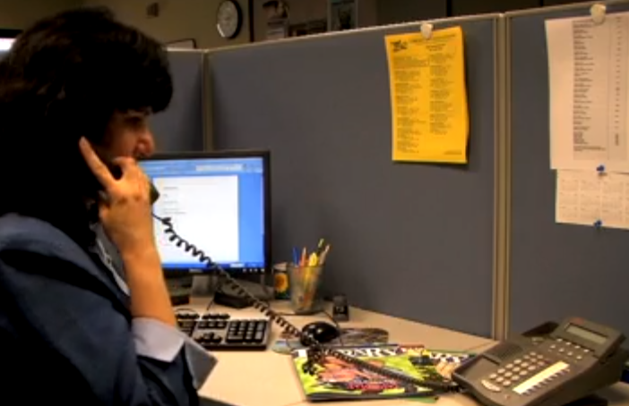
Activity
OTHER
Watch this Video
How often does the Admin Assistant check her email and why?
How does the Admin Assistant categorise her emails?
Give one example of what the Admin Assistant uses her calendar (Outlook) for?
What software does the Admin Assistant use to keep track of statistics and run various reports?
State 3 other duties the Admin Assistant may carry out.
Why should files (both manual and computerised) be kept organised?
Administrative Assistant

Slide 15

Key Questions
Key Questions: IT Task - Job Advert
Using the file “Job Advert”…
Complete the advert to show two more duties and three qualities and skills.
Print one copy of your completed advert – add this to your portfolio.
Administrative Assistant

Slide 16

Application Forms
Application forms allow applicants to provide information in a standardised format.
Great care should be taken to read all instructions, and proof read what is written.
Ideally application forms should be word processed.
Administrative Assistant

Slide 17

Curriculum Vitae
A CV allows a job applicant to provide information about themselves in a format that they have created.
Each job applicant’s CV may contain different information.
Administrative Assistant

Slide 18

Next Steps?
Human Resources Department:
Match applicants with the job description and person specification to check suitability
Short-List:
A selection of candidates invited for an interview
Interview:
Best person selected and a job offer is made
Administrative Assistant

Slide 19
Next Steps?
Reference:
May be enclosed with the application or followed up later – evidence of suitability (often) from current employer
Contract of Employment:
Details of the job, including remuneration and working conditions
Administrative Assistant

Slide 20

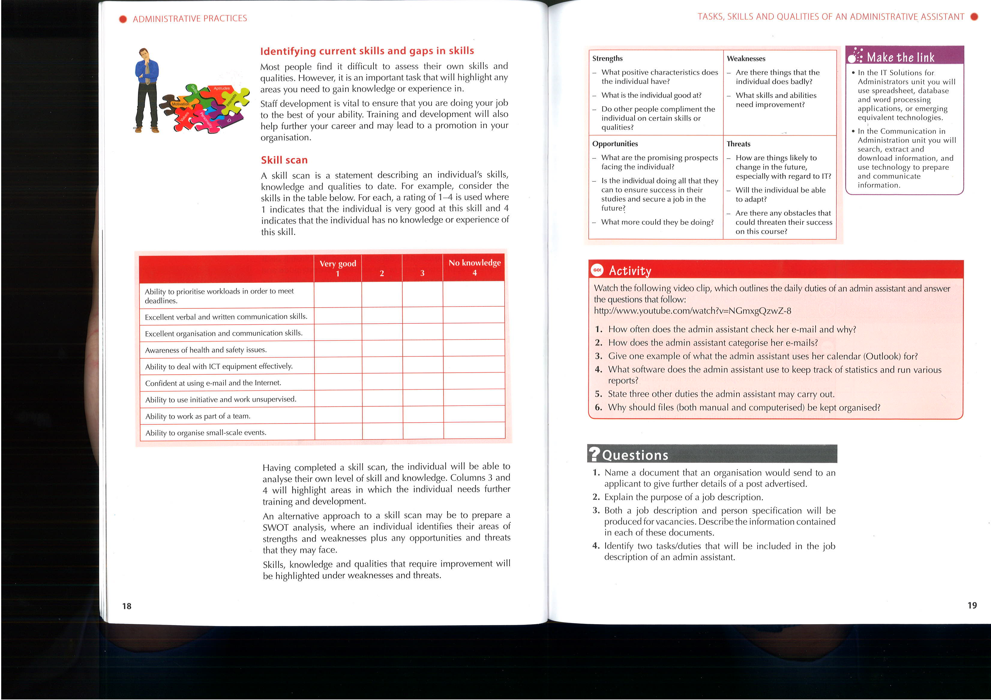
Skills Scan: 1-4
A skills scan is a statement describing an individual’s skills knowledge and qualities to date.
Areas for development are identified which could:
help further your career , leading to promotion
simply carrying out your job more effectively
Administrative Assistant

Slide 21
Skills Scan: 1-4
Administrative Assistant

Slide 22
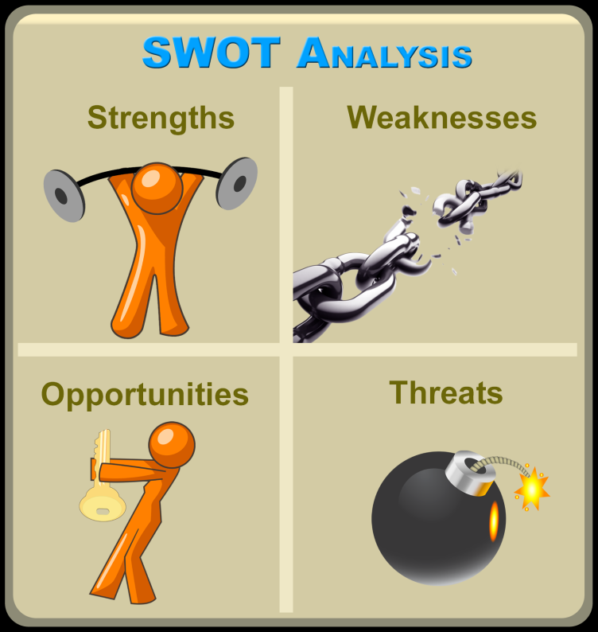
Skills Scan: SWOT Alternative
Identifying areas of Strength, Weaknesses plus Opportunities and Threats.
Complete a SWOT Analysis for yourself using a table in a word processing package.
Administrative Assistant

Slide 23
Skills Scan: SWOT Alternative
Administrative Assistant

Slide 24
Activity
Now that you know all about the Admin Assistant… complete the leaflet task.
Administrative Assistant

Slide 25

Questions (Socrative)
Answer the Quiz: Admin AP Out 1.1
Ref: SOCxxxxxx
Name a document that an organisation would send to an applicant to give further details of a post advertised.
Explain the purpose of a job description.
Both a job description and person specification will be produced for vacancies. Describe the information contained in each of these documents.
Identify two tasks/duties that will be included in the job description of an Admin Assistant.
Administrative Assistant

Slide 26
Questions (Socrative)
Answer the Quiz: Admin AP Out 1.1
Ref: SOCxxxxxx
The Human Resources department of a business issues contracts of employment. Give two pieces of information contained in the contract of employment.
What is identified by a skills scan?
Explain how a completed skills scan will be used by an organisation.
Administrative Assistant

Slide 27
Key Questions
Key Questions:
The application pack will contain an application form (to be completed by the applicant) and two other documents.
Name these documents.
List two pieces of information contained in each of these documents.
Describe how each of these documents is used by the applicant.
Administrative Assistant

Slide 28

Outcome Summary
In this topic you have learned what tasks and duties are carried out by an admin assistant. You have also learned which skills and qualities are required to be an admin assistant.
An admin assistant will be required to carry out a wide range of tasks and duties, eg organising events, updating and maintaining computerised records, answering the telephone and covering reception.
An admin assistant should have good IT skills, including the use of standard office applications and emerging technologies. Skills can be identified using a skills scan and/or a SWOT analysis.
An admin assistant should possess the following qualities:
Good time management
Be organised
Be motivated
Administrative Assistant

Slide 29

Outcome Summary
Complete the Learning Checklist
for this Outcome
Administrative Assistant

Slide 30
Administrative Practices Outcome 1.1 Tasks, Skills and Qualities of an Administrative Assistant Administration and IT
National 4 and National 5

