Slide 1
Administrative Practices
Outcome 1.3
Health and Safety
Administration and IT
National 4 and National 5

Slide 2

Did You Know?
In 2009/2010:
1.2 million working people were suffering from a work-related illness
175 workers were killed at work
115,000 workplace injuries were reported
26.4 million working days were lost due to work related illnesses and workplace injury
Workplace injuries and ill health cost society an estimated £14billion

Slide 3
Task:
Research
Visit the Health and Safety Executive’s website to find out a little more about H&S in the workplace.
www.hse.gov.uk/aboutus/realpeople
Health and Safety

Slide 4

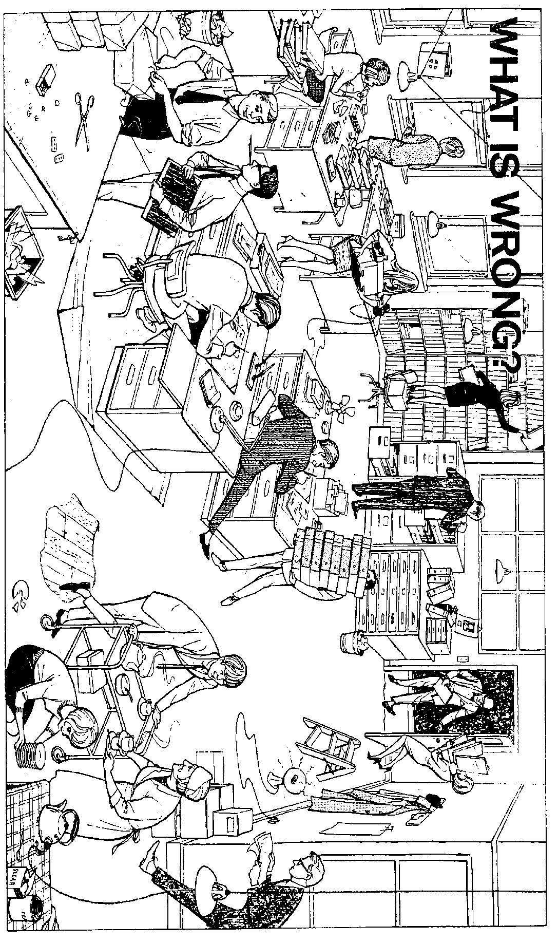
Identification of Hazards
Using the handout, how many hazards can you spot in this workplace?
Try to categorise the different examples.
Health and Safety

Slide 5

Identification of Hazards
Major injuries can be caused by:
Slips or trips (from trailing cables, open filing cabinets, etc.)
Falling (when trying to reach the top of a cupboard or shelf)
Poor lifting and handling techniques
Common sense is very important!
Notices can remind staff of their responsibilities
Health and Safety

Slide 6

Slips or Trips
To prevent slips or trips:
Use a cable management system
Keep filing cabinets away from doors
Store heavy items on lower shelfs, and use a step ladder if necessary
Clear spilt liquids (use a hazard warning sign)
Keep walkways free from obstructions
Health and Safety

Slide 7

Fires
To prevent fires:
Keep liquids away from computers
Never overload power sockets
Report any faults immediately
Empty waste bins regularly
Smoke in designated areas
Never prop open fire doors
Health and Safety

Slide 8

General Warnings
General Warnings:
Fix equipment only if trained to do so
Report loose flooring
Employees should always keep their work area tidy
Health and Safety

Slide 9

Recording Accidents
An Accident Report Form is completed.
The incident is entered into the Accident Report Book.
These may be stored on the computer server (intranet) so that all employees can
access the forms,
complete the forms
email to the correct person.
Health and Safety

Slide 10
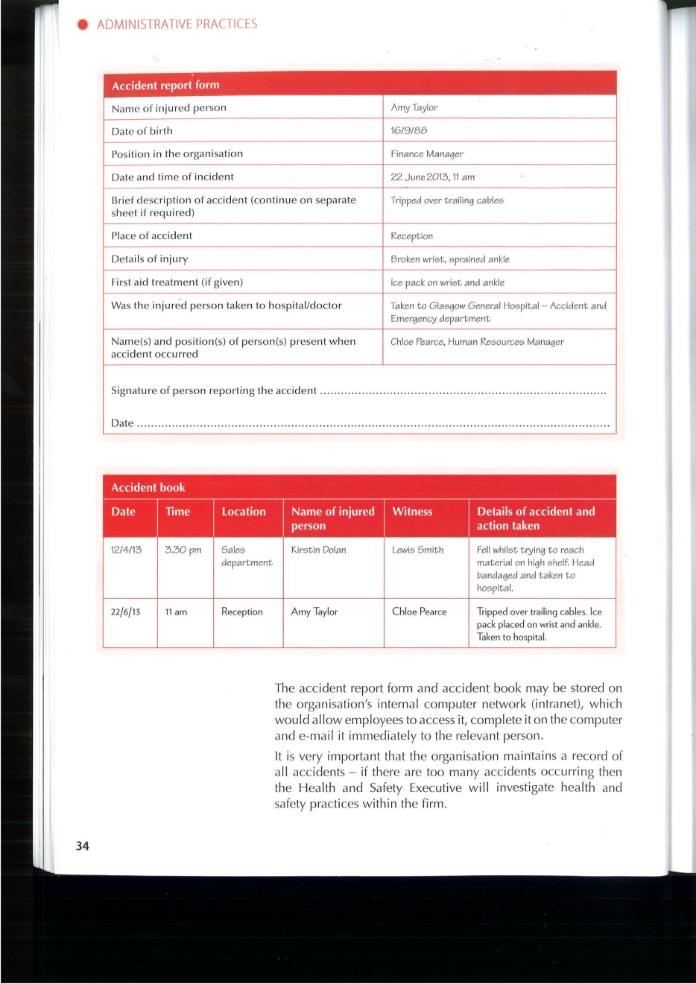
Accident Report Form
Health and Safety

Slide 11
The Accident Book
Health and Safety

Slide 12

The Health and Safety Executive
Work with local authorities to:
Check standards of health, safety and welfare
Give advice on how to prevent illness and accidents
Random spot checks are carried out:
Improvement Notice – with deadline
Prohibition Notice – premises closed
Prosecution – £20,000 fine/6 months prison
Health and Safety

Slide 13

Getting the Information
All employees should have access to the H&S policy statement – may be on intranet
Health and Safety procedures will be explained in detail during induction training along with fire and evacuation procedures.
Health and Safety

Slide 14

Health and Safety Policy Statement
If you employ 5 or more people a written policy is essential
The policy will include:
Name of the person responsible for H&S
How often checks are carried out
Health and Safety training
Evacuation procedures
How often employees are consulted
Maintenance of equipment
Health and Safety

Slide 15

The Health and Safety at Work Act 1974
Responsibilities of Employees
Responsibilities of the Employer
Take reasonable care of your own (and others) health and safety
Co-operate with the employer
Don’t misuse or interference with anything provided for your safety
Ensure safe methods of working
Ensure safe working conditions
Ensure all employees receive the relevant information and training
Keep equipment well maintained
Provide protective clothing

Slide 16

Health and Safety (Display Screen Equipment) Regulations 1992
Minimise the potential risks associated with the use of visual display units (VDUs)
Backache
Eye Strain
Headaches
Repetitive Strain Injury (RSI)
Health and Safety

Slide 17
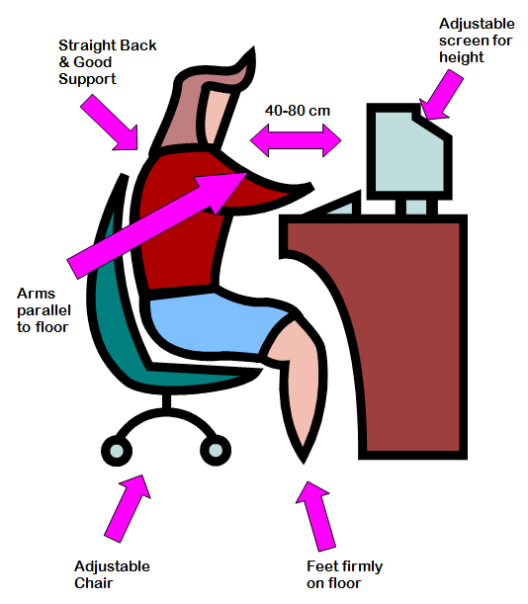
Correct Posture
Health and Safety

Slide 18

Health and Safety
(Display Screen Equipment) Regulations 1992
Responsibilities of Employees
Responsibilities of the Employer
Avoid potential hazards by:
Use adjustments on VDU
Adjust chair for maximum comfort
Arranging desk and screen to avoid glare
Assess workstation requirements
Provide adjustable seating
Provide adjustable and tilting screens
Provide health and safety training
Allow regular rest breaks/changes in activity

Slide 19
Health and Safety (First Aid) Regulations 1981
Organisations are required to:
Provide a well-stocked first aid box
Appoint a first-aider (one for every 50-100 employees)
Inform staff of first aid procedures
Keep a record of all accidents/incidents
Health and Safety

Slide 20
Fire Precautions (Places of Work) Regulations 1995
Organisations are required to:
Assess fire risks in the organisation
Provide appropriate fire-fighting equipment such as fire extinguishers
Maintain equipment
Provide warning systems (and check regularly)
Train employees
Regular fire evacuation drills
Health and Safety

Slide 21
Task:
Research
Use the internet to research a well-known organisation’s health and safety policy.
Use the information available to prepare a brief summary of your chosen organisation’s health and safety policy.
Health and Safety

Slide 22

Task:
Video Clip
Watch the video clip and answer the following questions:
What hazards can be found in an office?
Identify obstacles that may cause tripping hazards.
State two causes of slipping accidents in the office.
Identify three ways of eliminating hazards in the office.
What should be done with electrical cords/wires/cables to prevent slips?
What should be used to reach high places in the office?
Health and Safety

Slide 23

Questions (Socrative)
Answer the Quiz: Admin AP Out 1.3
Ref: SOCxxxxxx
State two ways to prevent slips or trips in the workplace.
Identify documents that should be completed if an accident does occur within the workplace.
State why these documents should be stored on an organisation’s intranet.
Explain the purpose of the health and Safety Executive (HSE).
Health and Safety

Slide 24
Questions (Socrative)
Answer the Quiz: Admin AP Out 1.3
Ref: SOCxxxxxx
List what information should be contained in an organisation’s health and safety policy.
State what is meant by the term induction training.
State 2 responsibilities of an employee and 2 responsibilities of an employer in relation to health and safety.
Health and Safety

Slide 25
Questions (Socrative)
Answer the Quiz: Admin AP Out 1.3
Ref: SOCxxxxxx
Identify two responsibilities of an employee and an organisation stated in the Health and Safety (Display Screen Equipment) Regulations 1992.
Outline the responsibilities of an organisation that are required by the Health and Safety (First Aid) Regulations 1981.
Suggest two steps that should be taken to prevent injury from fire within an organisation.
Health and Safety

Slide 26

Key Questions
Key Questions:
Outline two ways the following pieces of legislation are breached in the image on the next slide.
  Health and Safety at Work Act 1974
  Health and Safety (Display Screen Equipment) regulations 1992
Describe two responsibilities of an employee under the Health and Safety at Work Act 1974
Name and describe two other pieces of health and safety legislation that organisation’s must comply with.
Customer Care

Slide 27
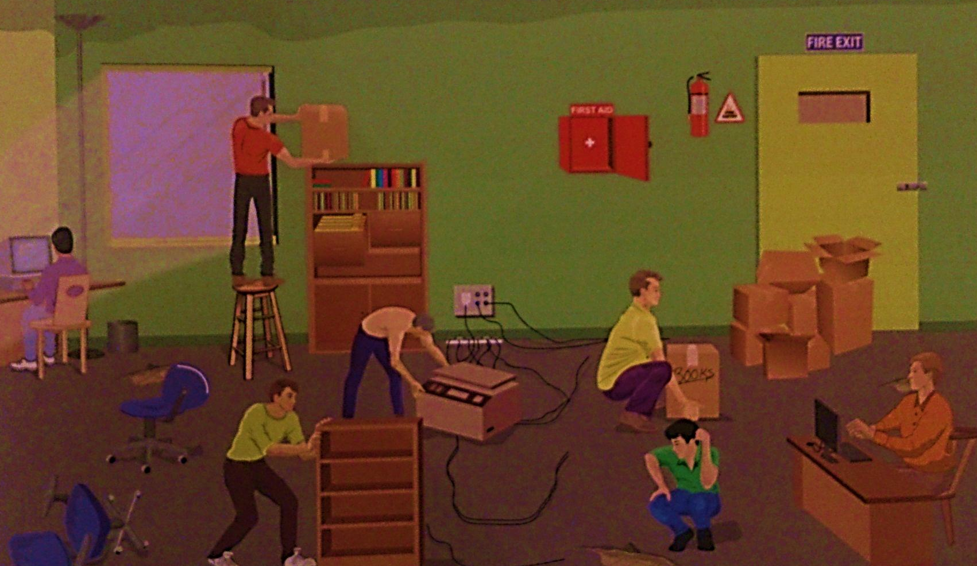
Key Questions
Customer Care

Slide 28

Outcome Summary
In this topic you have learned about hazards within the workplace and how to minimise these hazards.
If an accident does occur an accident report form and an accident book report should be completed.
The HSE work with your local authority to ensure that all health and safety laws are followed; if they are not, they have sanctions which they can apply to an organisation.
An organisation will have a health and safety policy statement that shows their commitment to health and safety within the organisation.
Employees must have access to the health and safety policy – it is often given to new employees when they undertake induction training.
You should also know the various pieces of legislation that cover health and safety in the workplace. In particular, the relevant responsibilities of employees and employers.
Health and Safety

Slide 29


Outcome Summary
Complete the Learning Checklist
for this Outcome
Administrative Assistant

Slide 30
Administrative Practices
Outcome 1.3
Health and Safety
Administration and IT
National 4 and National 5

