Slide 1
Administrative Practices Outcome 1.4 Security of People, Property and Information Administration and IT
National 4 and National 5

Slide 2

Security of People
Reception is at the front of an organisation, which provides a key role in security.
Reception Staff will:
Check staff ID badges/security passes
Monitor CCTV
Control an entry system
Manage the Appointments Book, Visitors Book and Staff Sign In/Out Book
Issue Visitor Badges
Security

Slide 3

Security of People
Additional security measures may include:
Keypads/combination locks/swipe cards
Locked doors
Staff uniform
Security Guards
Alarm the Building
Think about why each of the items above would help… discuss with a partner.
Security

Slide 4

Security of Property
Property may be secured using some of the following methods:
Attach equipment to desks
Mark equipment with UV pens
Keep an inventory of equipment (inc asset numbers)
Use security cables
Keep doors/windows locked
Alarm the building
Security guard and lighting
Security blinds
Security

Slide 5

Security of Information
Access to areas of the building where confidential information is stored should be limited.
Visitors should never be left unsupervised.
Be aware of problems that might occur with:
Filing cabinets (locks?)
Photocopiers/Printers (leaving unattended?)
Fax machines (sending to the right destination/unattended?)
Information should be filed after use, or shredded if no longer required.
Security

Slide 6
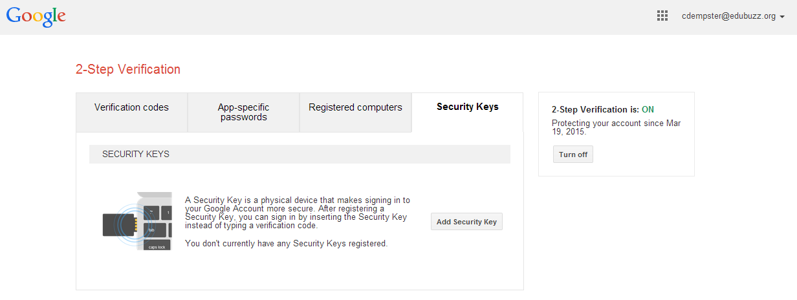
Electronic Files
Security

Slide 7

Electronic Files
Use of usernames/passwords:
Used to login to computer system
Sometimes used to access certain files/programs - different levels of access
May also be used with a screensaver
Members of staff should be trained on password strength – search online for the most common passwords
Computer system forces a password reset every eg 30 days
Confidential information should never be left on screen for others to see.
Security

Slide 8

Electronic Files
Read-only documents
Label and store external storage devices safely
Security ID cards/keys inserted before use into a computer
Voiceprint/fingerprint recognition
Anti-virus software
Encryption software
Backup procedures (does not prevent theft, but allows a restore of critical information)
In addition all files should be regularly backed up to a secure location – preferably off-site.
Security

Slide 9

The Data Protection Act
Protects both the data subject and the data user.
Data users must be registered with the Data Protection Registrar and follow the principles of the Act.
Security

Slide 10
The Data Protection Act
Individuals can request data held about them
Principles of the Data Protection Act
The Act states that information must be:
Fairly and lawfully processed
Used for the registered purposes only
Adequate, relevant and not excessive
Accurate
Kept for no longer than necessary
Kept securely
Processed in line with the individual’s legal rights
Transferred outside the EU only if the individual’s rights can be assured.
Failure to comply can result in fines or prosecution
Security

Slide 11

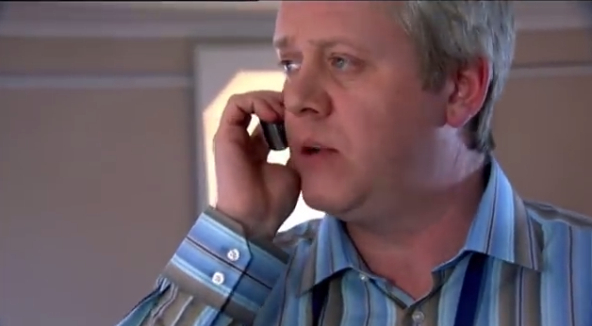
The Data Protection Act
Watch the video…
A shortcut can be found at this address: knox.is/dpa

Slide 12
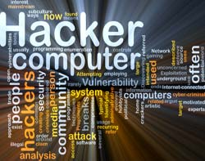
The Computer Misuse Act
This act makes it illegal to:
Access computers without permission (eg hacking)
Access computers with the intention of committing a criminal offence
Access computers to change or alter details without permission.
Security

Slide 13
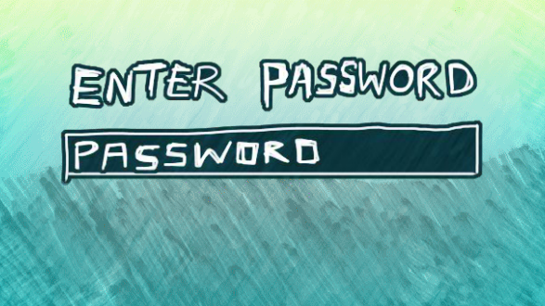
Task: BBC Bitesize & Questions
Use the BBC Bitesize website to revise ICT security, attempt the activity and then test your knowledge of data security.
Questions:
Explain why the reception area plays a crucial role in the security of an organisation.
Describe three security measures taken by the receptionist.
State how keypads/combination locks/swipecards can restrict unauthorised access.
Describe three security measures taken by an organisation to protect property.
List two ways that usernames and passwords can restrict access to information.
List three other methods of protecting information held on computer.
State what is meant by the term “back-up”.
Outline the main principles of the Data Protection Act 1998.
Give the purpose of the Computer Misuse Act 1990.
Security

Slide 14
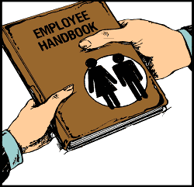
Task: Staff Handbook
Update the extract from the staff handbook with relevant information on employee and organisational responsibilities with regard to security in the organisation.
The file can be found on the server.
Security

Slide 15

Outcome Summary
Organisations view the security of people, property and information very seriously. They employ a range of measures to ensure that they are kept secure. Organisations should ensure that they comply with the Data Protection Act 1998 and the Computer Misuse Act 1990.
People: staff ID badges; monitor CCTV; intercoms/entry phones; appointments, visitors and staff in/out book; staff uniforms; swipe cards etc
Property: attaching equipment to desks; UV pens; inventory of equipment; security cables; doors/windows locked; alarms; security guard; security blinds
Paper-Based Information: restrict access to the building; lock filing cabinets; confidential information not left lying around; file/shred information after use
Computer-Based Information: usernames/passwords; encrypt confidential information; read-only files; voice/fingerprint recognition; iris scanners; anti-virus software; storage media locked away
Security

Slide 16

Outcome Summary
Complete the Learning Checklist
for this Outcome
Administrative Assistant

Slide 17
Administrative Practices Outcome 1.4 Security of people, Property and Information Administration and IT
National 4 and National 5

