Slide 1
Administrative Practices
Outcome 2
Organising and Supporting Events
Administration and IT
National 4 and National 5

Slide 2
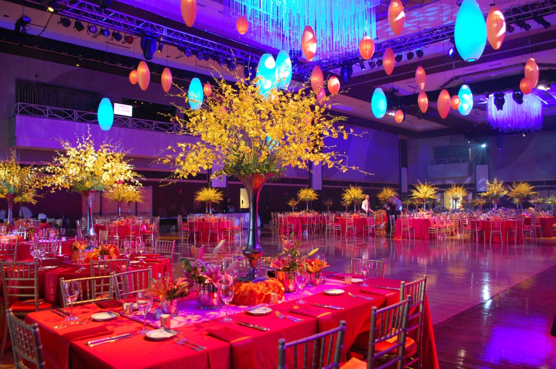
Event Planning
Event Planning has 3 key steps:
Planning – all tasks carried out before an event
Supporting – all tasks carried out during an event
Follow-up – all tasks carried out after an event
The Stages

Slide 3

Type of Event
An event is a planned assembly of people, brought together for a related purpose or cause.
Examples:
Meeting
School Event eg concert, dance, information evening
Interviews
Business Trip
Product Launch
Planning

Slide 4

Planning Questions
What are the objectives of the event?
Where is the event going to be held?
When is the event going to be held?
How many people will be attending the event?
What is the budget for the event?
Planning

Slide 5
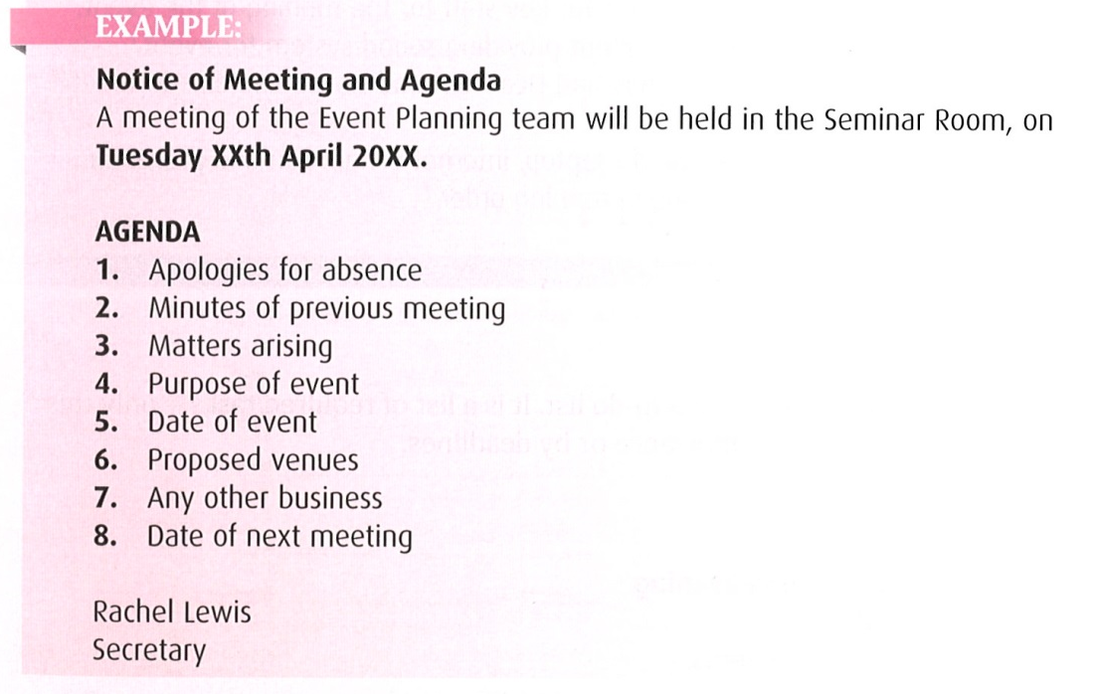

The Meetings
Meetings will be held on a regular basis and will keep those involved updated and allows progress to be monitored.
After the meeting the secretary will prepare the minutes of the meeting and send them to those in attendance.
Planning

Slide 6
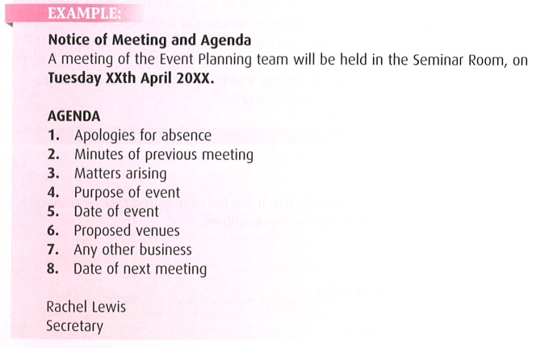

Slide 7
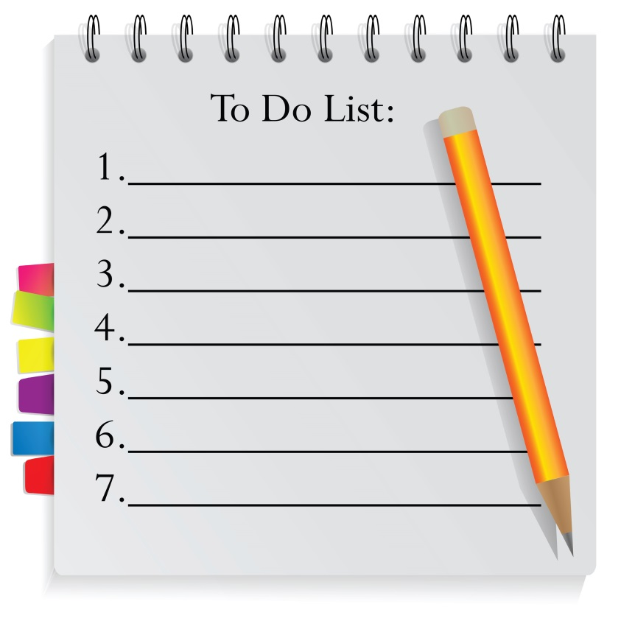
To-Do List
A ‘to-do’ list will ensure that you keep track of all your tasks.
This document simply lists all of the tasks that have to be completed.
To-do lists can belong to individuals, teams or departments.
Planning

Slide 8
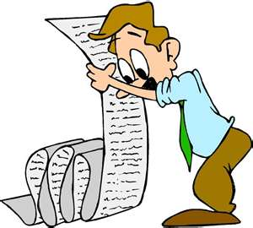
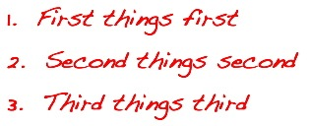
Priorities List
Similar to a to-do list.
It is a list of required tasks only this time, they are prioritised by importance or deadline.
This is a flexible document, as tasks change their priority will change.
Planning

Slide 9
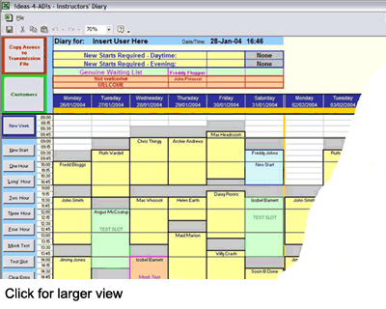
E-Diary
Check that you already have information on e-diaries and their benefits.
Planning

Slide 10

Campbell Dallas. An insight in the work of an administrator supporting a managers meeting at the Glasgow headquarters of the chartered accountants .
Education Scotland. An exploration of the work of an administrator supporting a launch event at the public sector body.
Material UK. A discussion with an event specialist who supports Scotland’s largest outdoor music festival.

Slide 11

Videos
Before the Meeting

Slide 12
Videos
During the Meeting

Slide 13
Videos
After the Meeting

Slide 14
What administrative skills are essential to event success?
Event Administration Skills
Teamworking
Communication
Problem solving
Working under own initiative
Creativity
Planning and time management
Attention to detail
Working with numbers
Literacy
Information Technology
Use of non-IT equipment (laminator, binder, etc)

Slide 15
What administrative ICT skills are essential to event success?
Hardware
Hardware used by an administrator before, during and after the event may include – photocopiers, printers, projectors, smart phones, audio speakers, monitors/screens, PCs, laptops, web cameras, etc
Software
Software used by an administrator before, during and after the event may include - word processing, spreadsheets, databases, presentation, desk-top-publishing, e-mail, e-diary, scheduling and social networking applications.
Networks
Administrators would also be expected to use internal networks (intranet) and external networks (including the internet) to access, extract and share information.

Slide 16

Outcome Summary
Needs Fully Completed…
Outcome 2

Slide 17
Outcome Summary
Summary Required….
Outcome 2

Slide 18

Outcome Summary
Complete the Learning Checklist
for this Outcome
Outcome 2

Slide 19
Administrative Practices
Outcome 2
Organising and Supporting Events
Administration and IT
National 4 and National 5

