Slide 1
Marketing
Higher
Business Management
2015-2016

Slide 2
Definition of Marketing
“The process involved in identifying, anticipating and satisfying consumer requirements profitably.”
The Chartered Institute of Marketing

Slide 3
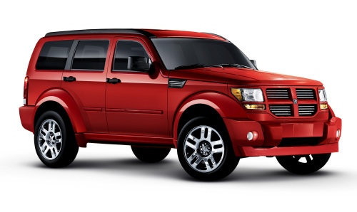
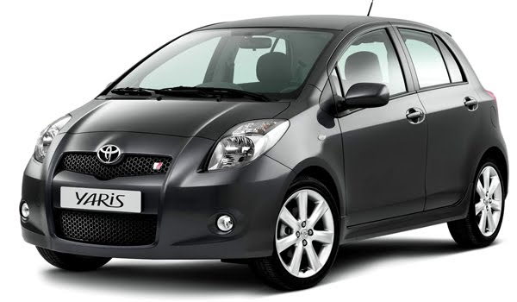
American Car Industry
American manufacturers tended to ignore trends taking place in the rest of the world where small, economical vehicles with lower engine capacities were capturing an ever-increasing share of the market.
American vs Japanese beliefs over the market in America
1970s - fuel, labour and raw material costs made American cars expensive to buy and run.

Slide 4

Swatch
1980s - well executed marketing plan
An inexpensive, good-quality quartz analog watch could rival the saturated digital market
Watches were to be a fashion accessory first and a watch second
Repeat purchasing was encouraged
Point of Sale was chosen carefully - not to flood the market

Slide 5
Product-Orientated Organisations
Feeling of no need for change or product development – no real competition
May be a new invention
Might be strong advertising eg Henry Ford: “customers can have any colour they want as long as it is black”

Slide 6
Customer-Orientated Organisations
Modification of products or services in response to changes in the market
Profits/success depend on meeting customer needs
1980s and 1990s – customers became more knowledgeable as to what was available on the market and the level of competition increased.
Consider the customer before production commences

Slide 7

Market Research
The systematic gathering, recording and analysing of data about an organisation’s products and/or services and its target market

Slide 8
Why Market Research?
To anticipate changes in customer tastes
Keep ahead of competition
Meeting customer needs
Correct pricing and promotion
Correct distribution chain
Attract new market segments

Slide 9

ICT and Market Research
Databases compiled by organisations
EPOS information can be collected
Loyalty cards
Can all be used to identify consumer trends and buying habits. Making it easier to direct specific products at consumers.

Slide 10
Market Research Methods
Field Research
Primary Information
Desk Research
Secondary Information

Slide 11
Personal Interview
Advantages
2-way communication
Encourage answers
Misunderstandings resolved
Disadvantages
Expensive (time and training)
Home interviews are unpopular

Slide 12

Focus Groups
Advantages
Qualitative information gained
Disadvantages
Difficult to analyse
May not reflect the views of the market

Slide 13

Telephone Survey
Advantages
Relatively inexpensive
Immediate response
Large number can be surveyed quickly
Disadvantages
Hostility can be encountered
Only possible to ask short questions

Slide 14

Postal Survey
Advantages
Inexpensive – no trained interviewer
Disadvantages
Questions must be simple to answer
Response rate is low
Often need prize-draws etc to encourage response

Slide 15
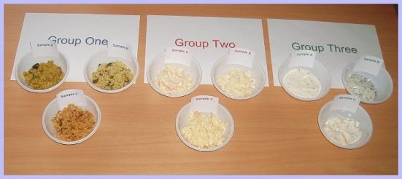
Hall Test
Advantages
Qualitative information gained
Disadvantages
Difficult to analyse
Results can be flawed – complimentary comments

Slide 16

EPOS (inc Loyalty Cards)
Advantages
Accurate customer profiles
Offer promotions linked to customer needs
Monitors brand loyalty
Disadvantages
Expensive to set up

Slide 17
Observation
Advantages
Qualitative information gained
Disadvantages
Can’t ask questions that explain actions – no direct contact with customer

Slide 18
Test Marketing
Advantages
Highlights aspects of product which are disliked
Saves expensive national launch
Disadvantages
Regional tastes may not be representative

Slide 19
Electronic Surveys
Email Survey - read the message, answer the questions and then reply to the researcher.
Web based Survey - sent an email containing a link to the URL address for the survey.
wide variety of response options can be used, for example check boxes
software is used to scrutinise the data and present it as information

Slide 20
Electronic Surveys
Advantages
Completed 24/7
Design is cost-effective
Sent to a large number of people
Disadvantages
concerns over the privacy and anonymity
reluctance of respondents
messages may be deleted
sample will contain bias

Slide 21
Consumer Panel
This is a group of people who are consulted on their reactions to a product over a period of time.
eg a number of households throughout the country have the TV programmes they watch monitored electronically

Slide 22

Sampling
When conducting market research it is often not feasible to question every potential respondent.
A sample has to be selected …
but how?

Slide 23
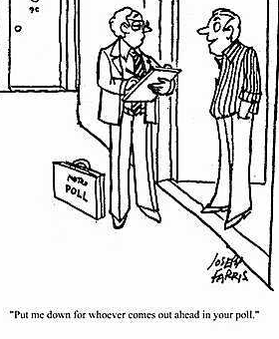
Random Sampling
Individuals preselected from a list
Each person has an equal chance of being chosen
No bias involved in selection – however may be unrepresentative of population
Must interview people selected – expense!

Slide 24

Stratified Random Sampling
Makes a random group more representative
Sample is divided into segments with a representative sample then chosen from each group
More administration and effort than simple random sampling

Slide 25
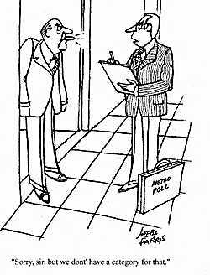
Quota Sampling
Interviewers are given targets for the number of people out of each segment (eg age, sex, marital status) they must interview
More targeted method of sampling the population interested in particular goods/services

Slide 26

Other Sampling Methods
Cluster Sampling
Multi-Stage Sampling
Snowballing

Slide 27
Benefits of Market Research
Decision Making
Reducing Risk
Link with the Outside World
Size of Markets
Public Relations

Slide 28

Problems with Market Research
No Guarantees
eg New Coke – returned to original recipe
eg Levi’s failed to enter men’s suit market
Sampling Bias
Human Behaviour
Interviewer Bias
Size of Sample
Expense of gathering information

Slide 29
The Marketing Mix
Product
Promotion
Price
Place

Slide 30
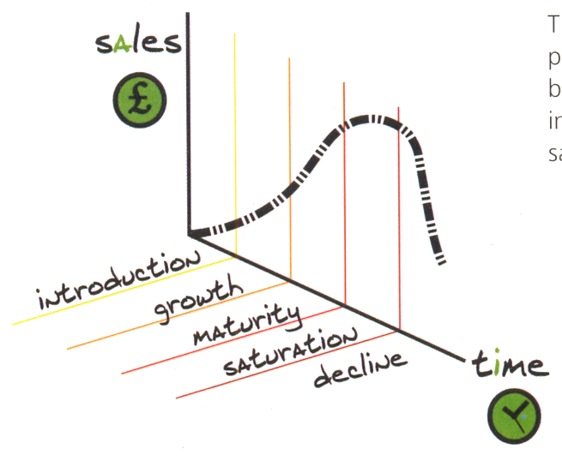
Product Life Cycle
Shows the different stages a new product passes through over time and the sales expected.
Include any relevant diagrams in product life-cycle or
product mix questions. Remember to label your diagrams.

Slide 31
Stages of Product Life Cycle
Research and Development
Introduction
Growth
Maturity
Saturation
Decline

Slide 32

Research and Development
Undergoing R&D during this initial stage
Costly and time-consuming
Prototypes
Extensive testing
Firm is making a loss at this stage due to high initial costs.

Slide 33
Research and Development
Benefits
Allows them to gain a competitive edge
Able to improve product quality
Able to improve product safety
Allows them to hold monopoly position for a period of time
Allows them to meet changing consumer demand to ensure a new product does not fail

Slide 34
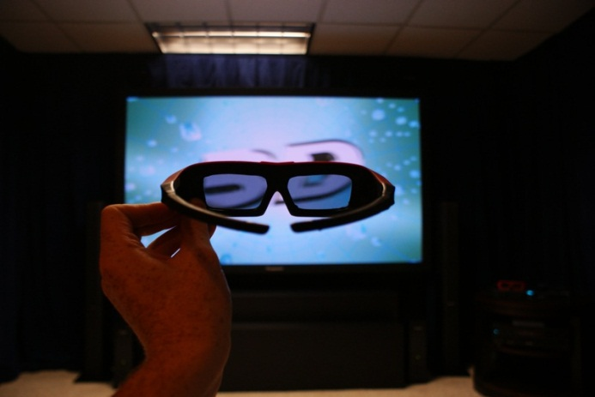
Introduction
Product is launched onto the market
Costs of holding stock, advertising and promoting the product high.
The firm is still making a loss at this stage.
Few competitors exist and usually a high price is charged to recover costs.
Sales are low.

Slide 35

Growth
Sales increase significantly
Customer knowledge of product and Word-of -Mouth increases.
A few competitors begin to launch products
Firm begins to make a profit, which continually increases.

Slide 36

Maturity
Product becomes commonplace
Growth begins to slow down, however sales are at their peak.
Competition increases
Price falls
Profits are high and remain steady

Slide 37
Saturation
Competition becomes fierce
Prices tumble
Customer tastes begin to change
Not all competing products survive

Slide 38
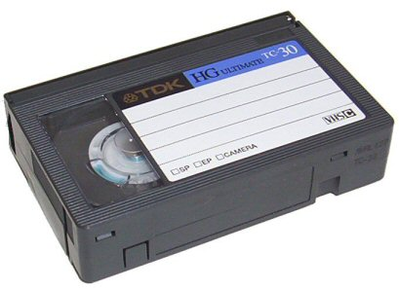
Decline
Other new advanced products are launched
Sales fall
Prices become very low
Profits begin to fall, product should be withdrawn before a loss is made.

Slide 39
Product Life Cycle
 | Development | Introduction | Growth | Maturity | Decline
Audience | None | Early adopters | Mainstream | Late adopters | Laggards
Market | Test | Small | Growing | Large | Contracting
Sales | None | Low | High | Maximum | Decline
Profit | None | None | Growing | Maximised | Diminishing to a loss

Slide 40

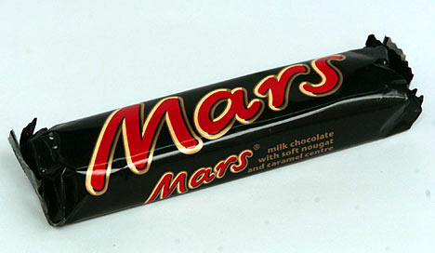

… going on forever?
Mars, Persil, Heinz Baked Beans, Coca-Cola appear to never reach the decline stage
Successful extension strategies
Constant brand promotion
No close rivals

Slide 41
Extension …………….. Strategies
Improve the product
Change the packaging
Change the channel of distribution
Change product prices
Change the promotion
Change the use customers have for a product
Rebrand the name of the product
Produce line extensions

Slide 42

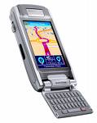
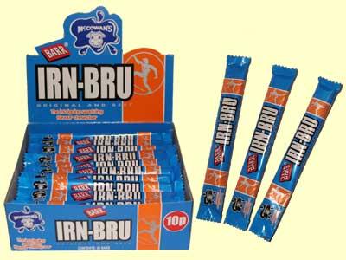
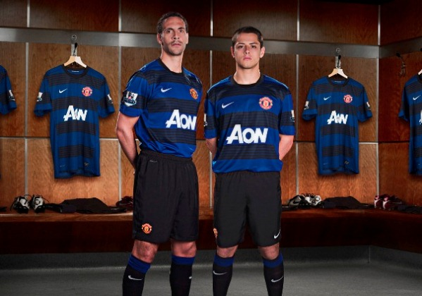
Extension ….. Examples
More frequent use was made of airlines with reduced cost carriers eg Easyjet.
Selling mobiles and computers to the home market.
Firelighters now used for barbecues.
New versions e.g. Irn-Bru: fruit chews and alcho-pops
Styling changes e.g. football strips

Slide 43
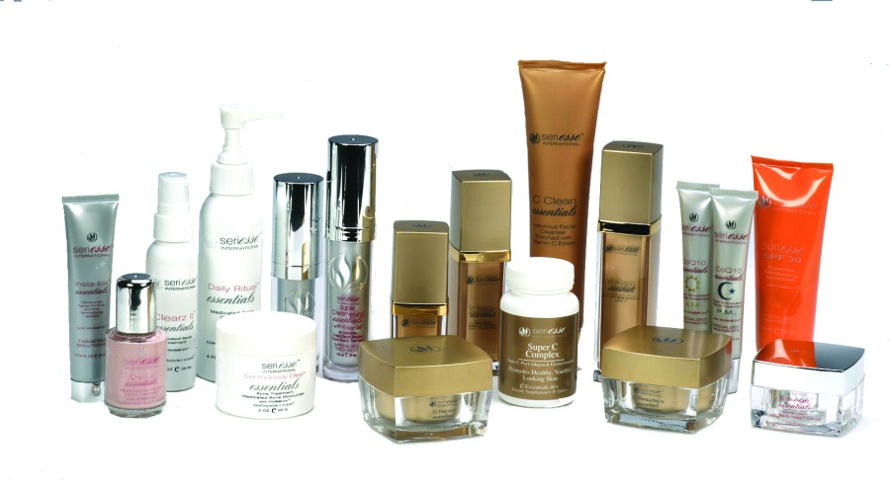
Product Mix (Portfolio)
Businesses plan the introduction of new products to replace existing ones before they become unprofitable
Products at different stages on PLC
Keeps profits stable

Slide 44

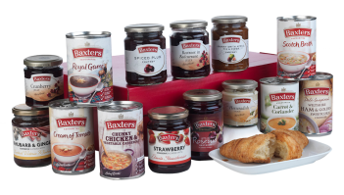
Product Mix (Portfolio)
Baxters Food Group have a product portfolio which includes jams, sauces, pickles and soups.
Allows Baxters to reduce risk
Baxters can also meet the different needs of consumers, increase profits and raise the business’s profile!

Slide 45
Product Line
A product line is a group of products that are closely related as they function in a similar manner and are sold to the same customer groups. For example, Heinz sells a range of tinned soups.

Slide 46
Product Mix (Portfolio)
Advantages
Risk is spread
The development stage is reduced
Customer Loyalty
Market share can increase
Profits can fund new products
Disadvantages
Negative publicity for one product could damage the reputation
Operations can become complex
Additional finance may be required to invest in new machinery

Slide 47



Diversified Product Portfolio
When a business sells a mix of different products.
Widens a business’s activities to include new products and new market segments.
Diversification is a high-risk strategy as the business is expanding to areas outside its core activities.
Virgin

Slide 48
Diversified Product Portfolio
Advantages
Increase sales/customers
flatten peaks and troughs in cash flow e.g. seasonal
Risk is spread
Growth should give the business more financial stability
Disadvantages
Requires considerable finance
High cost of research
Success may take longer to achieve
A bad reputation with one product may affect sales

Slide 49

Price
An important indicator of quality and image providing consumers with a way of making value-for-money judgements.

Slide 50
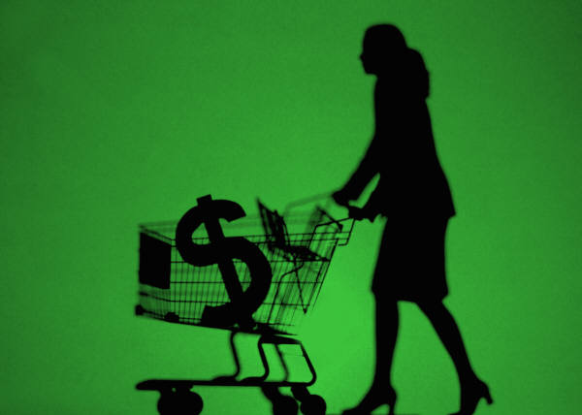
What Price?
The price for a product should be based on what the customer is prepared to pay:
Competitors’ prices
Position of product in PLC
Cost of manufacture
Time of year
Profit level expected
Suppliers’ prices
Point of sale
State of the economy
Government pressure

Slide 51

Pricing
Long-Term Strategies
Low Price
Market Price
High Price
Short-Term Tactics
Skimming
Penetration
Destroyer
Promotional
Demand Orientated

Slide 52
Long-Term Pricing
Low Price:
Where there is Price Elasticity of Demand ie low prices = much higher sales. Used where no brand loyalty, eg supermarket DVDs and CDs are lower than market price
Market Price
Where price competition is of no benefit eg petrol prices (no effect on demand)
High Price:
High-quality premium goods/services
USPs or patents
Where supply of goods is restricted
Newly launched innovative products

Slide 53

Price Skimming
Company launches a new product
High initial price allows R&D costs to be recouped before competitors enter the market
Price will gradually fall
Most common example: Home Electronics

Slide 54
Penetration Pricing
Competitors already sell in the market
Set a price lower than competitors
Once the product is popular, the price is raised

Slide 55
Destroyer Pricing
Trying to eliminate the Competition – setting an artificially low price
Business will make a loss initially
Prices will then rise possibly above current market price

Slide 56
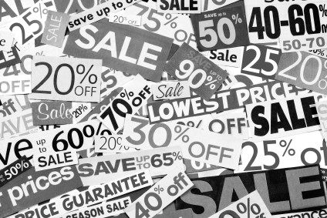
Promotional Pricing
Boosting sales in the short-term
eg Supermarkets use promotional pricing as loss-leaders
Attracts customers (hopefully to buy other products too!)

Slide 57

Demand-Orientated Pricing
Prices varies with demand
eg crops
Higher price when poor harvest – less supply available

Slide 58
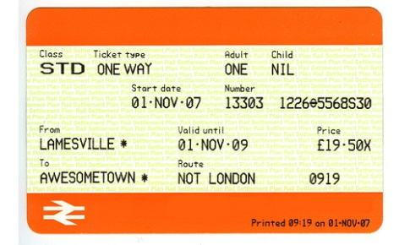
Price Discrimination
Different Prices for the same product!
Depends on the time of day, year or usage
Can you think of some examples?

Slide 59

Setting the Selling Price
Cost-plus pricing:
adding a % profit to the cost of manufacture
Contribution pricing:
Taking the total cost of manufacture (including wages etc) and sharing among the number of units expected to be sold. If the price is set above the contribution to fixed costs a profit will result

Slide 60
Price Comparison Websites
Compare the price of products and services from a range of providers, allowing the consumer to make an informed decision about which to choose.
Examples
Insurance
mobile phone contracts
credit cards/loans
energy tariffs
They generate revenue through ‘click throughs’ and they receive commission on purchases made.

Slide 61
Price Comparison Websites
Advantages
Business
Wide exposure
Cost effective marketing
Customer
Save money – empowered
Data only entered once
Unknown companies give good deals
Disadvantages
Business
Cost of website link
Suffer against competition
Customer
Not all companies use them
Can be misleading

Slide 62

Place
The Channel of Distribution is:
“the route taken by a product as it passes from the producer to the consumer”.
Ownership of goods not physical movement.

Slide 63
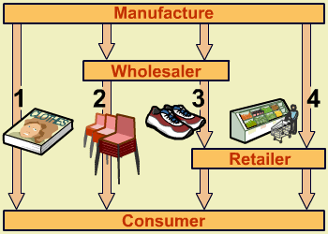
The Channels of Distribution

Slide 64

The Channels of Distribution
Each link in the chain means the end cost to the consumer will be higher:
Transportation
Storage
Advertising
Insurance
Each reseller will want to make a profit for the service they are providing

Slide 65
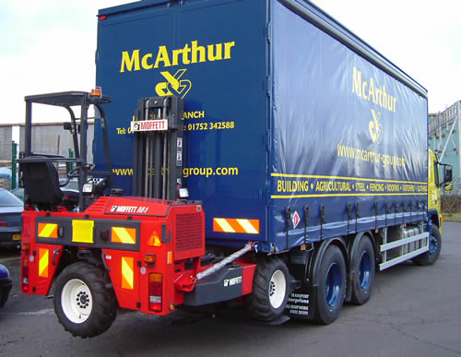
Factors affecting Distribution
Product being sold
Legal restrictions
Changes in buying habits
Existing buying habits
Finance available
Reliability of other companies
Desired image of the product
Stage in Product Life Cycle
Manufacturer’s distribution capability

Slide 66

Wholesaler
Advantages:
Provides a link between producer and retailer
Source of marketing information
Buys in bulk
May finish off packaging and pricing
Reduces producer's risk
Disadvantages:
Could destroy the producer’s marketing mix (poor promotion)
Less profit for the producer

Slide 67
Retailer
Located close to customers
Established customer base
Breaks down the bulk
Information and advice provided
Related services e.g. credit facilities, hire-purchase and after-sales-care

Slide 68
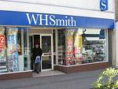


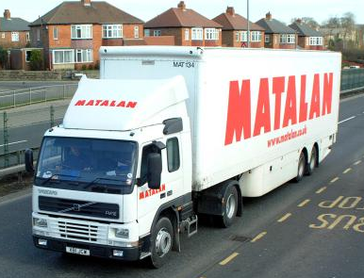
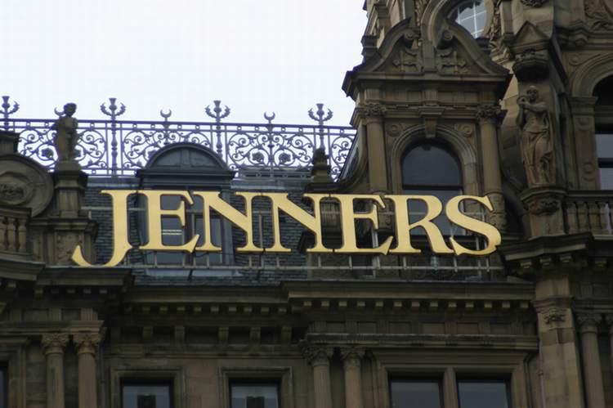
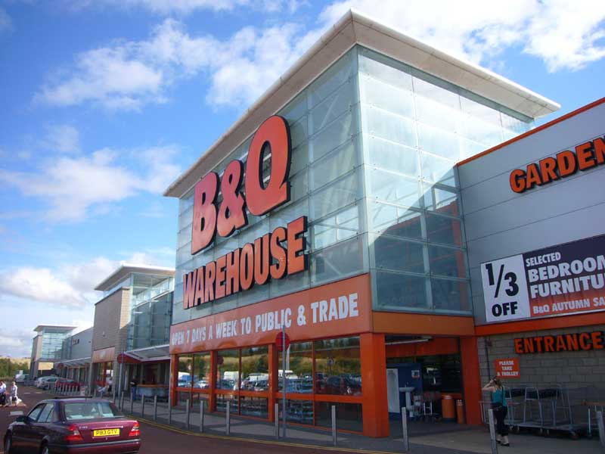
Types of Retailer
Independents
Multiple Chains
Supermarkets
Co-operatives
Department Stores
Specialist Stores
Franchises
Discount Stores

Slide 69

Other Methods
Direct-Selling/Internet selling
Mail Order
Direct Response Advertising
Newspapers/magazines
Direct “junk” mail
Personal/Door-to-Door/Telephone Selling
Television Selling eg QVC

Slide 70

Promotion
The way in
which a customer is
made aware of
a product
or service and is
persuaded to purchase it
Advertising
Sales Promotions
Public Relations

Slide 71
Promotion
Above the line:
use of TV/Newspapers – large audience, some of the promotion is ‘wasted’
Below the line:
sales promotions/direct mail/personal selling – targeted audience

Slide 72


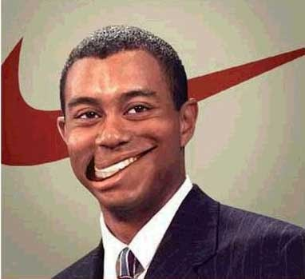
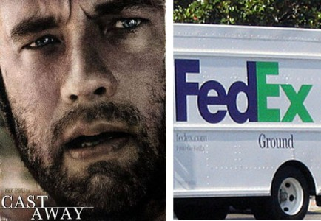
Advertising
Product Endorsement
Famous sports-person or celebrity is paid to wear a particular product
Product Placement
A firm pays for its products to be used in films or television

Slide 73
Sponsorship
A company supports an event, activity or organisation by providing money or other resources that is of value to the sponsored event. This is usually in return for advertising space at the event or as part of the publicity for the event.
Benefits
improve public image
logo displayed on shirts, cars, hoardings, providing a means of catching potential customers’ attention/name will be seen, promoted
associated products possible e.g. Vodafone Red mobile phones – association with Man United
TV coverage of sport enhances exposure to a massive audience

Slide 74
Online Advertising
Predominant method of communication for the majority.
Internet advertising offers value for money for companies.
Types:
email
search engine
social media
pop ups
Advertisers often use cookies which identify a specific computer and the browsing history of the user.
They can deliver targeted advertising, customised to an individual’s interests and tastes.

Slide 75
Viral Marketing
Very effective and inexpensive way of generating lots of interest in a business.
This is the electronic equivalent of word of mouth.
one person sees the information and forwards it to 10 people and so on

Slide 76

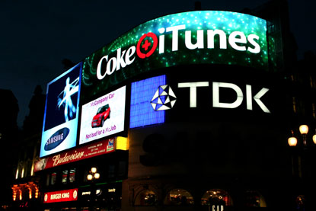

Advertising Media
Products aimed at the whole market are usually advertised during very popular TV programmes eg Coronation Street
3 main types of advertising media:
Print
Broadcast
Outdoor

Slide 77



Promotions into-the-pipeline
Dealer Loaders (6 cases for 5)
Point-of-Sale Displays (Real Deals/JML)
Dealer Competitions
Staff Training (deal more effectively with customers)
Sale or Return (newspapers/sandwiches)
Extended Credit (possibly several months)

Slide 78

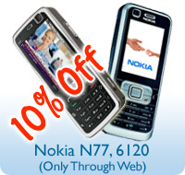

Promotions out-of-the-pipeline
Free Samples/Trial Packs (often on magazines)
Bonus Packs (eg 50% free)
Free Offers (50p off)
Buy one get another product free
Coupons/Vouchers (possibly for next purchase)
Credit Facilities (possibly 0% for 6 months)
Tastings/Demonstrations (test drives)
Competitions (scratch cards especially in newspapers)
BOGOF!
Merchandising

Slide 79
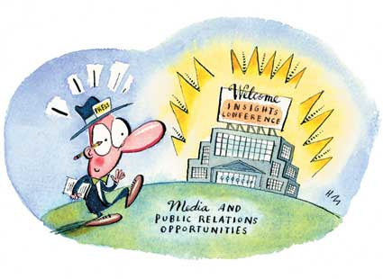
Public Relations
Communication with:
Public
Press
Government
Shareholders
Planned to enhance the organisation's image
Role includes:
Press statements
Charitable donations
Sponsorship
Product endorsement
Customer care

Slide 80

Publicity
Public Relations = time and money
Publicity can be free eg news broadcasts/magazine articles
Danger of bad publicity:
Fires
Scandals
Product side-effects

Slide 81
Public Relations & Publicity
i
a
g
s
Provide information
Build confidence/awareness
Develop goodwill
Support other areas of the Promotional Mix eg advertising

Slide 82
Extended Marketing Mix
PEOPLE
Employees and managers represent the business and have a substantial influence on their reputation.
Business must recruit people who are:
appropriately qualified
motivated
committed to training and development
able to fit into the culture of the business

Slide 83
Extended Marketing Mix
PROCESS
Processes ensure that all employees know what to do and how to do it.
This will guarantee that the level of service and quality of products and services received by customers will be consistent.
E.g. Fast Food restaurants

Slide 84
Extended Marketing Mix
PHYSICAL EVIDENCE
how the products/services, people and the name of the business are represented in the market place.
A strong brand image will help a business stand out from its competitors and attract customers who have pre-existing expectations.
This element of the marketing mix is used to distinguish a company from its competitors
E.g. Premier Inn vs Hilton Hotels

Slide 85
Ethical Marketing
Ethics are moral guidelines that regulate good behaviour.
Behaving in this way is seen as good business practice and will help develop a reputation of being socially responsible e.g. Fairtrade
Market Research:
No invasion of privacy
Stereotyping responses

Slide 86
Ethical Marketing
Promotion:
claims made by the business must be authentic
Use of violence, sex and profanity – this is likely to offend
Target Marketing:
When vulnerable groups are being targeted e.g. children
Pricing:
Price fixing – collusion with other firms

