Slide 1
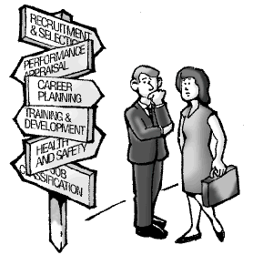
People
Higher (N6)
Business Management
2015-2016

Slide 2
Learning outcomes
By the end of this Unit I will be able to:
Describe methods used to ensure there are effective human resources available.
Explain methods used to motivate staff to improve effectiveness.
Explain how employee relations can impact on the success of a large organisation.
Describe the impact of current employment legislation.

Slide 3
WORKFORCE Planning
This enables an organisation to ensure that they have the correct employees at the right time to meet the needs of the organisation.
It involves analysing what needs to be done in an organisation and attempting to match suitably qualified and skilled staff to achieve the organisation’s objectives.

Slide 4
WORKFORCE Planning
Potential Staff
Factors to consider:
Current employment trends
Staffing requirements
Future supply of workers
Labour turnover
Satisfy and motivate employees
Organisation culture
Training and development
Release surplus staff
New Staff
Existing Staff
Departing Staff

Slide 5
Changing Patterns of Employment (1)
Increase in part-time work
full time staff led to inflexible workforce
Increase in service sector employment
coal, steel and shipbuilding no longer significant
Increase in public sector employment
30% of Scottish workers employed in this sector
Increase in women working
Special arrangements: flexi-time, job-share, child-care
Increase in home/teleworking
Improvement in communications

Slide 6
Changing Patterns of Employment (2)
Part-time work - in most cases voluntary decision
Variable hours - overtime or flexi-time systems
Temporary work - fixed-term, seasonal, casual or agency work
Downsized - now bringing workers back on a fixed-term or project basis for experience
Self-employment - now represent about 13% of workforce, route for those in unemployment and low pay and source of jobs for others

Slide 7
3 ‘Types of Workforce’
Core workforce - those essential to the business, giving the expertise. They are given good terms and conditions of employment.
Flexible Labour force - part-time or temporary basis eg during peaks in activity. Not employed when there is no demand for services.
Contractual fringe - sub-contractors eg cleaners, consultants, component suppliers. No need to pay for pensions, holidays etc.

Slide 8
Questions
Discuss the purpose of workforce planning.
Suggest benefits of workforce planning.

Slide 9
RECRUITMENT
Stages of the recruitment process were covered in National 5.
At Higher, we will be looking at internal and external recruitment.
Job vacancies can be advertised internally or externally, and therefore are available to internal candidates only or to internal and external candidates.

Slide 10
Internal Recruitment
The job vacancy is only advertised within the organisation.
Only people already working for the organisation can apply.
May be circulated via e-mail, advertised on an intranet site or an advert put on the noticeboard.
May be a promotion or change of job or location.

Slide 11
Advantages
Job vacancy can be filled quickly.
Employees are already known by the organisation. Have already demonstrated they have the ability to do the job.
Employees feel more valued and can become more motivated and productive.
Money can be saved on advertising a job, recruiting, selecting, training.
Existing employees are already familiar with the policies, procedures and culture within the organisation.

Slide 12
Disadvantages
Opportunity to gain new ideas from a new employee is lost; could mean new solutions to problems are not discovered.
An existing employee with the correct skills or ability for the job may not be available, and the position may remain unfulfilled.
May not be many existing employees who can apply for the position.
If a candidate is recruited internally, this will create another vacancy within the organisation.
Conflict amongst existing employees competing for the job might exist.

Slide 13
External Recruitment
When the job vacancy is advertised both within and outwith the organisation and anyone can apply. This can be:
Local and national newspapers
Journals (eg British Medical Journal)
Recruitment agencies
Company website
Recruitment websites eg s1jobs.com
Job centres/careers service
Skill seekers and New Deal
Schools, Colleges or Universities (Milk Round)

Slide 14
Advantages
People with new ideas can be brought into the organisation; can help with the effectiveness of the organisation.
Can attract large number of applicants so the organisation has a range of people to choose from (could be a disadvantage – why?).
Job vacancies can be filled quickly using the help of recruitment agencies.
Avoids conflict between competing employees if recruitment is only internal.
Specialist newspapers, magazines and agencies can be used to find appropriate staff.

Slide 15
disadvantages
Existing employees who apply but are overlooked may feel unvalued and lose motivation.
Can be expensive to advertise a job externally eg in a national newspaper.
A more thorough selection process may be required, which can be expensive.
Always a chance that the wrong person can be chosen, as they are unknown to the organisation.

Slide 16
Research task
Research places where a job could be advertised externally.
Present your findings to the class.
Past paper questions.

Slide 17
SELECTION
At National 5, we looked at some selection methods.
At Higher, we need to look at other selection methods in more detail:
Interviews
Testing
Assessment Centres

Slide 18
INTERVIEWS
Interviews are a common selection method. They allow the organisation to find out whether or not they are suitable for the job vacancy.
They also allow the applicant to ask questions. Candidates can be asked to do a short presentation.
One-to-one interviews
One interviewer makes a decision on who to select.
The disadvantage of this type of interview is that the interviewer may not be properly trained to carry out the interview. However it is cheaper than successive or panel interviews.

Slide 19
INTERVIEWS
Successive interviews
Several interviewers interviews each applicant separately. It means that the applicant has a number of interviews to attend. It has the advantage over one-to-one interviews in that it avoids interviewer bias.
Panel interviews
A panel interview involves one applicant being interviewed by several people at one time. The panel will discuss each candidate before making a final decision. Someone will be appointed to chair the interview panel.
VIDEO

Slide 20
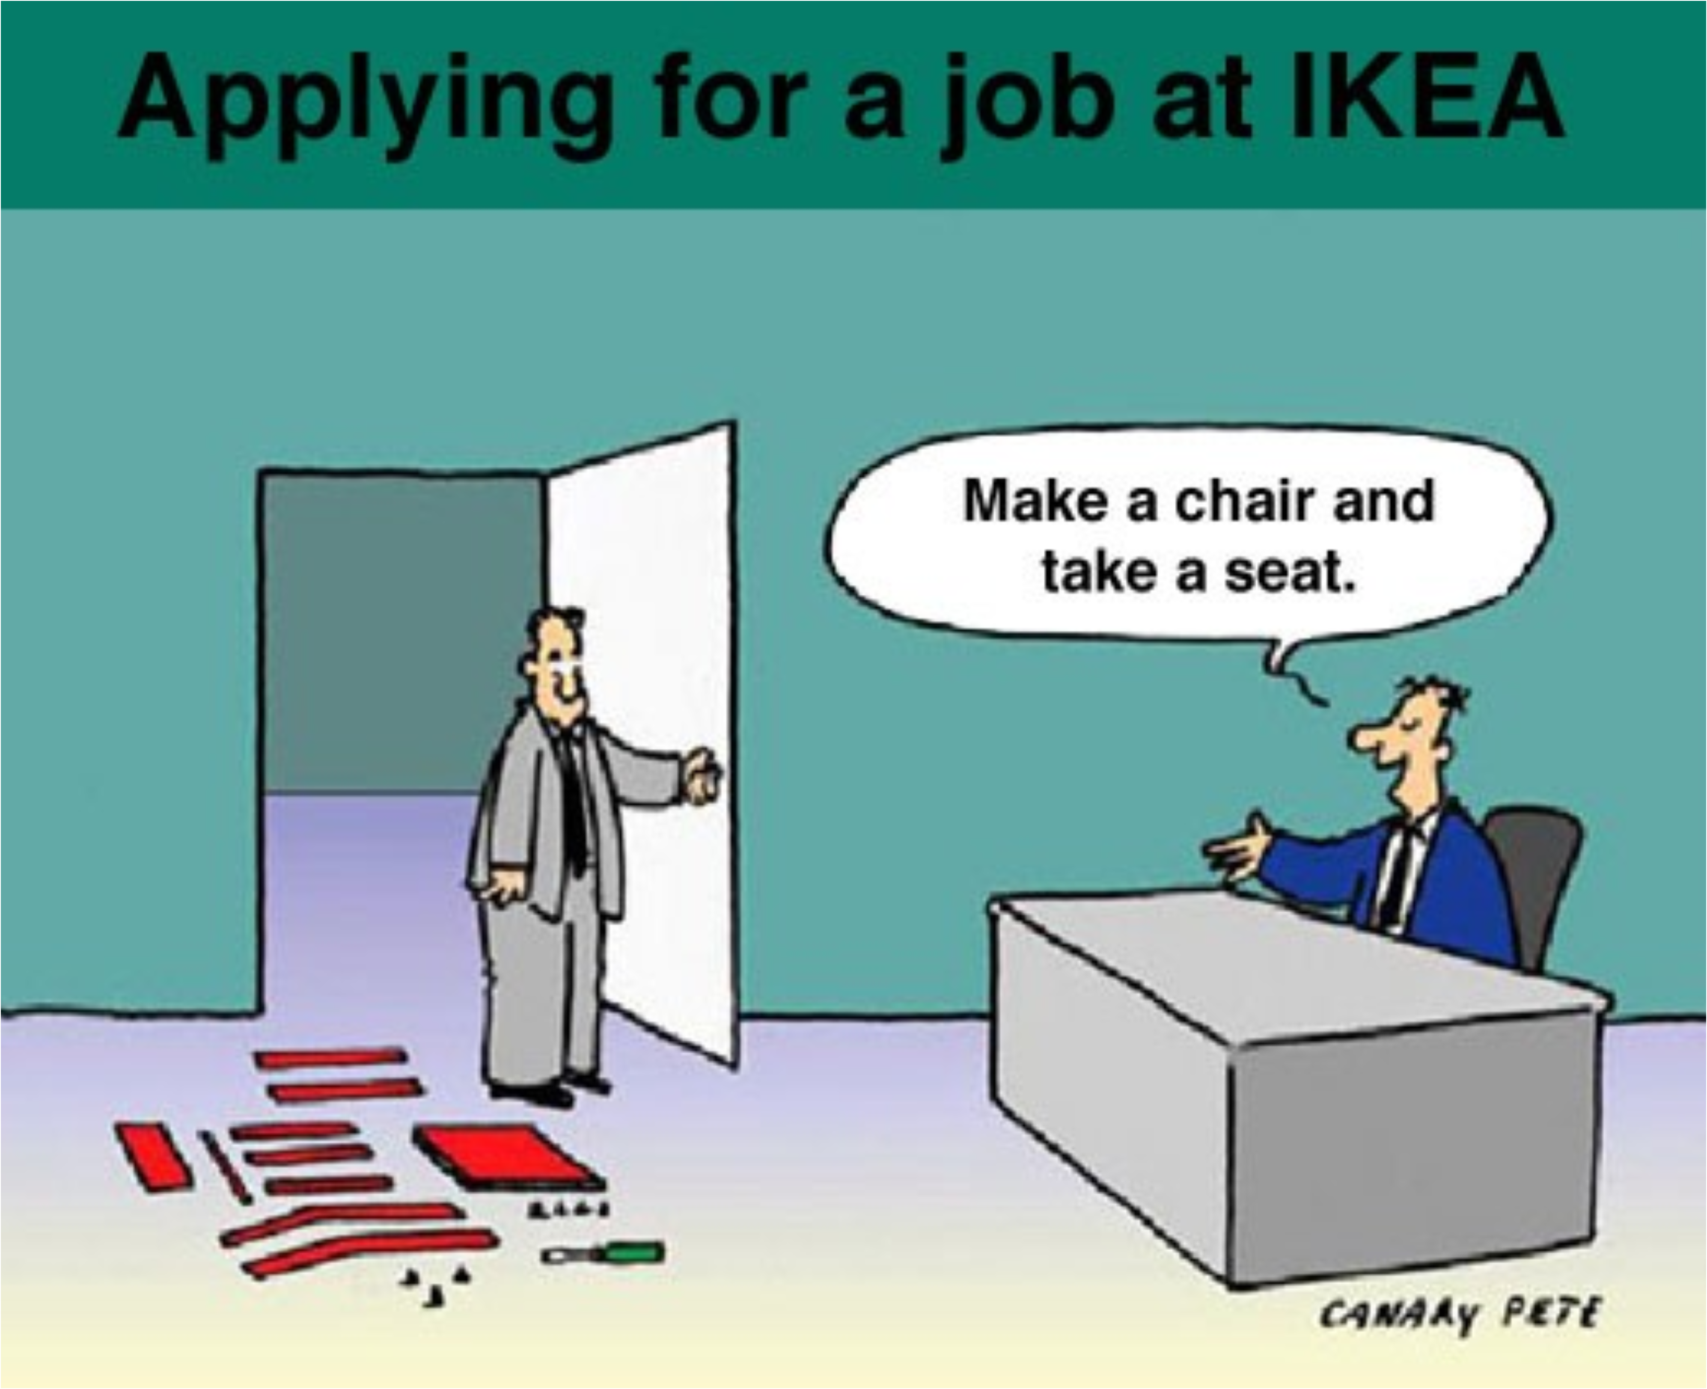
Testing

Slide 21
Testing
A variety of tests can be carried out to help in the selection process. Each test will assess a different aspect of the applicant’s abilities or skills and can confirm what the applicant has written on their application form or CV.
Tests can be expensive to carry out and are time-consuming.
They need to be carried out carefully because, just like exams, people can perform worse than expected due to the pressure and stress imposed on them.

Slide 22
Testing
Attainment Tests
Allows an applicant to demonstrate that they have a specific skill eg ICT. A typing test may be given to a potential administrative assistant.
Intelligence Tests (IQ Tests)
These assess the mental capability of the applicant. It might be that an applicant needs to be able to process lots of information in a pressurised environment.
Aptitude Tests
These assess the natural abilities of applicants on the skills required for a particular job they are applying for. Aptitude tests might assess literacy and numeracy skills.

Slide 23
Testing
Psychometric (Personality) Tests
Applicants are asked questions that assess their personality. The tests can be used to find out whether they suit the requirements of the job. Applicants should give truthful answers so that an accurate picture can be built up. However, applicants might select the answer that they think the organisation wants to hear.
Medical Tests
Each applicant is examined for any medical issues or concerns that may impact upon their ability to perform the duties of the job. Used by the police, army and fire brigade.

Slide 24
tasks
Candidates applying for office work might be asked to take an aptitude test to measure the accuracy and speed of their keyboard skills. Visit the website www.typeonline.co.uk . Have a few attempts at the speed test and then note your accuracy and speed.
In your jotter, write a short paragraph to explain how an aptitude test could help an employer to select the best candidate for a job.
Visit the website www.practiceaptitudetests.com and try some of the tests.
A manager applying for a senior position in an organisation might be asked to undertake a psychometric test to assess their intellectual ability, character, personality and attitudes. Visit the website www.psychometricinstitute.co.uk/Free-Personality-Test.asp. Complete the psychometric test.
In your jotter, write a short paragraph to explain how a psychometric test could help an employer select the best candidate for a job.

Slide 25
Assessment Centres
Many large organisations have their own assessment centres, where candidates are asked to attend.
This allows the organisation to observe candidates over a period of time and in a range of different scenarios.
Applicants are usually required to take part in role-play, team-building and delivering presentations. They will be observed to assess their communication, team work, leadership and problem-solving skills.
It can be costly to set up an assessment centre. Small and medium-sized firms often send candidates to private consulting firms for evaluation.

Slide 26
Assessment Centre activities
In-basket tests where the candidates are asked to sort through a manager’s in-basket e.g. letters, all of which describe different scenarios. Candidates are asked to prioritise them and respond appropriately with problem-solving strategies.
Leadership group discussions are group exercises in which a group of candidates is asked to respond to various kinds of scenarios, without a group leader. Candidates are evaluated on their behaviour.
Role-play exercises, candidates have to interact with another employee to solve a problem. Candidates are evaluated on the behaviour they display, solutions they provide or advice given.

Slide 27
tasks
Past paper question.

Slide 28
TRAINING AND DEVELOPMENT
At National 5 we looked at 3 types of training: induction, on-the-job and off-the-job. Make sure you revise these.
At Higher, we will be looking at different methods of staff development, training schemes and work-based qualifications.

Slide 29
Revision - Types of Training
Induction training – given to new recruits. Designed to give information about the organisation.
On-the-job training – ‘sitting next to Nellie’. This is carried out while the employee is doing their job.
Off-the-job training – carried out away from the organisation ie college.

Slide 30
Continuing professional development (CPD)
Organisations need to provide their staff with opportunities to develop as individuals and as employees.
Training allows people to carry out their jobs better and gives them the opportunity to learn new skills.
Staff development is an important part of being able to provide a high quality service or product.

Slide 31
Continuing professional development (CPD)
Providing opportunities for development is important in being able to achieve the organisation’s objectives in a changing business environment.
The Scottish Government has invested significant sums of money into providing opportunities for people to learn new skills and qualifications.
A record of all CPD is normally kept and when an employee is requesting training, they need to demonstrate how this matches the organisation’s aims. Evaluation after CPD is also carried out so that it can be discussed at the appraisal.

Slide 32
VIRTUAL LEARNING ENVIRONMENT (vle)
A virtual learning environment (VLE) is an e-learning system that simulates a real-life classroom. It allows staff and learners to communicate without being in the same physical environment. Resources can be uploaded to the VLE and learners can access them whenever.
VLEs can be used alongside classroom-based courses or distance learning courses where staff and learners never meet in person.
VLEs are increasingly used by employees to further their careers as they allow employees to combine employment with studying for a qualification.

Slide 33
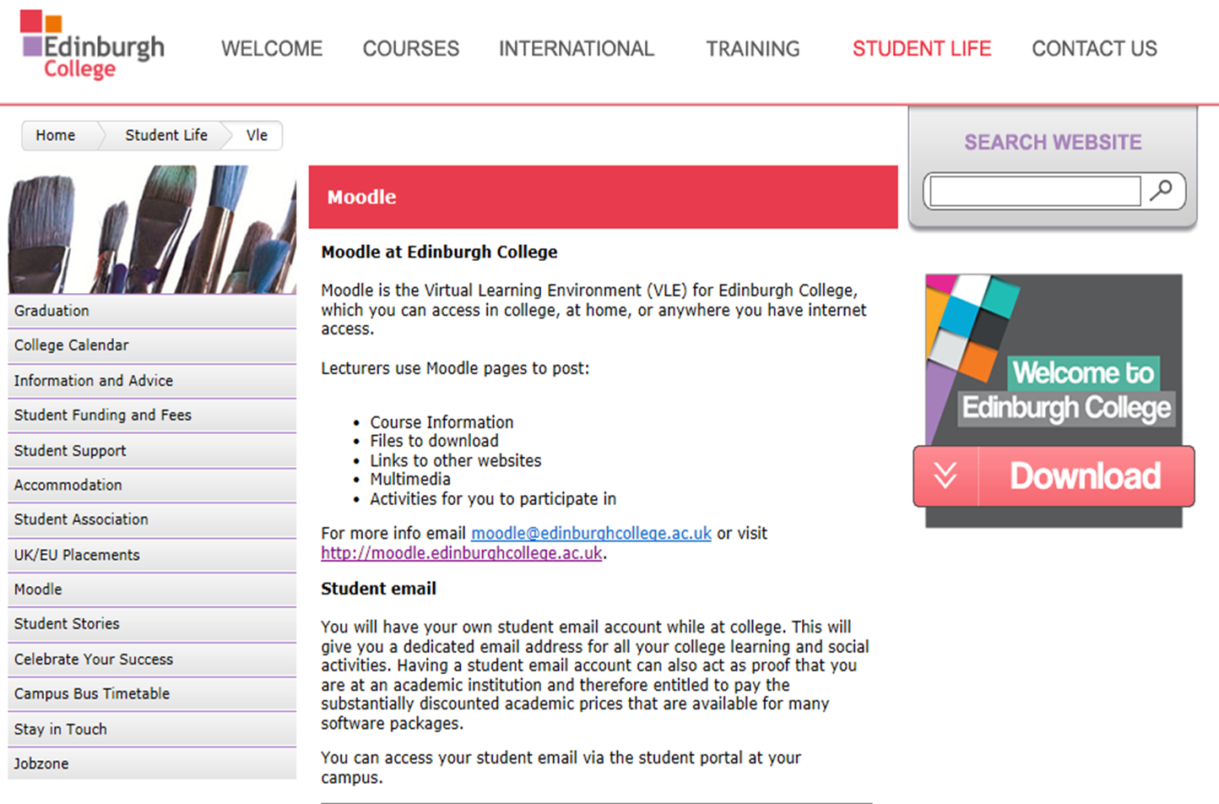

Slide 34
task
The following YouTube clips demonstrate how a virtual learning environment (VLE) works.
How one university structures its VLE:
http://www.youtube.com/watch?v=bsQ6blEXC7o
A more light-hearted look at the benefits of a VLE – storyboard:
http://www.youtube.com/watch?v=gC6QnSEChss
View these clips and identify the advantages and disadvantages of using a VLE.

Slide 35
VLE – Advantages TO EMPLOYER
Less time is spent away from the work place which improves productivity and reduces costs.
Travel costs are eliminated as employees can access the VLE anywhere.
Development of employees will increase motivation and reduce staff turnover.

Slide 36
VLE – Advantages TO EMPLOYEE
Increased flexibility as the VLE can be accessed at any time.
Employees learn at their own pace and can refer back to virtual lesson materials.
Social space on the VLE allows employees to interact through discussion forums or chat.
Homework and assignments are completed and returned online, which is cost- and time-effective.
Improve chances of career progression.

Slide 37
VLE – Disadvantages
People need to be self-disciplined to access the facility and carry out the activities.
Some employees may be reluctant to learn in a virtual environment.
Might be expensive to employ a specialist to set up and maintain a VLE.
If the internet hosting the VLE is down materials cannot be accessed.

Slide 38
Professional development through training schemes
Training schemes provide an opportunity for employees to gain core experience and skills with an employer.
At the end of the training period the employee may have the opportunity to secure a job with their employer.
They will also have a range of experiences to include in their CV.
Training schemes are offered in many industries from manual to white collar. Training schemes are one of the most favoured career routes of graduates, with huge competition for each position.

Slide 39
Professional development through training schemes
Graduate training schemes are offered by many large employers and give employment for a period of 1–2 years.
Employers which offer these schemes visit universities to promote these opportunities – graduate recruitment fair or ‘milk round’.
The graduate may undertake a specific role or spend time working in different areas of the organisation.
Opportunities for graduates are available with a wide variety of employers, including those in accountancy, as well as public sector organisations.

Slide 40
Professional development through work-based qualifications
Work-based learning enables employees to study towards a qualification while still earning a salary. Courses are delivered in conjunction with a university, or training provider.
While studying for the qualification the employee is also gaining relevant practical experience in real work situations. By achieving a recognised qualification they can enhance their career prospects.
Work-based qualifications have no or limited time away from the workplace. Work-based qualifications are available in many business sectors e.g. Business, Accountancy and customer service.

Slide 41
Professional development through work-based qualifications
Apprenticeships are traditionally undertaken by employees learning a trade, for example plumbers.
Apprentices earn a salary while learning the job. Although the salary is relatively low compared to graduate salaries and the government also covers the apprenticeship costs.
Most of the training is carried out on the job allowing the apprentice to put the skills learned into practice. In addition, apprentices will also attend college.
Successfully completing an apprenticeship may lead to permanent employment.

Slide 42
Task 1
Use the following websites to research graduate training schemes. Identify the requirements to apply and access real-life profiles of trainees on these schemes.
NHS Scotland graduate training scheme: details of how to apply and profiles of trainees.
http://www.mts.scot.nhs.uk/
Details of graduate training scheme vacancies in Scotland. Research one in the field you hope to work in.
http://www.reed.co.uk/jobs/graduate-training-internships/graduate-training-schemes/scotland

Slide 43
Task 2
The following YouTube clips illustrate the use of apprenticeships and workplace learning:
Clip of apprentices explaining why they chose this method of training (Guildford College)
http://www.youtube.com/watch?v=6sGyCkKy8pE
Clips of two employers who have used EDEXCEL courses in the workplace.
http://www.youtube.com/watch?v=dIGu93MZ32U
www.youtube.com/watch?v=BBaCey4y7NM
Identify the advantages and disadvantages of this type of learning.

Slide 44
Motivation theories
Theories of motivation can be used to help understand what motivates people. They can be applied in an organisation to motivate employees. Different theorists have different ideas about what motivates employees at work.

Slide 45
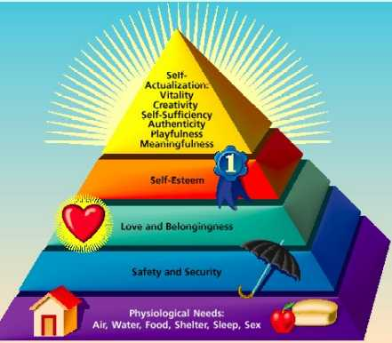
Maslow’s Hierarchy of needs
There are 5 levels of human needs that need to be satisfied.
In order to move up the hierarchy the lower needs have to be met first.
http://study.com/academy/lesson/the-needs-theory-motivating-employees-with-maslows-hierarchy-of-needs.html

Slide 46
Maslow’s Hierarchy of needs DEFINITIONS/uses in business
Self-actualisation - needs filled through self-fulfillment, more responsibility, ownership shares, self-employment
Esteem - self-respect, recognition, promotion, awards, title, size office/desk
Emotional - love, belonging, teams
Safety - job security, trade unions, laws
Physiological - food, clothing, shelter, warmth
Self-actualisation – opportunities for staff to use their own initiative and assume leadership roles. Ensure that promotion structures are in place.
Esteem – rewarding staff with status symbols like job titles, company cars, private offices, personal assistants.
Emotional – team work and possibly social facilities eg gym, nights out.
Safety - job security, safe working conditions, pension schemes.
Physiological – a fair wage, a work canteen and staff room.

Slide 47
TASK
Which levels of the hierarchy would be satisfied with the following conditions?
Employee of the year awards
Increase in wages
Company football team
Company pension scheme
Achieving your career goal of becoming a department head

Slide 48
Hertzberg’s theory of motivation
2 sets of factors that organisations should consider when trying to motivate employees:
Hygiene factors
Motivational factors

Slide 49
Hertzberg’s theory of motivation
Hygiene factors
These do not necessarily motivate employees. However, if these factors are not in place then this could cause dissatisfaction at work. Hygiene factors include company policy, wages and job security.
Motivational factors
These are based on an individual’s need for personal growth, achievement and recognition. When motivational factors exist they can actively create job satisfaction. Motivational factors include opportunity for advancement, responsibility, and a challenging/stimulating environment.

Slide 50
Mcgregor’s theory x and theory y
Theory X
Theory Y
Workers are motivated by money, they are lazy, selfish, ignore the needs of the organisation, avoid responsibility, lack ambition. They need controlled and directed by management.
Workers have different needs, they can enjoy work. If motivated they can organise themselves and take responsibility. Managers should allow creativity to be shown.

Slide 51
Leadership styles
Autocratic – autocratic leaders tell each employee what and how to do it. Employees feel controlled and this could lead to a high rate of employee turnover. It limits creativity and independent thinking. It can result in high quality products and efficiency.
Democratic – democratic leaders involve workers in decision making. Employees can contribute to decisions made and have a degree of flexibility in how to carry out their roles.
Laissez-faire – the laissez-faire leader does not exercise any control over their employees and people are really left to get on with things themselves. Support and guidance are only provided by the leader when requested. There is little direction given to the group, which can lead to limited achievement of organisational goals.
https://www.youtube.com/watch?v=Mo5Qk0Ed6iA

Slide 52
Workers need to feel safe and secure. An unsafe working environment will not motivate workers to work, and to work well, nor will the possibility of being made redundant.
What’s the point of
working, I’m going
to lose my job anyway
I’m no gonna work for
this firm again, cos a goat
a sair heid.

Slide 53

Appraisal
Allows identification of future training needs
Improves the performance of employees through constructive feedback
Identification of those with promotion potential and skills beneficial in other areas of the organisation
Allows personal targets to be set

Slide 54
Increasing Motivation
Quality Circles - meet regularly to identify, analyse and attempt to solve work-related problems
Job Enlargement - increased number of tasks, jobs less repetitive, organised into groups and trained to be multi-skilled - job rotation
Job Enrichment - giving workers opportunities to choose how to complete a particular task, usually as part of a team

Slide 55

Employee Relations
The formal relationship between employers and employees, which may involve each of their representatives.

Slide 56
Importance of Employee Relations
Good employee relations can mean:
Staff turnover will decrease which will reduce costs.
Absence will reduce which means productivity will be higher.
Employees will be more motivated which will mean customers receive a better standard of service.
Employees will be more willing to accept changes in the organisation.

Slide 57


Main Groups
Trade Unions
Employers
Employers’ Associations
ACAS
Task:
Research some of the groups above.
Find examples of different types of Trade Unions and Employers Associations.
Find out who their main stakeholders (members are) and what they do to protect them.
Look for any examples of where they have been in the news recently.

Slide 58


Trade Unions
An organisation that represents employees:
Rates of pay and bonuses
Work facilities and conditions
Breaks
Job security
Redundancy/Dismissal
Grievance
Negotiating job descriptions and person specifications
Collective
Bargaining

Slide 59

Employers
A duty of care to undertake a process of negotiation and consultation with their employees and keep them informed of changes

Slide 60
Employers’ Associations
Organisations which represent employers
Often useful for a small firm negotiating with a large union
COSLA (Convention of Scottish Local Authorities)
CBI (Confederation of British Industry)
Meat Marketing Board

Slide 61
Professional Associations
Similar to Trade Unions -
include setting and maintaining standards/monitoring of qualifications
BMA (British Medical Association)
Police Federation
Professional Footballers Association
GTCS (General Teaching Council Scotland)

Slide 62


Advisory, Conciliation and Arbitration Service
Best way to improve industrial relations is for employers and employees to work together

Slide 63
ACAS
Preventing or resolving employment disputes
Conciliating in actual/potential complaints before industrial tribunal
Providing information and advice
Promoting good practice

Slide 64
Worker Directors:
Elected by co-workers to sit on the Board of Directors
No voting powers but express employee views directly to BoD
Works Councils:
Equal number of employees and managers
Discuss suggestions for change and changes being introduced
Legal right of access to information on employee matters
Joint decision making powers

Slide 65
Industrial Action
Official industrial action has the backing of a Trade Union:
Trying to force the employer to take action on a particular issue – lost output, lost sales, poor image
Employers can also take action:
Lost earnings
Threaten redundancy

Slide 66

Industrial Action
Employee Action
Sit in
Overtime ban
Work-to-rule
Go slow
Strike
Employer Action
Withdrawal of Overtime
Lock out
Close

Slide 67
Policies and Procedures
Appraisal – performance of employees is monitored at regular intervals
setting targets, identify training needs, identify promotion opportunities
Grievance – what should employees do if they have been badly treated
Discipline – if the employee is in breach of organisation’s rules
Health and Safety – safety precautions, accident procedures etc

Slide 68
Equal Opportunities Facts
People with mental health problems face significant difficulties accessing work eg only 23% of people with depression are in employment.
Strong occupational segregation by race and gender still persists eg one in 4 Pakistani men is a taxi driver; one in 3 women is in a managerial job while more than ¾ of administrative jobs are done by women.
The gender pay gap widens significantly as a result of motherhood, with mothers with mid-level qualifications facing a 25% loss in lifetime earnings and those with no qualifications a 58% loss.
Lesbian, gay or bisexual adults are twice as likely to report harassment, discrimination or other unfair treatment at work compared to other employees.

Slide 69
The Equality Act 2010
Replaced previous anti-discrimination laws with a single act
To make the law simpler
To remove inconsistencies
Easier for people to understand and comply with
Strengthened protection in some situations

Slide 70
Protected Characteristics
Age
Disability
Gender reassignment
Marriage and civil partnership
Pregnancy and maternity
Race
Religion or belief
Sex
Sexual orientation

Slide 71
Age
Refers to a particular age or a range of ages
“I’m dismissing you because you’re 65”
“No applicant over 50 will be considered for this job”

Slide 72
Disability
A physical or mental impairment and the impairment has a substantial and long-term adverse effect on their ability to carry out normal day-to-day activities.
Physical: eg arthritis, sciatica, diabetes, heart disease
Mental: eg depression and anxiety, learning difficulties, autism, Asperger’s syndrome
Long-term: 12 months, rest of life

Slide 73
Gender reassignment
Person is proposing to undergo, is undergoing or has undergone a process (or part of a process) for the purpose of reassigning the person’s sex by changing physiological or other attributes of sex.
Process does not need to be a medical procedure.

Slide 74
Race
Includes:
colour eg black or white
Nationality eg British, Columbian or Slovakian
Ethnic or national origins eg Roma or Irish traveller background

Slide 75
Religion or belief
Includes:
Any religion or philosophical belief
Lack of religion or philosophical belief
Religions covered include:
Christianity
Hinduism
Islam
Judaism
Sikhism

Slide 76
Sexual orientation
Outlaws discrimination in employment based on sexual orientation towards:
people of the same sex
opposite sex
the same sex and the opposite sex

Slide 77
Direct discrimination
A person directly discriminates against another person if ‘because of’ a protected characteristic’ they treat them less favourably than they treat or would treat others.
Eg a woman was turned down for a job as a labourer on a construction site because the manager thought women were not physically strong enough for such work.

Slide 78
Indirect discrimination
A person A discriminates against another B if A applies to B a provision, criterion or practice that is discriminatory in relation to a protected characteristic of B’s.
Excludes the protected characteristic of pregnancy and maternity.
John is Jewish and keeps the Sabbath. His employer requires all workers to work until 10pm on a Friday evening.

Slide 79
Examples
Linda is a single parent with 2 small children. Her employer introduces a new shift system that requires all employees to work some late shifts and alternate weekends.
Jemima suffers with repetitive strain injury. Her employer introduces a new form of keyboard that she cannot use because of her RSI.

Slide 80
Other form of discrimination
Arising from disability
Harassment

Slide 81
Impact of the equality act
When adverts for jobs are being created, managers need to ensure they are worded in a way that is not seen to break the law eg ‘a young person is required’.
Barriers to physically accessing the building will need to be considered and action taken, where possible, to make the building more accessible.
The organisation must investigate any complaints re discrimination in the workplace.
Policies need to be created to ensure employees are aware of the legislation and what they need to do to comply with it.

Slide 82
Health & Safety at Work
Raising the standard of safety and health for all individuals at work and the public as far as ‘reasonably practicable’
Employer’s Duties:
Written statement of general policy prepared
Providing training, information, instruction and supervision
Ensuring that all equipment is safe and risk associated with handling, storing and transportation of articles are minimised

Slide 83
Health & Safety at Work
Employee’s Duties:
Take reasonable care of themselves and others
Co-operate with the employer
Not intentionally or recklessly interfere or misuse anything in relation to H&S
Carry out duties in accordance with training or instructions
Report any dangerous situations
Health & Safety Executive:
Power to enter employer’s premises and carry out investigations and examine materials

Slide 84
Trade Union and Employment Rights Act 1993
Employees cannot be dismissed for:
Taking steps to protect themselves in circumstances of danger
Performing H&S responsibilities
Leaving a dangerous part of a workplace
Bringing a H&S concern to employer’s attention
Performing functions as a H&S representative

Slide 85
Employment Protection
Employment Relations Act 1999
one year = no unfair dismissal
Parental leave (adoption)
Remove limits on awards for unfair dismissal
Reasons (which are unfair):
Membership of trade unions
Pregnancy (being able to do job)
Redundancy (without correct procedures)
As a result of transfer of business
Sunday Trading Act 1994

Slide 86
Employment Protection
Reasons (which are fair):
Incapable of doing job
Unqualified
‘Misconduct’ – minor or major
If unable to employ – eg lost driving licence
False details given – eg application form
Redundancy
Redundancy
Job must have disappeared
Must consult with trade unions
Period of notice
Redundancy payment

Slide 87
Wage Act 1986
Wages are any sums paid to the worker in connection with the job:
Fees, bonuses, commission, sick pay, gift tokens, vouchers
Redundancy payments, expenses, loans are not included
Deductions
NI, shown in contract, agreed in writing eg Trade Unions
If an employer doesn’t pay – employee can complain to a tribunal

Slide 88
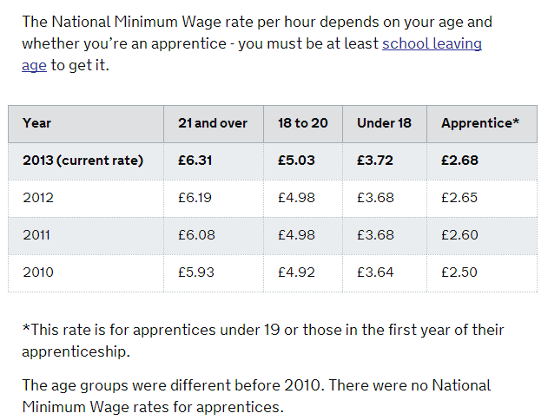
National Minimum Wage Act 1999
Why?
Prevent poverty
Reduce inequality between men and women
Greater equality and fairness should motivate employees, reduce staff turnover and improve productivity

Slide 89
TECHNOLOGY
What types of Technology might the HR Department use?
Describe what they might use each one for and why?

