Slide 1





Dictionary Skills

Slide 2

Get to know your dictionary.
Which side do you need to look up French words?
Which side do you need to look up English words?

Slide 3
French – English side (the first half)
What does it all mean?
what might ‘n’
tell you?
The type of word
N = noun – a
naming word
What is this word?
the French word
chaise [ʃɛz] nf chair
Any ideas on this part?
The sound
It tells you how to pronounce the word.
the gender:
f=feminine so
a chair = une chaise
the chair = la chaise
What is this word?
what might ‘f’
tell you?
the English word

Slide 4
English – French side (the second half)
What does it all mean?
what might ‘n’
tell you?
The type of word
N = noun – a
naming word
what might ‘m’
tell you?
the gender:
m=masculine so
a foot= un chaise
the foot= le chaise
What is this word?
the English word
foot [fut, fi:t] n pied m
Any ideas on this part?
The sound
It tells you how to pronounce the word. You can IGNORE this part.
What is this word?
the French word

Slide 5
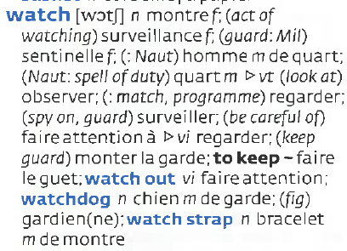
Is it a verb or a noun? - watch
Which French word do you need for ‘to watch (a TV programme) (verb)?
regarder
Which French word do you need for ‘the watch’ (noun)?
la montre

