Slide 1

S1 Christmas Project - Nativity Scenes

Slide 2
Learning Intentions
I have investigated the Christian Nativity Story
I have creatively produced a piece of work on the Nativity Story
I have managed my time at home to produce my best work on the Christmas story

Slide 3
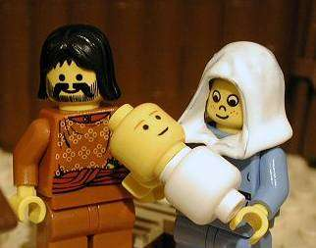
The Christmas Nativity

Slide 4
Your task is to create a nativity scene. Your final product could be a model, a stained glass window, a painting, a poster; it could even be edible!

Slide 5
Success Criteria
Ability to demonstrate your knowledge and understanding of the Nativity Story
Quality of final product
Creativity
Effort

Slide 6
Need some inspiration?
For more information about the Christmas story and to get some ideas, visit the website www.whychristmas.com. On this website you can read, listen or watch the Christmas story and also see some examples of nativity scenes.

Slide 7
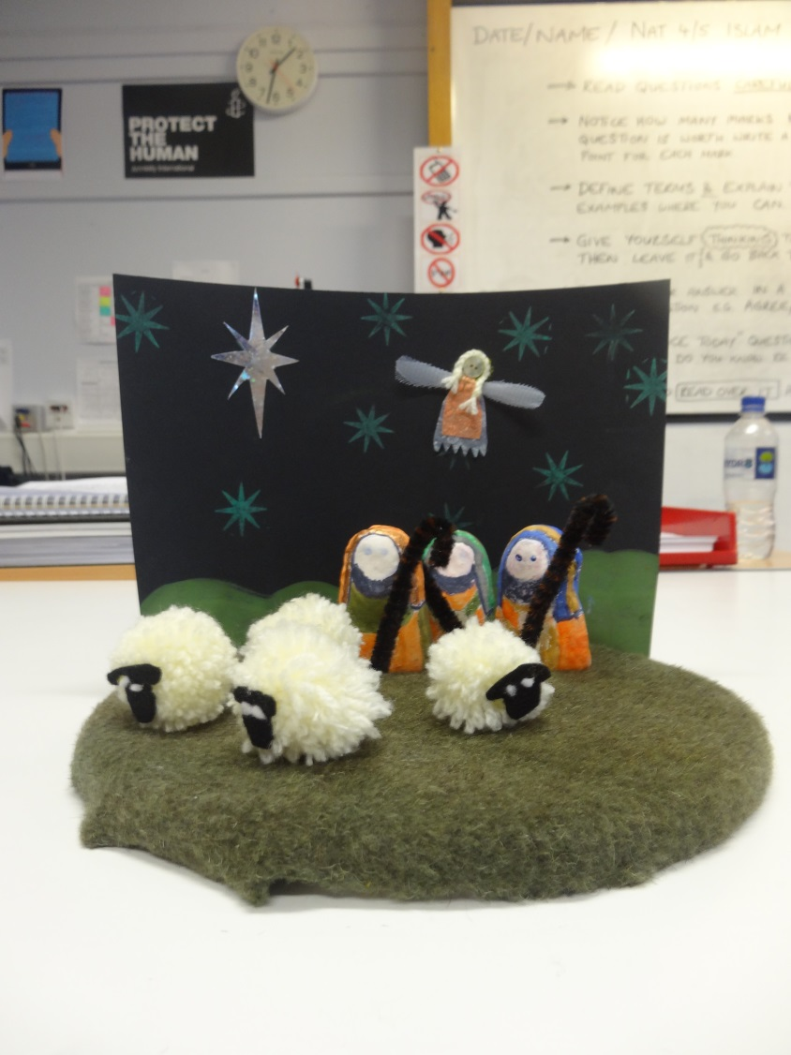
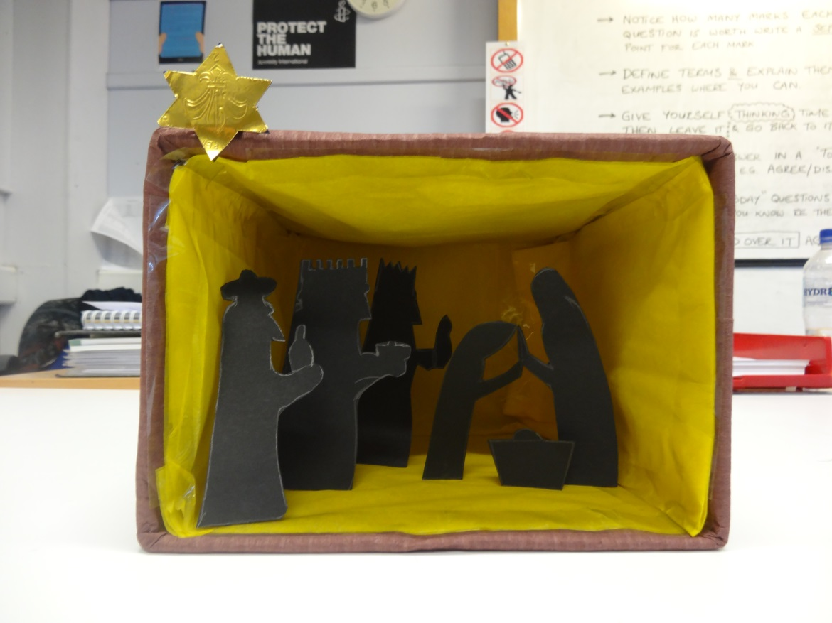
Examples from previous years…

Slide 8
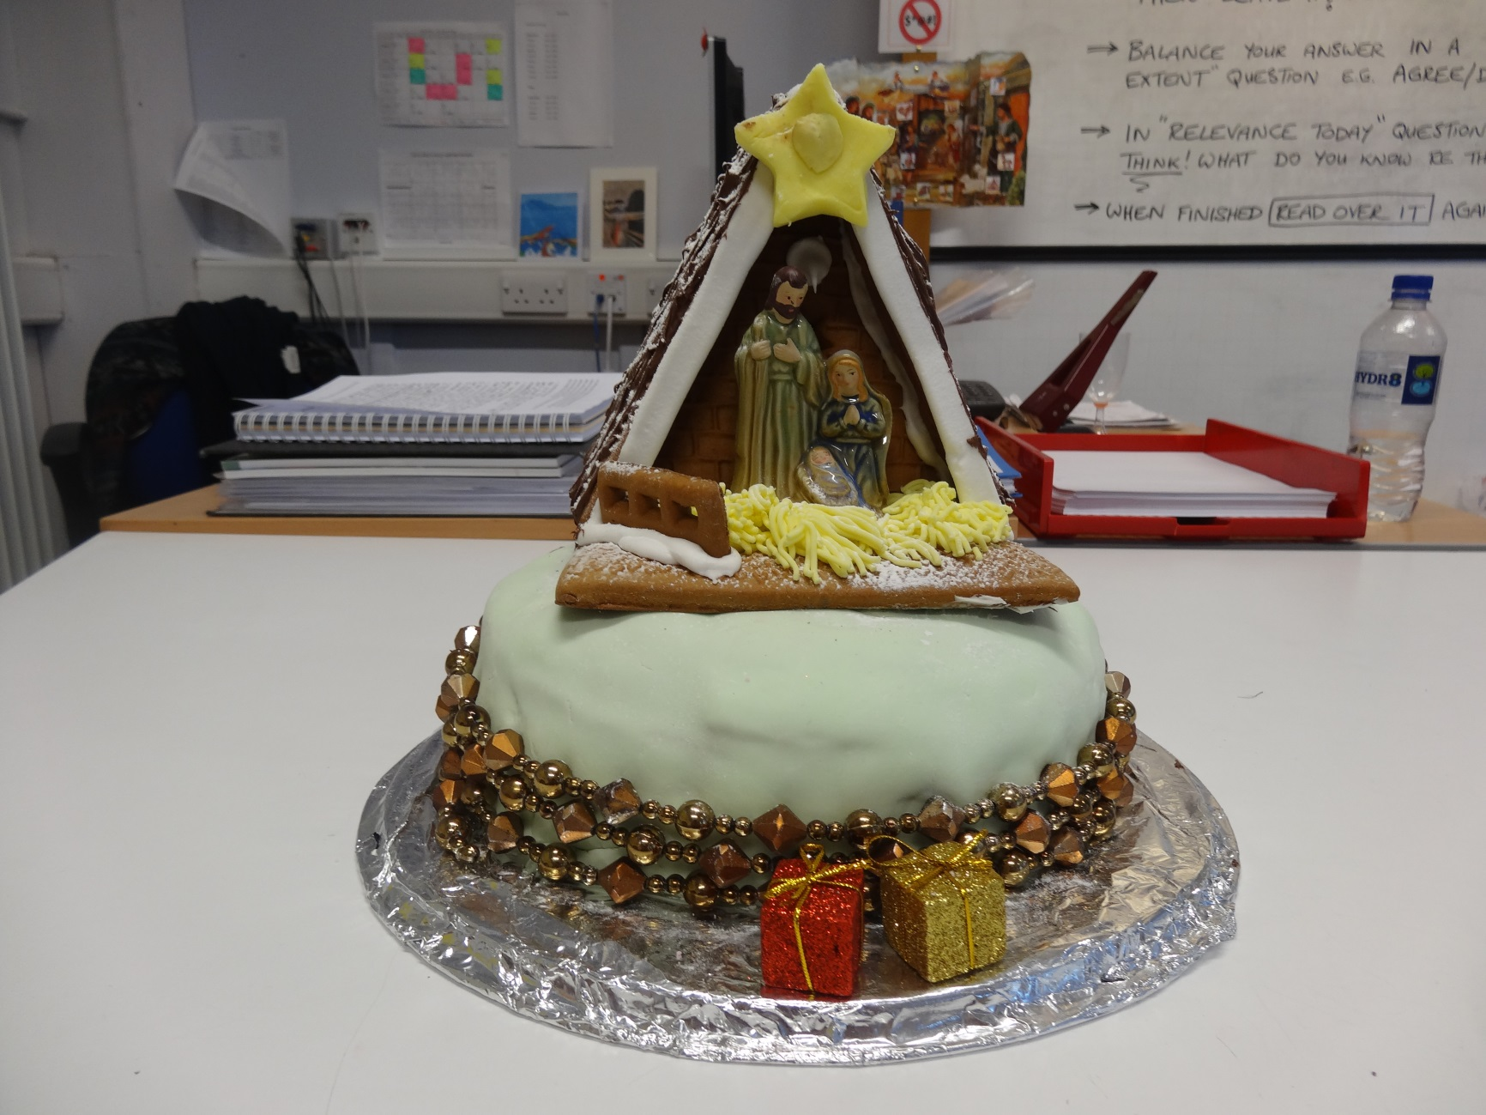

Slide 9
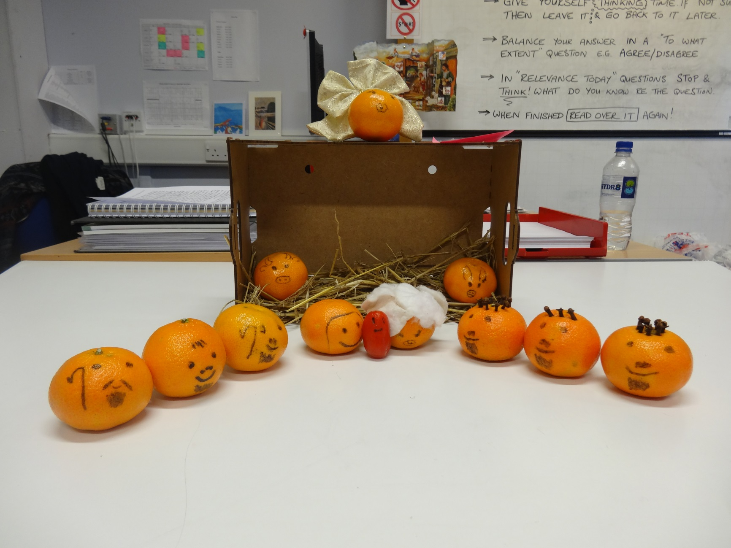

Slide 10
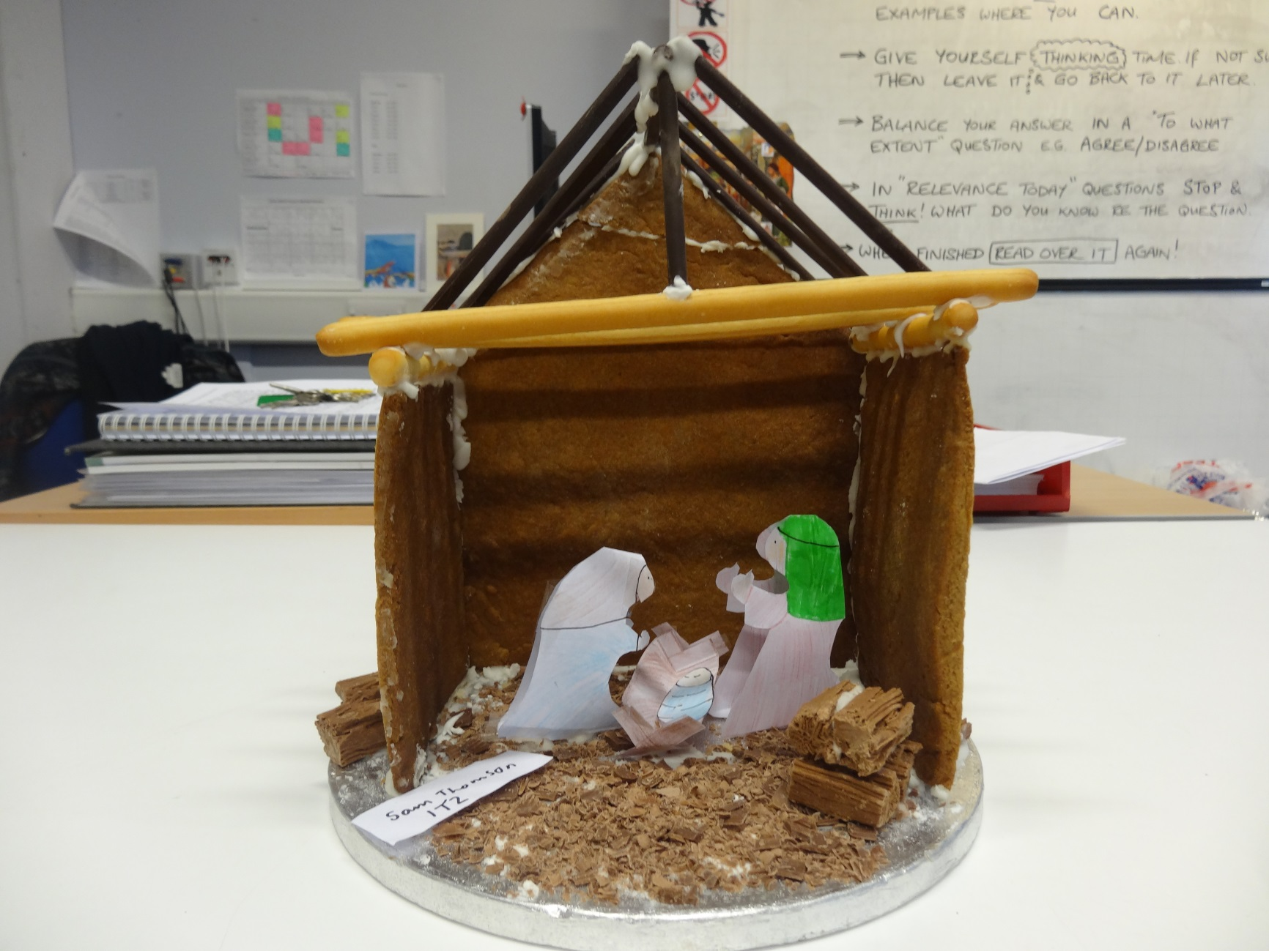

Slide 11
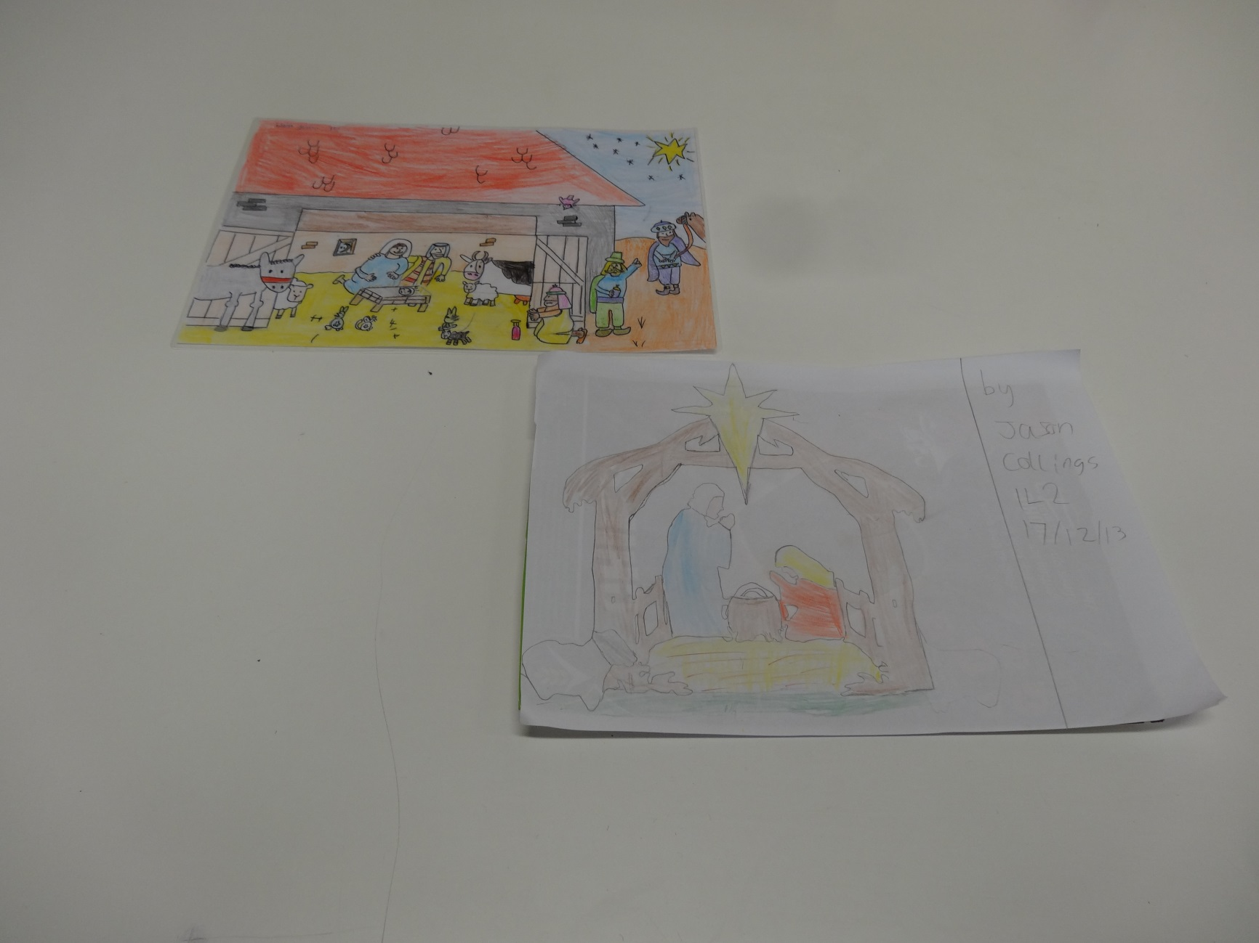

Slide 12
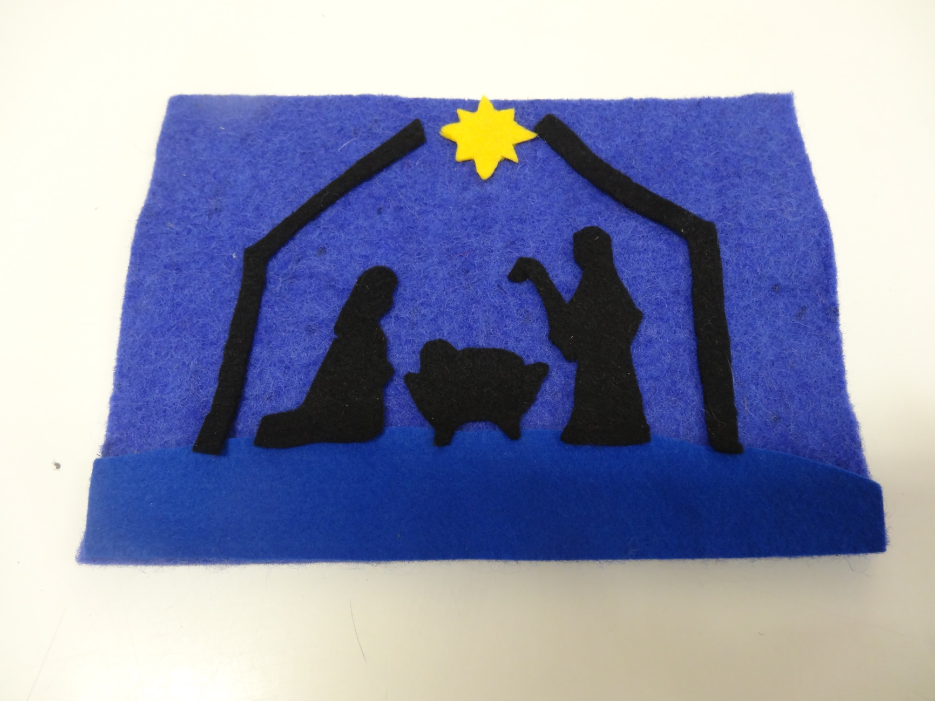

Slide 13


