Slide 1
Understanding Business
Business Organisations
Higher Business Management
2015/16

Slide 2
The Role of Business in Society

Slide 3
Business Activity
Goods & Services
Any activity which results in the provision of goods/services which satisfy human wants
Wants
Needs
Capital
Goods
Consumer Goods
Durable
Non-Durable

Slide 4
Sectors of Industry
Sector | Description | Example
Primary | Extracting and exploitation of natural resources (raw materials) | Fishing, farming, oil drilling
Secondary | Take the raw materials and manufacture them in to goods | Cars, computers, cakes
Tertiary | Provide a service to the consumer | Education, banking, tourism
Quaternary | Provide information services and often involve innovation | ICT, consultancy, R&D

Slide 5
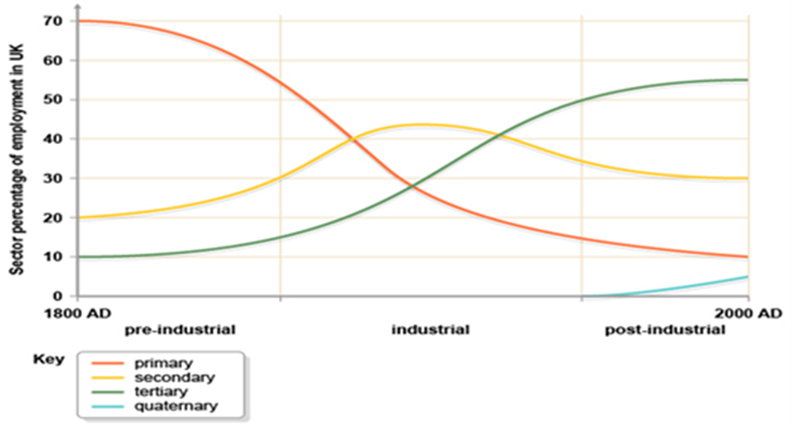
Sectors of Industry - Trends
Line graph showing UK employment structure from 1800 to 2000.

Slide 6


Activity : Jobs of the Future
Using the BBC website find out the automation risk for a job that you would be interested in. knox.is/robotjobs
  Likely chance of automation
  Earnings
  Sector of Industry
Based on this look at the following article knox.is/jobsofthefuture
  Pick one job of the future and find out what it is?
  What sector of the industry is it in?
In your opinion in the year 2050 what will a lesson explaining the sectors of industry look like?
  Explain your answer

Slide 7

Wealth Creation
The 4 Factors of Production are combined together to produce an output
  Land – natural resources
  Labour – workforce
  Capital – equipment and money invested
  Enterprise – the entrepreneur (more later)
At each stage of production value is added with each new ingredient therefore wealth is created
Goods/Services are then sold in markets.
The total value of all goods/services sold is called Gross Domestic Product (GDP)

Slide 8
Wealth Creation - Impact
Benefits
Costs
More jobs are created = less unemployment
People become skilled
Demand for goods/services increases as people have more money
Increased taxes – benefit public sector
Increased investment in infrastructure
Negative environmental impact (pollution)
Loss of non-renewables (oil), greenfield sites
Increased demand can lead to inflation – price of goods/services increases

Slide 9
TASK
There have been significant changes to the economy over the last 10 years.
Use the internet to find out current figures and trends over the last 10 years for the following things:
  GDP
  Economic Growth
  Inflation
  Unemployment
  Tax revenues

Slide 10
Types of Organisation

Slide 11
Sectors of Economy - recap
Sector | Description | Example
Private | Organisations that are privately owned and exist to maximise profit for their owners | Sole Trader, Partnership, Ltd, PLC, Franchise, Multinationals
Public | Organisations that are owned by the taxpayer and run by the government to provide the public with a quality service. | National Govt (NHS, Education, BBC), Local Govt (ELC)
Third | Organisations that aim to raise awareness for causes and help other | Charities, Non Profit Making Orgs (hockey club), Social Enterprises

Slide 12






Private Sector
Public Limited Companies (PLC)
Ownership | Size | Objectives | Finance
Shareholders (sold on stock exchange) Run by a Board of Directors | >250 employees Often multinational | Also: Market leader Social responsibility Growth Maximise profits | Also: Shares easily sold on Stock Market
£50,000 investment

Slide 13

Private Sector
Public Limited Companies (PLC)
Advantages
Disadvantages
Limited liability
Large amounts of capital can be raised (stock exchange)
Economies of Scale possible
Can control more of the market than smaller organisations
Rules and regulations of Companies Act
Annual Accounts must be published
No control over ownership of the company
High start-up costs

Slide 14




Franchises
A person who starts a business and provides a product or service supplied by another business is known as a franchisee and operates a business known as a franchise
The franchisee is allowed to use the franchisor’s business name and sell its products

Slide 15

The Franchisor
Advantages | Disadvantages
Quick entry to new markets | Reliant on franchisees to maintain image and ‘good name’
Receive % of profits | More money would be received if they ran it themselves
Protection from competition
Risk is shared

Slide 16
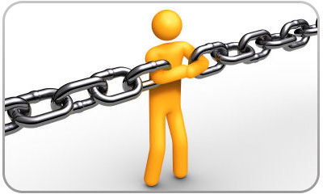
The Franchisee
Advantages | Disadvantages
Already established name and brand | % of profits paid to franchisor
Training provided by the franchisor | Strict rules imposed by franchisor, so they have little control
Back-up Service provided (advice) | Performance depends on franchisor’s input and other franchisees
All benefit from shared ideas
Risk is shared

Slide 17
FRANCHISES
Go to the following websites:
  http://www.thebfa.org/members
  http://www.franchisedirect.co.uk/
Find out the following information:
  Start-up costs
  What does the franchisor provide
  What does the franchisee have to do to become a franchise
  Information from people who have set up a franchise (testimonials)

Slide 18

Multinationals
A multinational operates in more than one country. It will normally have a headquarters based in one country known as the ‘home country’.

Slide 19

Multinationals: Benefits
Economies of Scale
Legislation (relaxed)
Taxation or Grant incentives
Increased sales/less chance of takeover
Lower wage rates
Higher skilled workforce
Can operate competitively (locally)
Save on costs of transportation
Avoiding Trade Barriers

Slide 20

Multinationals: Costs
Legislation may be too restrictive
Cultural difficulties
Lack of technical expertise
Poor infrastructure
Political Instability
Exploitation (e.g. low wages)
Forcing local businesses out

Slide 21

The Public Sector
Managed by the government on behalf of the taxpayer who owns them
Funded through taxation (income tax, council tax…)
  Can you think of other taxes?
Aims:
  Provide quality services
  Improve communities
  Act in best interests of society

Slide 22

Types of Public Sector Organisations
Central Government (UK Govt) | Defence, Welfare, Taxation People are elected to become politicians (MPs) Politicians are elected to the House of Commons
Central Government (Scottish Govt) | NHS, Education, Transport People are elected to become politicians (MSPs)

Slide 23



Types of Public Sector Organisations
Local Government | East Lothian Council gets funding from the Scottish Govt Schools, roads, council housing and leisure Elected politicians control and appointed managers to run local government
Public Corporations | BBC, HMRC, Office of Fair Trading Goods and services provided Owned by government – nationalised industries Funded by government and taxes Chairperson and Board of Directors

Slide 24
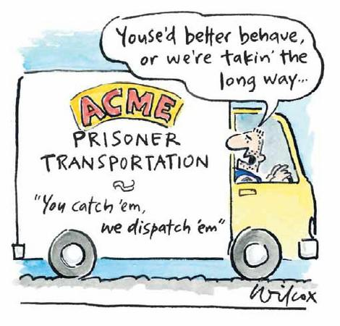
Privatisation
Governments sold these companies because:
  Huge amounts of income for the Treasury
  Some public corporations were poorly managed and not profitable
  Wanted to increase share ownership and make public interested in the success of companies/the economy
However:
  Public corporations were often sold off too cheaply
  Privatisation has not always led to greater competition

Slide 25
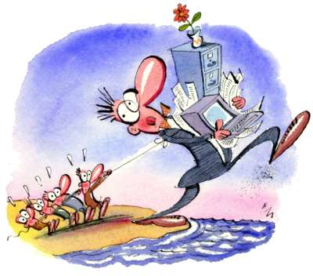
Contracting Out
Examples are refuse collection and school meals
Firms are invited to submit bids (competitive tendering) to provide these services
Cost effective? Private Sector organisations have an incentive to keep costs low

Slide 26




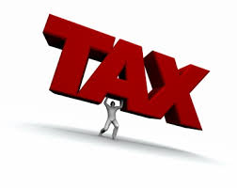

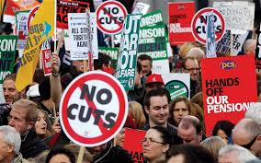
NEWS!
The Public Sector is in the news everyday. Over the last few years there have been huge changes to the public sector and the services it provides. The public sector will also look very different with current plans for the next few years.
TASK
  Research a news story that gives and example of changes we have seen over the last few years or will see in the coming years.

Slide 27


Third Sector
Non-profit making organisations such as charities and voluntary organisations are set up to support specific causes
Charities | Oxfam, Cancer Research Owned and controlled by a board of trustees They will fundraise to raise finance (TV appeals, collections, selling products)
Voluntary Organisations | Youth Clubs, Sports Clubs Provide a service without the profit making motive Raise funds through donations, memberships, fundraising events

Slide 28

Third Sector
  www.socialenterprisescotland.org.uk
  http://Se100.net/index
Social Enterprises | Trade in all markets selling goods/services They have a social/environmental aim rather than profit making Run like a business All of the profits must be invested in to meeting their social aim. Less regulated by Govt than charities
Example | Wooden Spoon Catering – provide job and education opportunities for women in vulnerable positions

Slide 29
Objectives

Slide 30

Objectives
Targets or goals
Required so that a measurement of success can be made
Make decision to achieve goals eg:
objective = expand overseas
action = find location; recruit staff; market products
Remember objectives can change over time

Slide 31
Objectives – mission statement
Sets out the vision and aims of an organisation.
Allows different stakeholders to see the aims of the business:
  Employees can see the company’s plans, how it affects their job.
  Customers can see future plans for the business.
  It can raise the profile and reputation of the organisation.

Slide 32
Objectives
Objective | Description | Justification
Survival | To continue trading | Need to survive or the business would not exist
Maximise Profit | To have a higher income than costs | Allows the business to improve/expand
Customer Satisfaction | Make customers happy | Customer loyalty, new customers
Market Leader | Biggest business in a market | More customers than competitors

Slide 33
Objectives
Objective | Description | Justification
Social Responsibility | Behaving in an ethical and responsible way (marketing & operations unit) | Improves the organisation’s reputation
Satisficing | Ensuring that your business operates to a satisfactory position | Not always possible to reach perfection (limited resources etc.)
Managerial Objectives | Their own internal objectives e.g. bonuses | Motivational for the manager to do well
Growth | Making the organisation increase in size | Increases sales/profits/reputation/economies of scale

Slide 34

Methods of Growth –
Internal(Organic)
Increasing number of stores
Selling new products
Entering new markets
Employing more staff (demand)

Slide 35








Methods of Growth –
External
When two businesses come together to form one business:
Merger – The companies agree to join and share resources
Takeover – This can be friendly or hostile, one company subsumes the other

Slide 36

Methods of Growth
External - Integration
Horizontal Integration
Combining two firms at the same stage of production:
  Eliminate competition
  Increase market share
  Achieve economies of scale
  Acquire the assets of the other firm
  More secure from hostile takeover bids

Slide 37
Methods of Growth
External - Integration
Backwards Vertical: take over a firm at an earlier stage
  eg jam manufacturer taking over a farm
  Availability and quality of products ensured
Forwards Vertical: take over a firm at a later stage
  eg cheese manufacturer taking over a local delicatessens
  Control of distribution outlets gained
Eliminates middleman and his profit
Gives the firm greater economies of scale
Allows the firm to link processes more easily

Slide 38
Methods of Growth
External - Integration
Diversification (Conglomerate):
  Two firms producing completely different goods from each other joining together
  Diversification results with reduced risk eg one firm/product failing; seasonal changes; acquire assets of other company
Management buy-out/buy- in:
  A team of managers get together and buy an existing company from its owners. Large bank loans will be involved
  Buy-out: managers come from within
  Buy-in: managers come from outside

Slide 39








Task
Create a full integration diagram for one of the following organisations:
  It should show horizontal, backwards, forwards & diversification
  Include clear reasons why you would integrate each way
  Include a justification for the businesses you will integrate with

Slide 40
Methods of Growth
Reducing in size
De-merger:
  Splitting up the conglomerate so that its subsidiaries become companies themselves
Divestment:
  Business sells some of its assets or part of its company
  The part sold might not be performing well
  Can raise finance to focus on core activity expansion

Slide 41
Internal Structure
Organisations are set up to suit the type of activity that they carry out.
Organisations can be set up their structure in a number of ways. Organisation structures include:
  Tall
  Flat
  Matrix
  Entrepreneurial
  Centralised/Decentralised

Slide 42
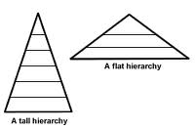
Organisational Structures
Structure | Description | Advantages | Disadvantages
Tall | Many layers of management | Clear lines of control Promotion opportunities | Communication issues Increased management costs
Flat | Fewer levels of management | Quicker decision making Staff are empowered | Increased workload for some staff Wide span of control makes it hard to manage

Slide 43
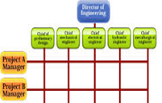
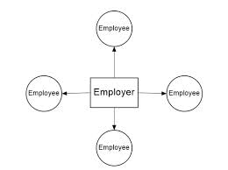
Organisational Structures
Structure | Description | Advantages | Disadvantages
Matrix (project) | Used for completing a specific task. Involves various departments | Motivating for employees Wide range of skills used Helps solve a problem | Costly to implement as runs next to normal structure Two managers can be confusing
Entrepreneurial | Found in smaller org’s. Decisions mostly made by owner | Decisions are made quickly Clear direction for the company | Demotivating for employees Limited number of ideas Not suitable for large org’s

Slide 44
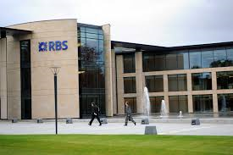
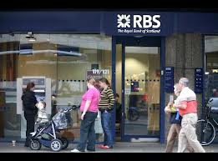
Organisational Structures
Structure | Description | Advantages | Disadvantages
Centralised | Decisions are made by senior managers at Headquarters | Clear and consistent direction for the org Skilled staff in charge of decisions made | Demotivating for branch staff Communication issues
Decentralised | Decisions are delegated to departments/branches | SMT have more time for other issues Prepares junior managers for promotion Decisions can be made quickly | Lack of experience or willingness amongst managers Procedures carried out differently Not a consistent approach used
vs.

Slide 45
Changing Organisational Structure
Often organisations change their structure. This may be due to the changing size of the organisation or financial pressures.
They can do so by:
Downsizing – removing some of the activities carried out e.g. closing a branch
Delayering – removing layers of management e.g. changing from tall to flat
Outsourcing – Allowing an outside agency to provide that service e.g. cleaning

Slide 46
Organisational Grouping
After an organisation has chosen a structure they must then decide how to group their activities.
These can be done in a number of ways:
  Functional
  Product/Service
  Customer
  Geographical

Slide 47
Organisational Grouping -
Functional
Activities are grouped into departments based on similar skills, expertise and resources used:
  Marketing
  Operations
  Human Resources
  Finance
Advantages | Disadvantages
No duplication of resources | Loyalty to department vs organisation
Become experts in field | Communication barriers
Career paths developed | Slow to respond to change
Communication and cooperation

Slide 48
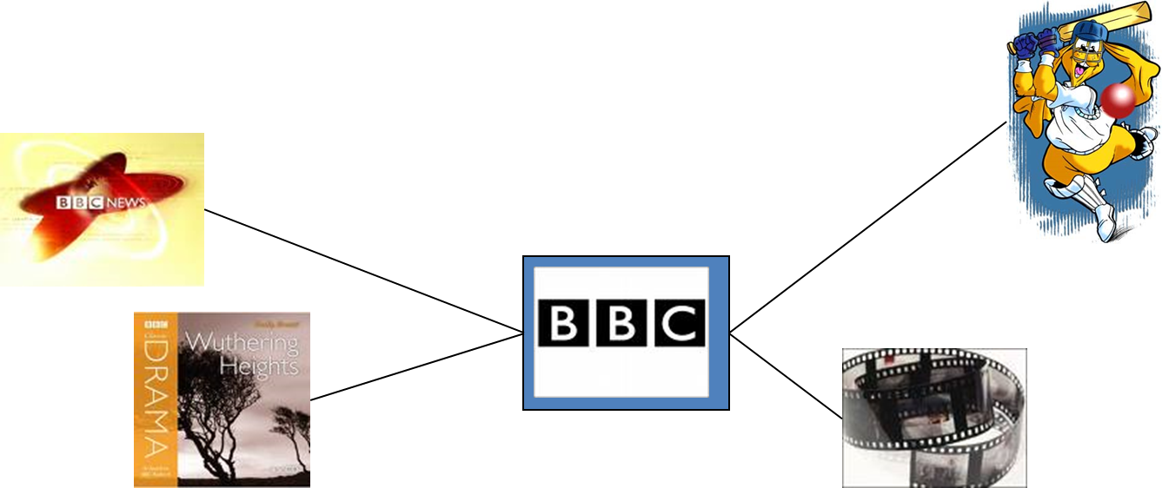
Organisational Grouping -
Product/Service
Grouped around product or service offered
Each product requires specialist knowledge and expertise
Advantages | Disadvantages
Self-contained units | Duplication of resources
Expertise develops | Difficult to share research or equipment
Quicker response to external changes | In competition with other divisions

Slide 49
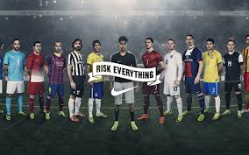
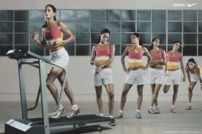
Organisational Grouping -
Customer
This is grouped by customer types e.g. market segment.
Advantages | Disadvantages
Price/promotion suit customer | Expensive – staff costs
Customer loyalty develops | New group for new customer eg ecommerce
Quick response to changing needs | Duplication of resources

Slide 50

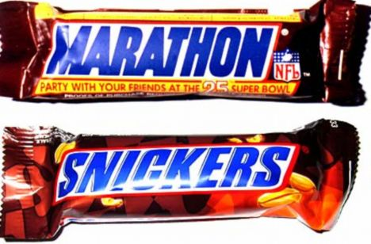
Organisational Grouping -
Geographical
Organised by geographical region
  e.g. North-East Scotland and Midlands group
Advantages | Disadvantages
Local offices = local knowledge | Cost of re-location
Accountable for success/failure in area | Language and cultural barriers
Responsive to customer needs | Duplication of resources

Slide 51
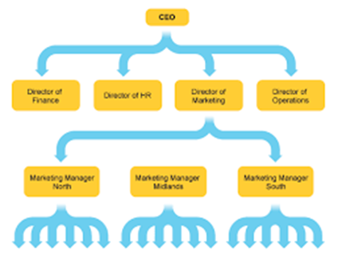
Organisational Relationships
Responsibility – being answerable for decisions and action taken
Authority – having power to make decisions
Chain of Command – how instructions are passed down through an organisation and how communication flows up and down.
Delegation – giving the responsibility to someone else to carry out a task

Slide 52
Organisational Relationships
Line Relationship – manager and subordinate e.g. Marketing Director > Marketing Assistant
Lateral Relationship – two or more people on the same level e.g. Marketing Director >Finance Director
Functional Relationship – support for other functional areas e.g. Admin Dept giving support to the HR Dept
Informal Relationships – colleagues communicating on an informal basis. These are said to be the most important relationships in an organisation

Slide 53
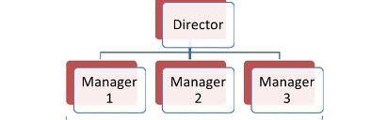
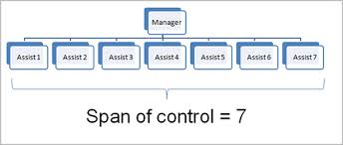
Organisational Relationships
Narrow Span of Control
  Fewer subordinates to manage = less empowerment
  More opportunities to communicate with managers
  Subordinates likely to be involved in decision making
  Longer chain of command
Wide Span of Control
  More empowerment for subordinates
  Tasks can be delegated
  Large number of subordinates to control
  Fewer managers which saves money
  Shorter chain of command

Slide 54

TASK
Using A3 paper or a relevant computer programme produce an organisation chart for the school.
Your diagram should include the following information:
  Organisational Structure – justify
  Organisational Groupings – justify
  Organisational relationships - justify

