Slide 1
Higher Administration & IT
2013-2016 PPQs

Slide 2


Higher Administration & IT
Time and Task Management

Slide 3
Time and Task Management
2013-2016
Justify the need for employees to have good time management skills. (2)
Outline 4 ways a team leader may monitor the progress of a project. (4)

Slide 4
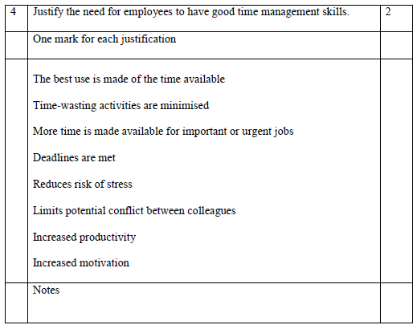

Slide 5
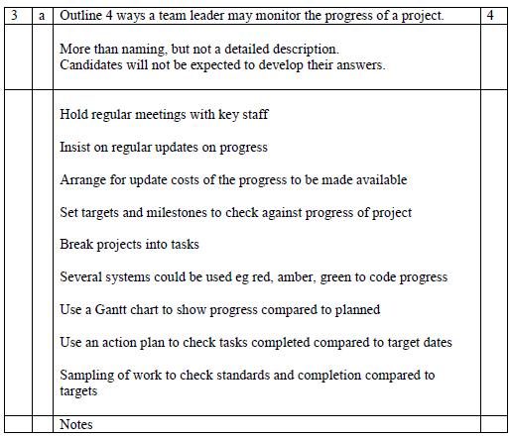

Slide 6
Time and Task Management
2013-2016
Outline 4 features of effective targets. (4)
Describe the implications of a manager failing to delegate effectively. (6)

Slide 7
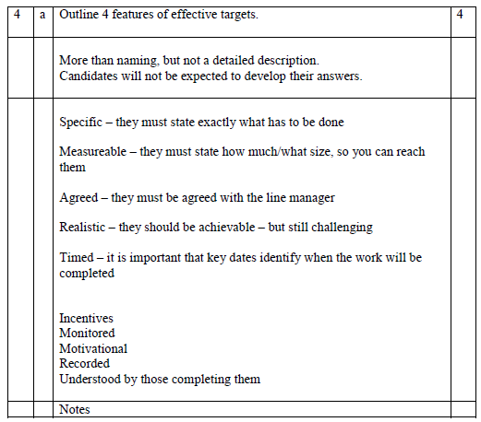

Slide 8
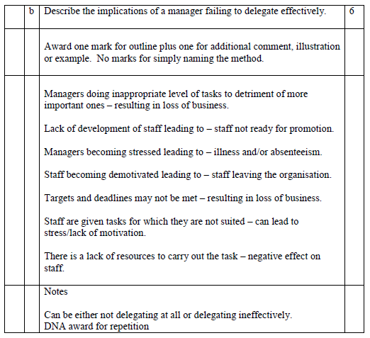

Slide 9
Time and Task Management
2013-2016
Describe 3 methods of monitoring and controlling targets. (6)
Describe 3 time management techniques. (6)

Slide 10
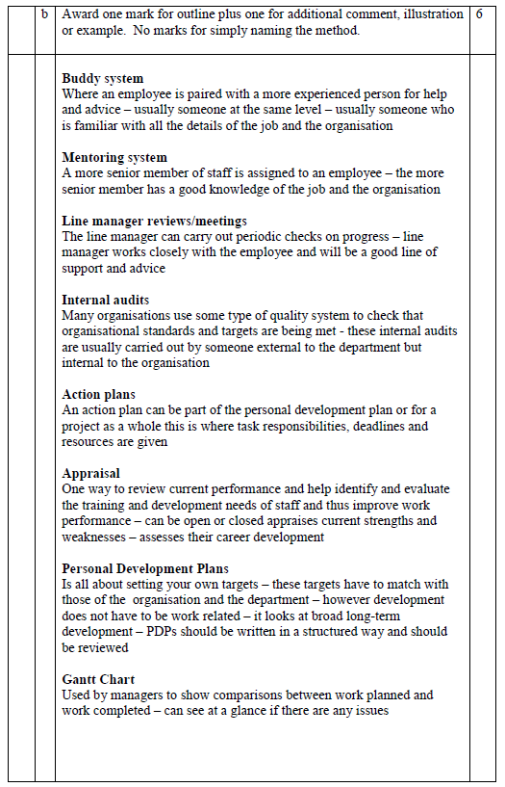
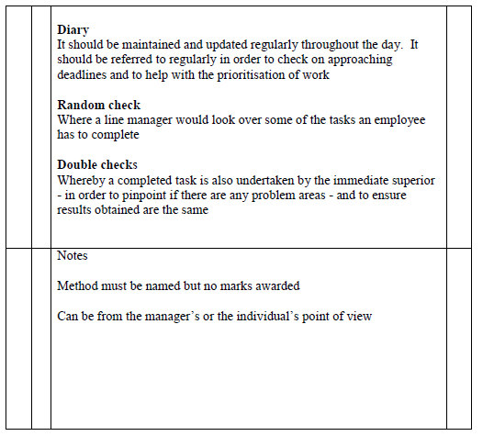

Slide 11
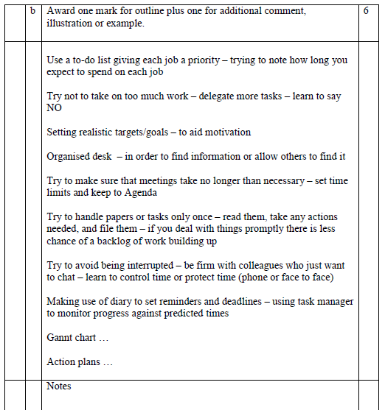

Slide 12
Time and Task Management
2013-2016
Outline the reasons why a team leader may be reluctant to delegate. (4)
Describe 3 strategies a team leader could use to improve their own efficiency in task management. (6)

Slide 13
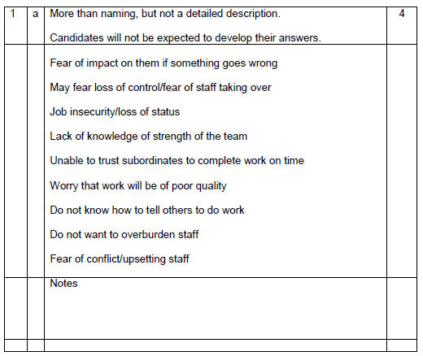

Slide 14
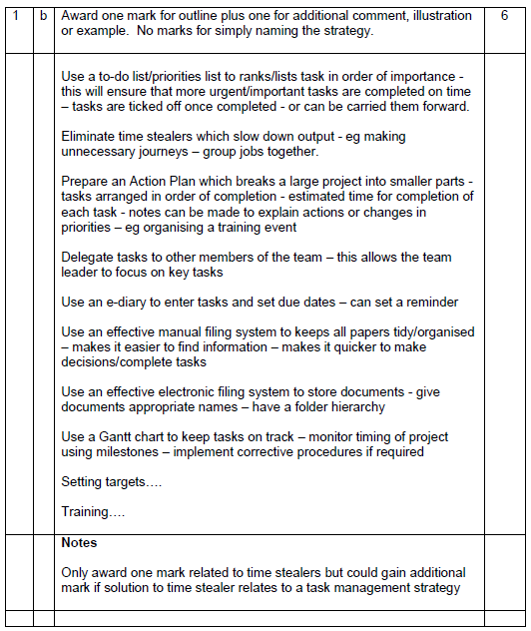

Slide 15
Describe the time and task management strategies that employees could use. (6)
Justify 2 qualities/skills that Janet Stevenson will require in her role in Milne Accounting Ltd. (2)

Slide 16
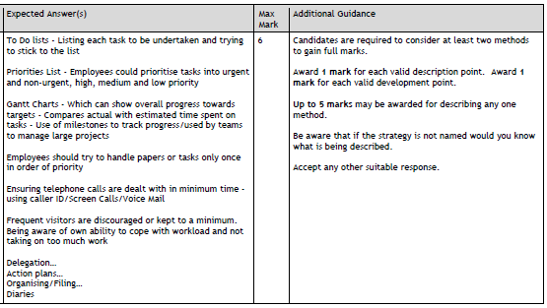

Slide 17
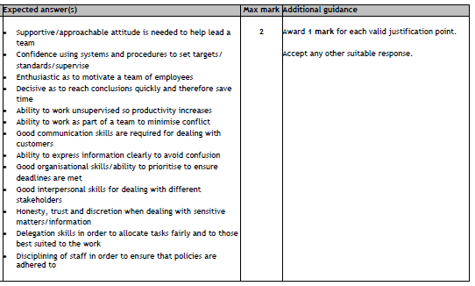

Slide 18
Time and Task Management
2013-2016
Outline 4 methods which could be used to monitor and evaluate an employee’s work. (4)

Slide 19
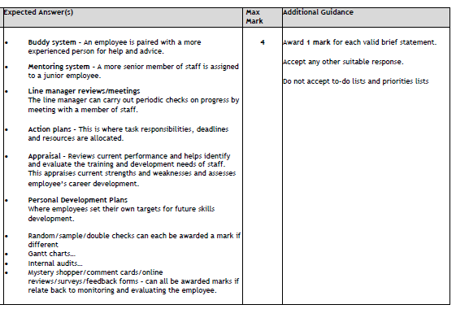

Slide 20
Higher Administration & IT
Teams

Slide 21
Time and Task Management
2013-2016
Discuss the impact of poor communication between an administrative assistant and their line manager. (6)

Slide 22
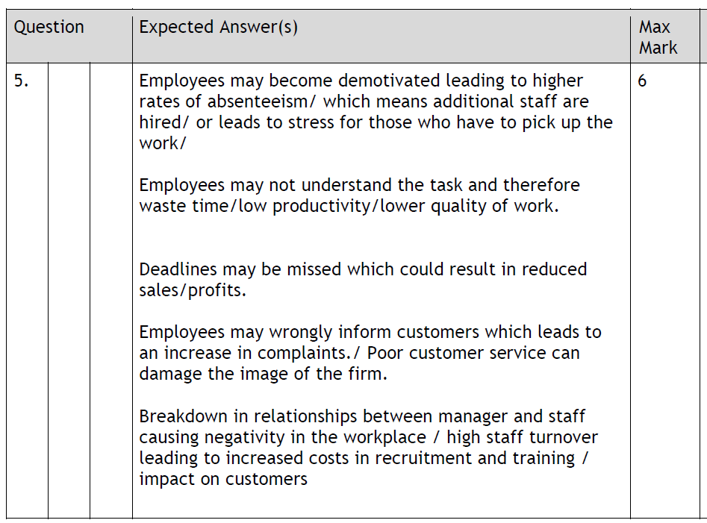

Slide 23
Time and Task Management
2013-2016
Discuss the reasons why some teams are more effective than others. (8)

Slide 24
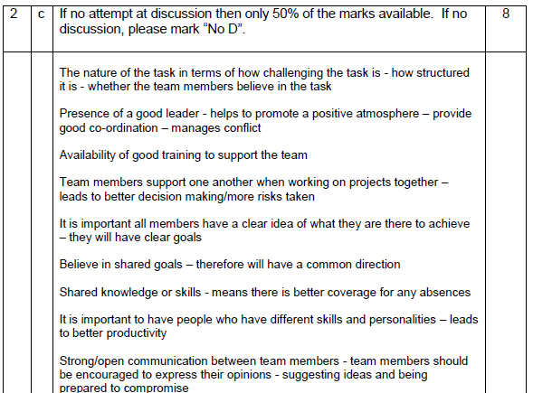
CONT…

Slide 25
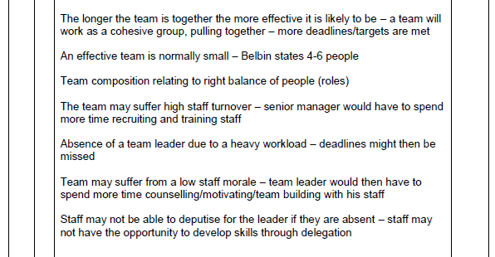

Slide 26
Time and Task Management
2013-2016
Discuss the benefits of team working for the organisation and the employee. (6)

Slide 27
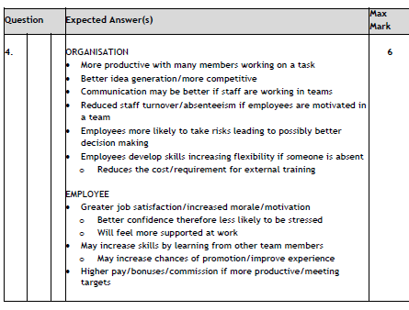

Slide 28
Time and Task Management
2013-2016
Outline 4 skills you would expect to see in an effective team leader. (4)

Slide 29
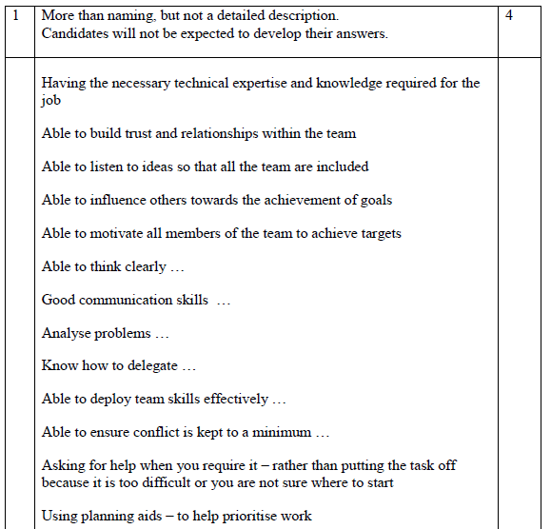
CONT…

Slide 30
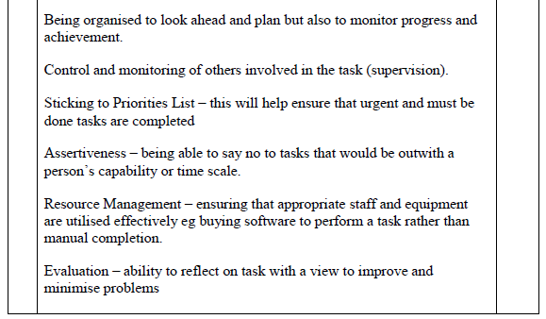

Slide 31
Time and Task Management
2013-2016
Describe 3 features of an effective team. (6)

Slide 32
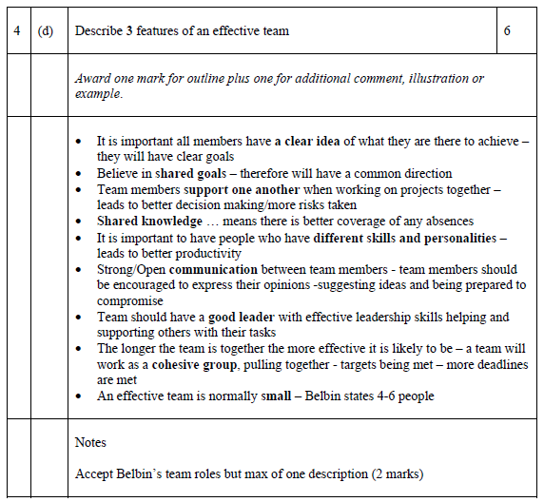

Slide 33
Higher Administration & IT
NEXT UNIT TITLE

Slide 34
Higher Administration & IT
2013-2016 PPQs

