Slide 1

Features of Software Packages
Higher Administration & IT
Thanks to Miss Dickson ☺

Slide 2
What is this unit about?
As well as being able to carry out the practical tasks in presentation software, word processing, spreadsheets and databases you also need to know the features of these and be able to write about these in a theory question.
Although Higher Administration & IT 2020/2021 does not have databases in the practical aspect of the course you still need to know and understand the features of this software.

Slide 3

How can I prepare?
The best way to prepare for your exam is to be familiar with the range of questions that have been asked in the past in addition to your own knowledge.
You can often use the Marking Instructions as an additional set of notes!
Ask your teacher about anything that you find that you aren’t familiar with.
You will find past exam questions at the end of this presentation

Slide 4

Spreadsheets | MS Excel
It is a useful software to store numeric information as it can be easily updated and show information clearly all in once place
What If situations can be performed with automatic calculations updating final results
You can filter information A-Z and Z-A making it easy to find information at a glance
You can show information in charts which is easier to read in a more eye catching way
Conditional formatting – show information in certain colours to emphasise certain cells depending on cell content
Data validation – only permit certain entries based on set criteria (eg range or list)
A range of formula allowing you to carry out complex calculations – sometimes with named cells and named cell ranges
VLookups and HLookups – allow you to pull information over from other sheets and view it all in one place
Formula and values can be printed
Using Pivot Tables can summarise data to enable detailed analysis
Dynamic Linkage – eg to update a chart in a Word Processing Document

Slide 5

Word Processing | MS Word
You can add a front cover – enhances a document and makes it look professional
Headers and Footers – you can show separate information on separate pages eg company names, section titles and your name. You can also put an image in a header or footer
Formatting – use bold, underline and italics to emphasise and draw attention to specific information
Contents page – if It is a large document then it makes it easier to find certain information on specific page
Page numbers – makes it easier to find certain pages
Section and page breaks – splits up information and you can change pages to landscape to show graphs or tables more clearly on one page
Watermarks – can show a document as a draft before final copy is made
Letters – use the correct layout including reference/date, inside address, subject heading and complimentary close
Forms – use a suitable layout (often using tables – don’t make it complicated) to allow handwritten entries

Slide 6

Databases | MS Access
Sorting – You can perform complex sorts on information in alphabetical/numerical order, ascending or descending
Queries – Allows you search and narrow down a lot of information using complex criteria including wildcards / NOT / NULL / BETWEEN – can carry out calculations
You can create forms from selected data and records allowing a focus on an individual record when entering or editing the data
Data validation/Input masks – ensures that data entry is valid
You can create a report showing information more clearly and including the results of calculations eg summary totals
Relationships allow individual tables to be linked together with primary and foreign keys.
Multiple users can access the database and update – this means that all relevant data is stored in one place and everyone is accessing the most up-to-date information

Slide 7

Presentation | MS PowerPoint
Can add a design template to make it eye catching and have a professional appearance
Add action buttons – easy to navigate through slides using these buttons
Can give each slide a time limit and let it run automatically while speaker is talking
Slide transitions and animations draws attention to specific information
Can add information in from spreadsheets – charts, word documents and databases
Footers – you can add in the company name
Speaker Notes – aids a professional presentation
Slide numbers to keep track of speaker notes
Master Slides – allows a company corporate image to be communicated with set fonts/sizes/styles/logos
Sound and Video can be embedded
Hyperlinks to different documents/websites during the presentation
Can be printed in many different ways e.g. notes pages and handouts

Slide 8

Email & E-diary
E-Diary Reminders – People will not forget about important events meetings or tasks and can encourage people to be organised – both mobile notifications and emails can be set
E-Diary Tasks – Ensures people know what they have to do and by when
E-Diary Events – Events can be electronically created and shared with others attending – can see when others are free – can send invites
Emails can be marked as urgent to highlight the importance
Emails can be sent to multiple people at once – a distribution list
Email allows you to automatically filter emails into folders which means emails are easy to locate and do not clutter the inbox
Email is an inexpensive method of communication suitable for communication across time zones
Email lets you send attachments e.g. business documents and pictures
Depending on the email software – read receipts can be requested

Slide 9
SQA Software PPQs (NQ)
2006-2015
Higher Administration & IT

Slide 10
2006 SPEC 2/5a
Describe 3 features of database software which aids the entry of data. (6)

Slide 11
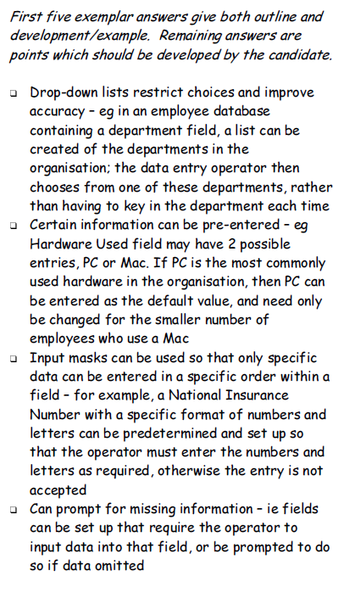
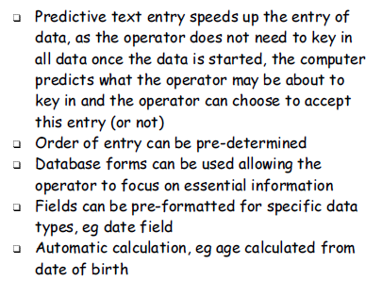

Slide 12
2006 2/2c
Describe the benefits of using a form in a word processing package to collect data from customers. (6)

Slide 13
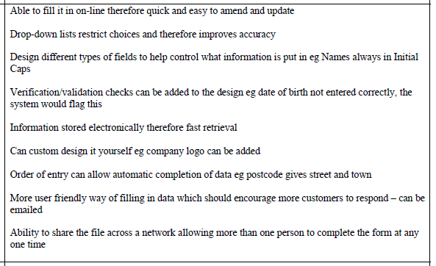

Slide 14
2008 2/5b
Suggest a way in which each of the following spreadsheet features may be used. (4)
  Comments
  Conditional Formatting
  Dynamic Linkage
  Named Range

Slide 15
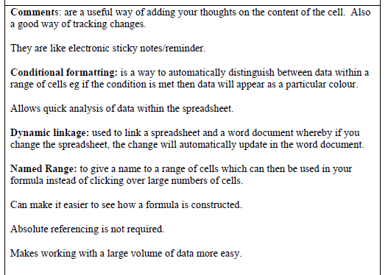

Slide 16
2009 2/5d
Compare the use of a database and a spreadsheet for storing and analysing information. (4)

Slide 17
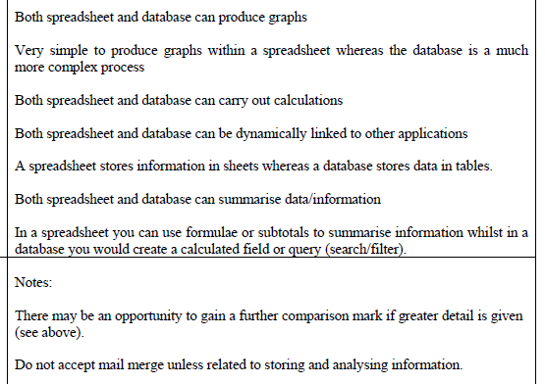
Automatic updating eg a Chart in a WP

Slide 18
2010 2/2c
Outline each of the following IT terms. (4)
  One-to-many relationship
  Conditional formatting
  Master Slide
  Cross-referencing

Slide 19
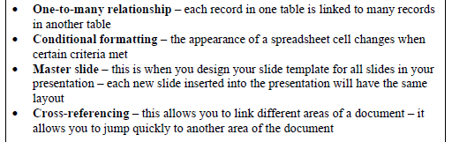
Word Processing

Slide 20
2011 2/2d
Suggest and justify 3 features of presentation software which a speaker would find useful. (6)

Slide 21
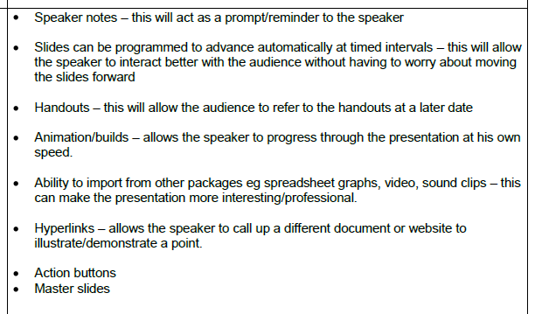

Slide 22
2012 1/4
Justify the use of database software to store employee records. (3)

Slide 23
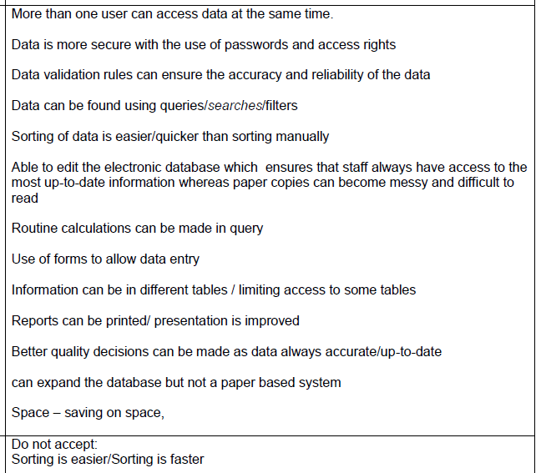

Slide 24
2013 1/3
Describe 3 software applications that can be used by an Administrative Assistant. (6)

Slide 25
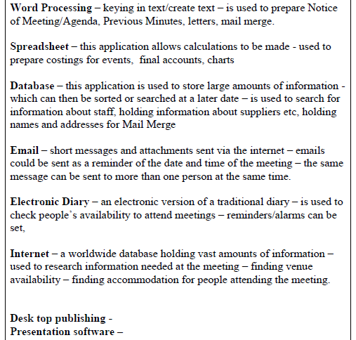

Slide 26
2013 2/1d
Justify the need for staff details to be held in a relational database. (2)

Slide 27
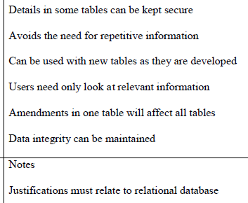
RELATIONAL DATABASE

Slide 28
2014 2/5a
Outline 4 features of presentation software. (4)

Slide 29
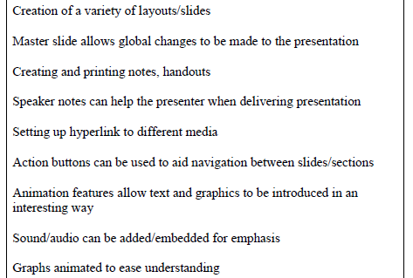

Slide 30
2015 2/2b
Describe 3 features of presentation software that a team leader may use when training staff. (6)

Slide 31
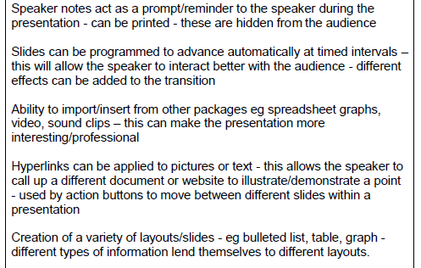
CONTINUED...

Slide 32
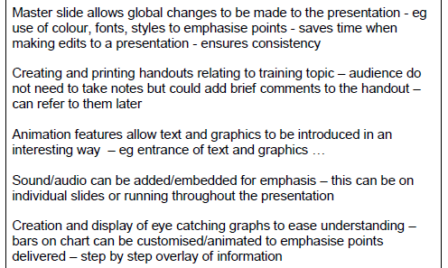

Slide 33
SQA Software PPQs (CfE)
2015-2019
Higher Administration & IT

Slide 34
2019 Q12
Justify the following spreadsheet features:
  Named cell
  Pivot Table
  (4)

Slide 35
