Slide 1
Higher Administration & IT
Administrative Services
Outcome 1.4

Slide 2

The Contract
The Employment Rights Act 1996 states that an employee must receive a written contract of employment within 8 weeks of starting work.
Itemised pay-slips; rights regarding working on a Sunday and maternity/paternity leave and the termination of employment are also covered.
Job title | Holiday details
Required duties | Pension details
Working hours | Discipline and Grievance Procedures
Salary details | Commencement Date

Slide 3

Working Contracts
Part-time – permanent or temporary
Full-time – permanent or temporary
Temporary contracts – for an indefinite period of time
Fixed-term contracts – will have a fixed start and end date

Slide 4

Implied Terms in a Contract
Some terms of employment may not be written down but are implied by law or by custom and practice
An example traditionally finishing at midday on Christmas Eve.
For further background see Tutor2U.

Slide 5
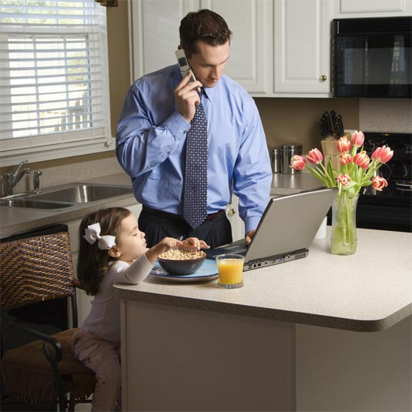
Examples of Work Patterns…
Traditional Work Patterns (Office-Based) | Newer Work Patterns
Part-time | Homeworking, Teleworking
Flex-time | Hot-desking
Shift work | Career Breaks
Job Share | Non-paid leave

Slide 6

New Working Practices
We now live in a 24/7 society.
9-5 pm hours have been replaced with a variety of different forms of working
Working from different locations (home, office, café, on the road etc)
Some tasks are outsourced to other organisations.
Allows the best workers to be retained

Slide 7

Flexible Working…
Employers use the flexibility of contracts to cover periods of boom, slump and holidays in the most efficient and effective way.
It is unusual for an employee to serve 25 years or more in a single organisation, as full-time permanent contracts are increasingly rare.

Slide 8
Impact on the Employer
Advantages to Employer | Disadvantages to Employer
Larger pool of labour so wider range of available skills | Difficult to offer training and staff development to all part-time workers
Ability to offer flexible work patterns may suit employees with children – retaining good staff | Not always easy to ensure health and safety in home environment
Happier staff will improve morale and increase productivity | Harder to organise and control a large number of part-time workers
Less absenteeism | Difficulties in communication
Cheaper rent/accommodation | Technical difficulties when equipment breaks down

Slide 9
Impact on the Employer
Advantages to Employee | Disadvantages to Employee
Improved ‘work-life’ balance | Fewer opportunities for staff development training
Lower stress levels – time to ‘recharge’ on days off | Feelings of isolation in the home environment
Freedom to choose when and where to work | Hot-desking may result in depersonalisation of space, leading to a feeling of not belonging
Reduction in travel | More difficult to develop new relationships
More accessible for people with disabilities | Difficult to balance work and home commitments, need for discipline to work working hours

Slide 10

Internet Research
Visit the Flexibility website to find out more about options for flexible working.

Slide 11

Career Breaks
The aim of a career break is to retain a valued and competent employee and allow them to have an agreed period of time off.
Can range from 6 months to 5 years.
Some retraining may be offered before the return to work.
Non-paid leave may also be offered to parents during the long summer holidays.

Slide 12
Career Breaks: Your Rights
Investigate what rights an employee has while on a career break.

Slide 13
Employment Rights
Visit the websites of these organisations:
  BERR – to find out about the rights of part-time workers
  ACAS – to find out about the rights of fixed-term employees.
  WorkSMART – for more about workers’ rights.

Slide 14

Outsourcing
Work is contracted out either to gain services more cheaply and cost-effectively (eg cleaning, security or catering) or for specialist services (eg web design, payroll or call centres)
Organisation concentrates on core services.

Slide 15
Internet Research
Gov.uk is a new website combining various other government websites.
Search for procedures to be followed when disciplining employees.

Slide 16
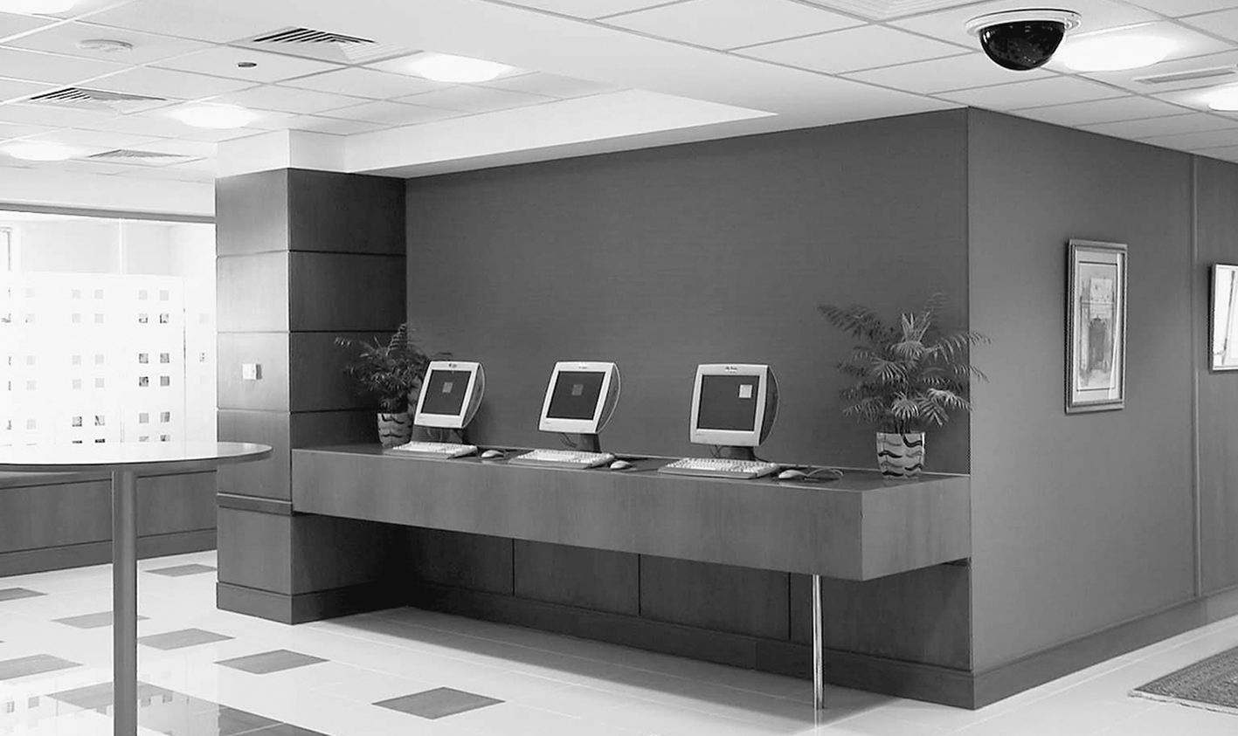
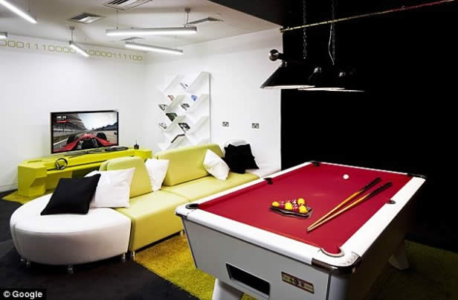
The Changing Work Environment
Touchdown Area
Chill-Out Areas
Public Transport (Promotion)
Digitisation of paperwork
Move to open-plan offices

Slide 17
Designing The Office
Things to think about:
Aesthetics – colour, décor, fabrics, surfaces
Acoustic screens and barriers (noise)
Lighting and heating
Layout

Slide 18
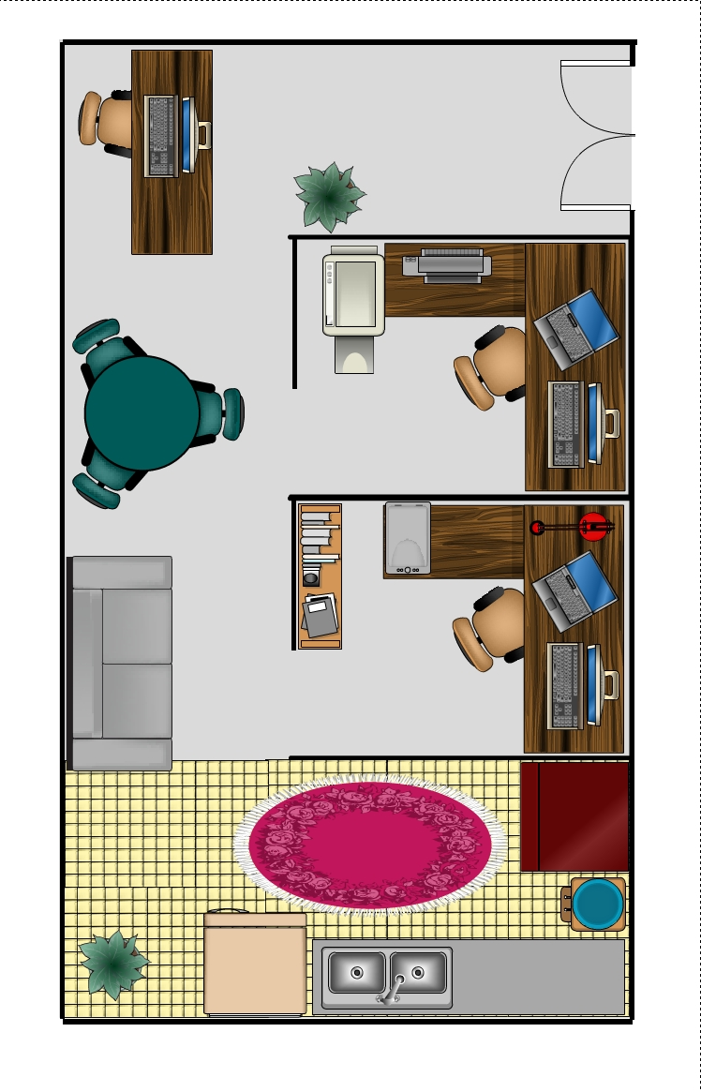
Office Layout
Poorly designed layout will disrupt the efficiency of workflow.
eg you should not need to walk from one end of the building to another to collect a printout.
Motivation is improved by pleasant surroundings

Slide 19

Sick Building Syndrome
Employees who work in large open plan office environments sometimes complain of illnesses such as:
headaches
sore throats
tiredness
which they believe are associated with the building that they work in.
Causes: Drafts / Leaks / Poor Ergonomics
Results: Absence / Stress / Low Productivity

Slide 20
Open Plan Office Example

Slide 21
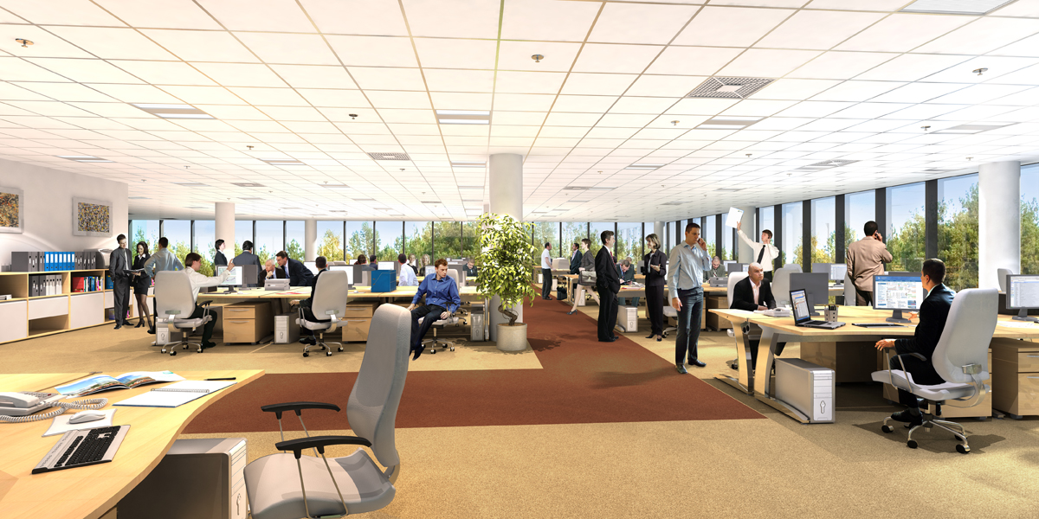
Open Plan Offices
Advantages | Disadvantages
Easy to supervise staff | Noisy – distractions
Savings in Space and Equipment | Unable to alter heating to suit personal requirements – often only air conditioning.
Staff social areas away from work area | Lack of privacy and personal space
Meeting rooms for private work | Illnesses are more easily spread
Shared resources | Difficulty in keeping information confidential

Slide 22
Cellular Office Example

Slide 23
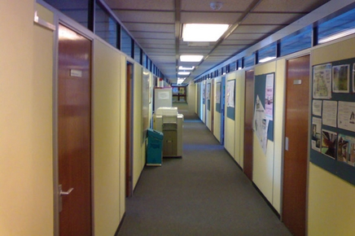
Cellular Offices
Advantages | Disadvantages
Quiet – doors can be closed | Wastes space
Status – boss has own room | More difficult to supervise and share resources
Privacy for one-to-one discussions | Uneconomic
Ability to alter heat and light to suit personal tastes | Difficult to promote teamwork – staff feel isolated
 | Workflow difficult to monitor

Slide 24

Google’s London Office
Visit this website to view photographs and a short video.
The BBC News website also has a short article and video.

Slide 25
Internet Research
Use the Internet to find out more about sick building syndrome.
Make notes about the syndrome, and find out how organisations can arrange the work environment to prevent it.

Slide 26
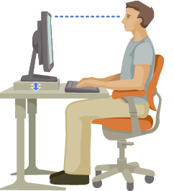
Office Ergonomics
Fitting the workspace environment and the employee together in the best way to prevent physical and mental health problems.
Increasing musculoskeletal disorders:
  Carpal tunnel syndrome
  RSI
  Back injuries
  Neck and Shoulder pain

Slide 27
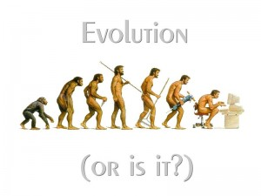
Office Ergonomics
Creating a feeling of well-being:
  The right type of furniture
  Equipment
  Lighting
  Ventilation
  Décor
  Pictures
  Plants
  Personal possessions

Slide 28
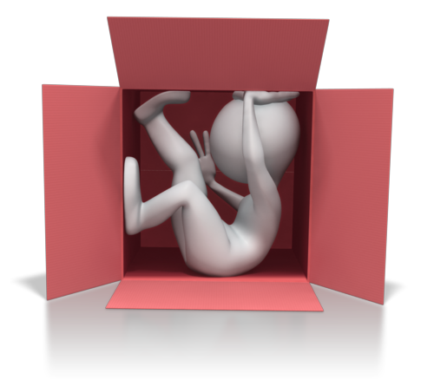
Examples of Ergonomics in Practice
Dull or dark colours can be demotivating.
Blue, Lemon and Green – restful and have a positive effect on morale and motivation.
Noise – can add to stress levels.

Slide 29
Internet Research
Visit the Open Ergonomics website for more information on the importance of ergonomics in the workplace.
Note: this website is no longer live on the internet – make use of the WayBack Machine (Internet Archive).
www.tinyurl.com/safeoffice

Slide 30
Internet Research
Further advice can be found here.

Slide 31

The Different Networks
Local-Area Network (LAN)
  connects computers and peripherals within small geographical areas, e.g. within a building
Wide-Area Network (WAN)
  connects computers on a world-wide scale. can also be used to connect to different branches of an organisation

Slide 32
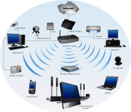
Local-Area Network
Advantages | Disadvantages
Easy to share peripherals eg printers and photocopiers | A network fault means no-one can access files, which will slow down productivity
Ability to share files and information with employees | If the file server is damaged or stolen then all files could be lost
Back-ups can be taken automatically on a regular basis | A virus can spread very quickly
Security can be set to restrict access to certain areas of the network (access rights).

Slide 33

Wide-Area Network
Advantages | Disadvantages
Data can be transmitted between branches very quickly | People outside the organisation could have access to your data so there need to be tight security measures in place.
Gives easy access to the internet. | There is no control over external websites – they can be removed or changed by the owner so some pages could become unavailable.

Slide 34

Using The Internet
Most organisations now use the internet to advertise their business, advertise job vacancies and, most importantly, for e-commerce
Advantages of e-commerce | Disadvantages of e-commerce
The organisation can reach a wide range of customers world-wide. | The cost of setting up a website and keeping it up to date can be high.
Customers have access to the site 24/7, which could increase sales. | Security systems have to be in place that will ensure that the customer has no worries about inputting personal information.
The organisation can reduce costs by not needing to extend premises and not having to increase staffing. | Organisations lose out on face-to-face contact with customers.
Customers can shop from the comfort of their own homes and get products delivered to them. | Some customers like to see products before they buy them.
Organisations can monitor what customers are buying and use this information for marketing purposes.

Slide 35

Email Work Culture
Employees are now able to check and respond to emails on mobile devices.
Created the culture of immediate response expected.
In a recent survey 38% of employees check emails at dinner and 50% while in bed.
The Plan to Ban Work Emails Out of Hours

Slide 36

Video/Web Conferencing
No longer necessary to travel to a single location to hold a meeting.
See Meetings Presentation for more information…

Slide 37


Other Communication Methods
Skype/FaceTime – face-to-face communication with mobile devices.
WhatsApp – cross platform messaging app. Also has the ability to setup groups. Can send images, video, audio messages.

Slide 38


Cloud Based Software
The ‘cloud’ is a metaphor for The Internet
Individuals can access programs and files from any computer/device connected to the Internet
Documents are stored in ‘the cloud’ and backup is often automatic
Software is automatically updated
Convenience for users

Slide 39
Sample Exam Questions
How To Pass Higher Administration & IT
Describe a benefit of flexi-time to the organisation, and the employee. (4)
Describe the benefits of home-working for an employee. (4)
Discuss the factors regarding IT that need to be considered for employees who want to start working from home. (6)
Compare the use of audio-conferencing with web-conferencing. (2)
Discuss how effective data management can be ensured within an organisation. (6)

Slide 40

Actual Examination Questions

Slide 41
SPEC 2/1a
In order to retain valuable members of staff, organisations have introduced staff friendly working practices.
Compare job share and part-time working practices. (4)

Slide 42
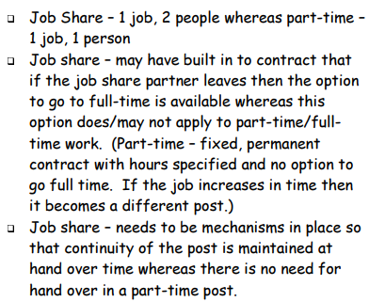
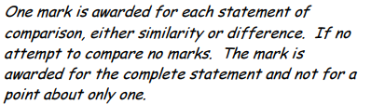
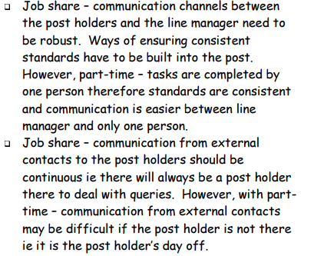

Slide 43
SPEC 2/5c
Discuss the impact of office layout on workflow and employee morale. (8)

Slide 44
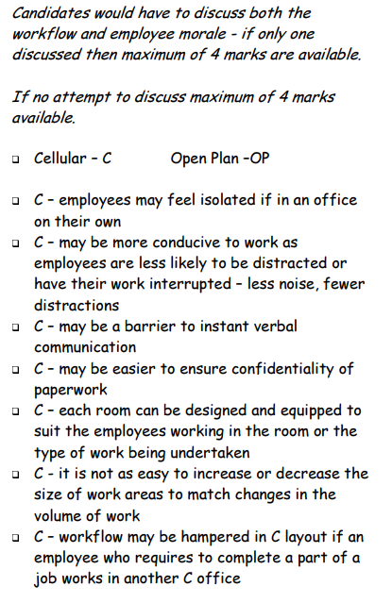
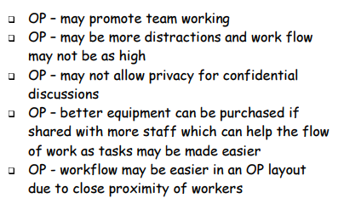

Slide 45
2006 2/3b
Describe the ways in which an intranet can assist communication between members of a team. (6)

Slide 46
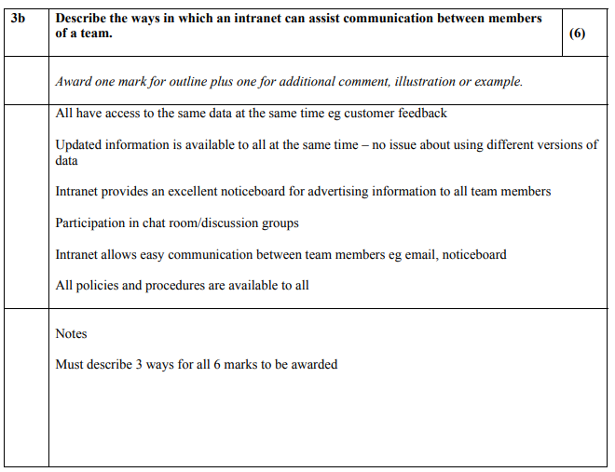

Slide 47
2006 2/3c
Describe and justify 2 working practices that could be introduced which would reduce a high staff turnover. (6)

Slide 48
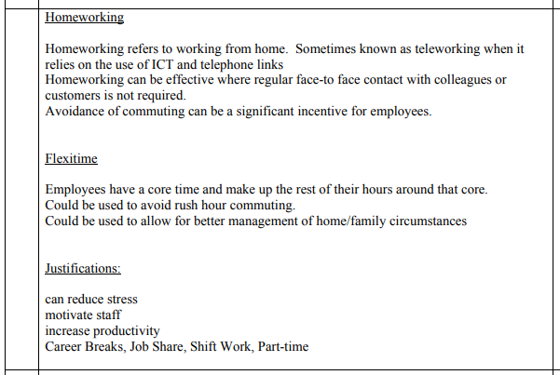

Slide 49
2006 2/3d
Discuss how the physical environment can affect staff morale. (6)

Slide 50
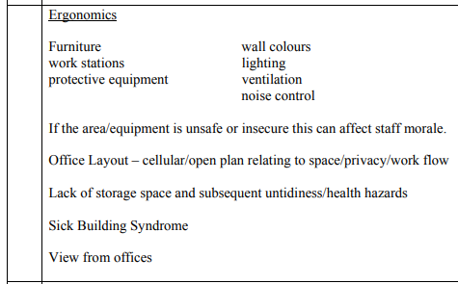

Slide 51
2006 2/5a
Outline 4 features of a contract of employment. (4)

Slide 52
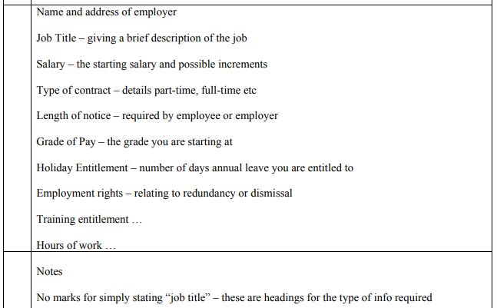

Slide 53
2006 2/5b
Discuss ways in which an organisation could deal with employees who breach the conditions of their employment contract. (8)

Slide 54
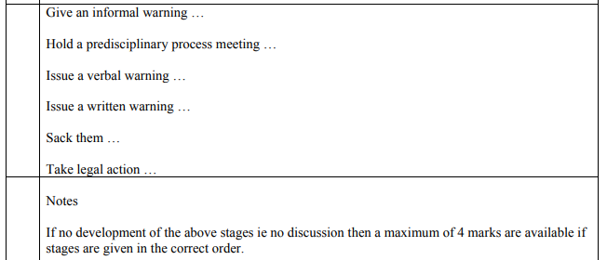

Slide 55
2007 2/3d
Justify an organisation’s decision to change from an open plan layout to a traditional cellular layout. (4)

Slide 56
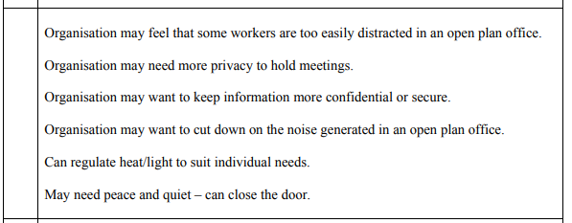

Slide 57
2007 2/4c
Discuss how developments in ICT have had an impact on:
workflow, and;
working practices
(8)

Slide 58
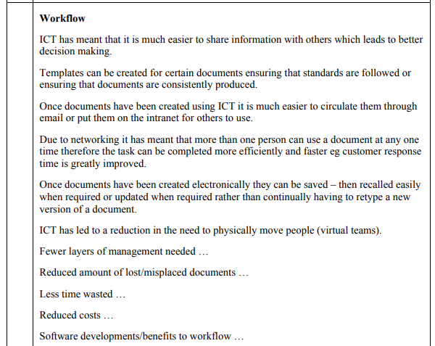
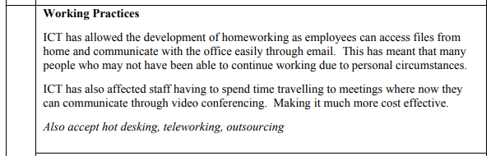

Slide 59
2008 2/1a
Outline 4 flexible working practices which may exist in an organisation. (4)

Slide 60
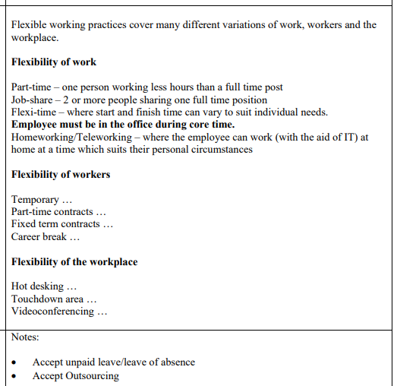

Slide 61
2008 2/1b
Discuss the impact of flexible working practices on the modern working environment. (8)

Slide 62
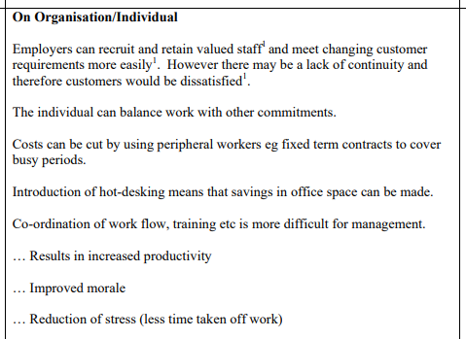

Slide 63
2008 2/5c
Discuss how office layout can affect productivity. (6)

Slide 64
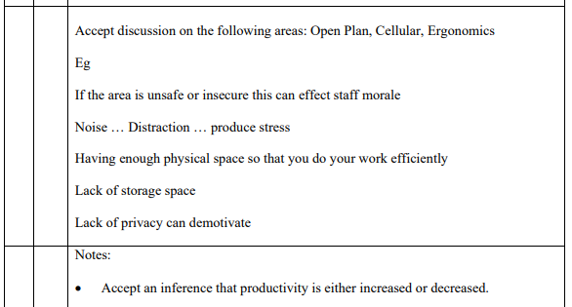

Slide 65
2008 2/5d
Justify the expense to an organisation of introducing an intranet. (4)

Slide 66
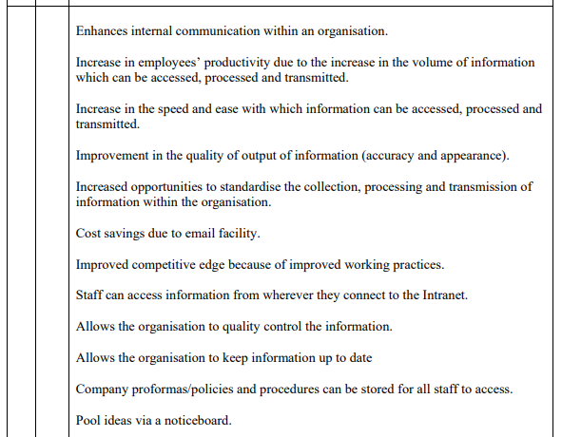

Slide 67
2009 2/2a
Outline the benefits of a career break to:
the organisation
The employee
(4)

Slide 68
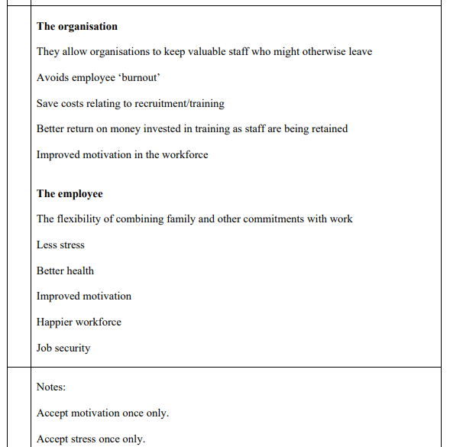

Slide 69
2009 2/2b
Describe ways in which flexible working practices can improve the work/life balance of employees. (8)

Slide 70
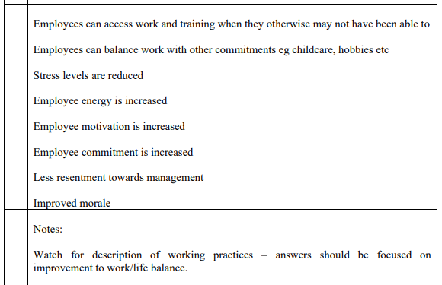

Slide 71
2009 2/4a
Outline decisions taken by an organisation to minimise Sick Building Syndrome. (4)

Slide 72
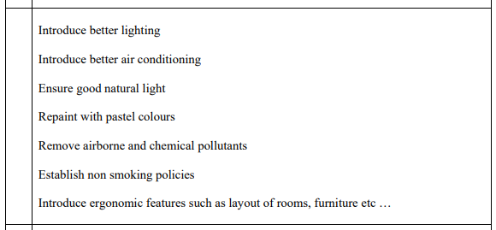

Slide 73
2009 2/4b
Describe 2 possible consequences for the employee moving from a cellular to an open plan office layout. (4)

Slide 74
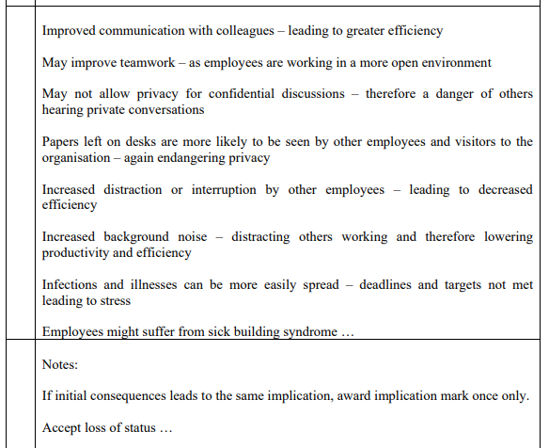

Slide 75
2010 1/4
Discuss the advantages and disadvantages of flexible working for an employer. (6)

Slide 76
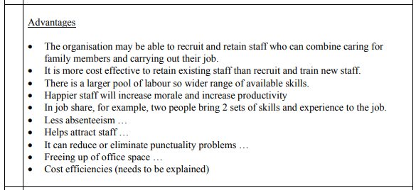
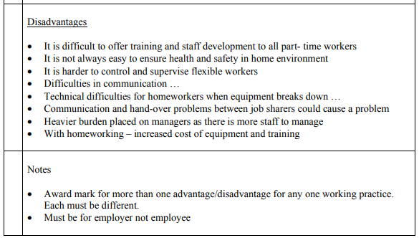

Slide 77
2010 2/5a
Outline the benefits of an organisation’s decision to change from a traditional cellular office layout to an open plan layout. (4)

Slide 78
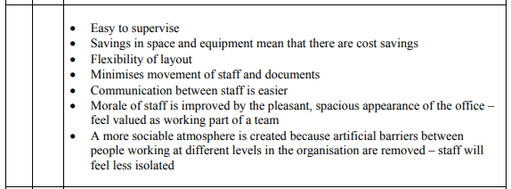

Slide 79
2011 1/1
Outline 4 benefits of homeworking. (4)

Slide 80
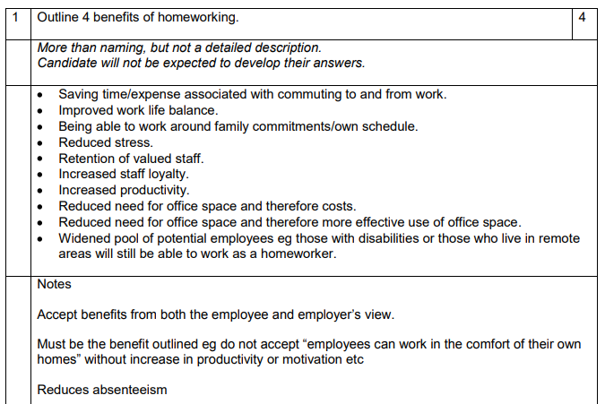

Slide 81
2011 1/2
Other than homeworking, describe 3 flexible working practices. (6)

Slide 82
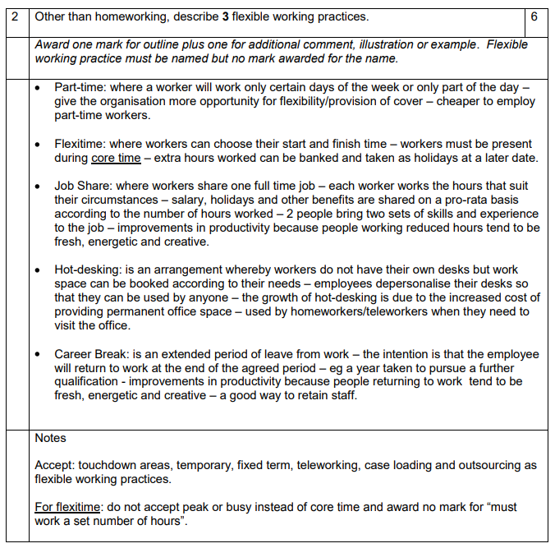

Slide 83
2011 1/3
Discuss the factors regarding IT that need to be considered for employees who want to start working from home. (8)

Slide 84
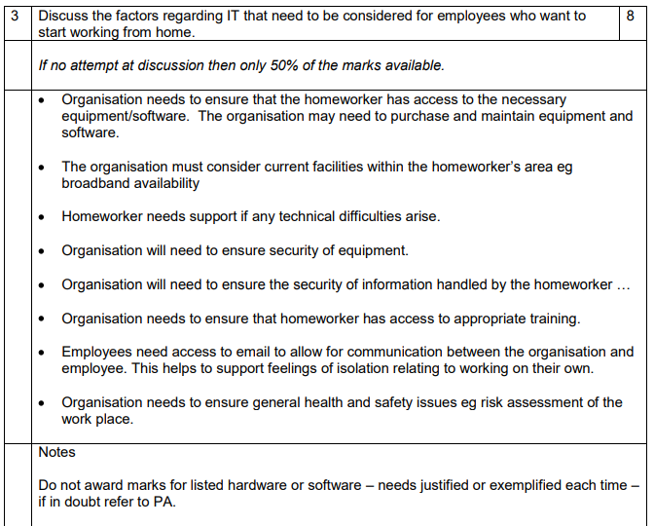

Slide 85
2011 2/2c
Discuss how productivity is affected by office layout. (6)

Slide 86
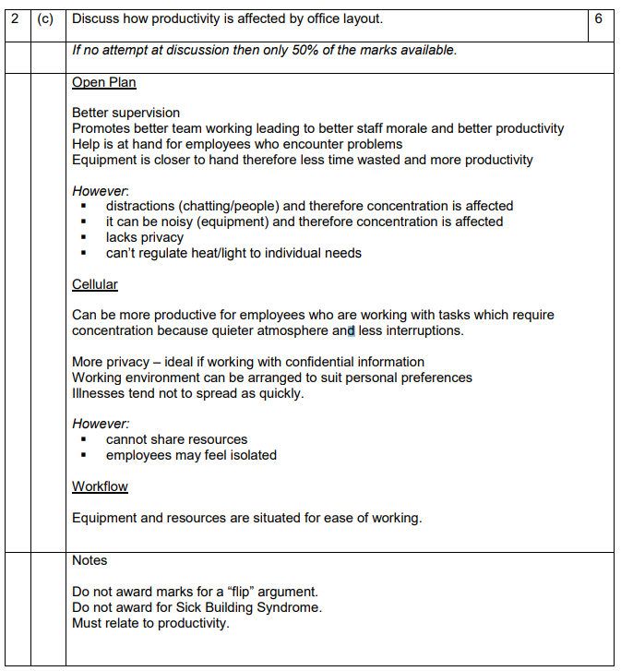

Slide 87
2011 2/3a
Outline 4 features of an intranet within a school. (4)

Slide 88
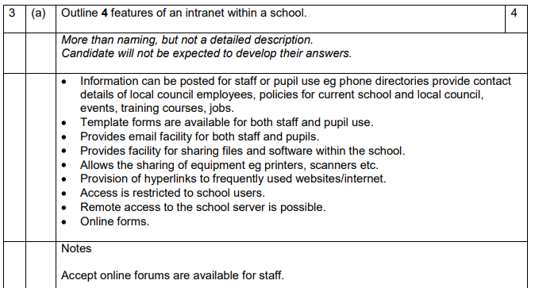

Slide 89
2012 1/1
Outline flexible working practices that an organisation could offer. (4)

Slide 90
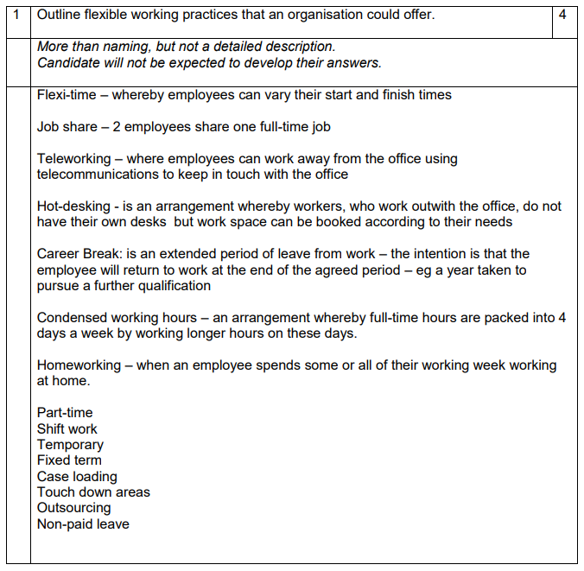

Slide 91
2012 1/2
Describe the impact of flexible working on an organisation. (4)

Slide 92
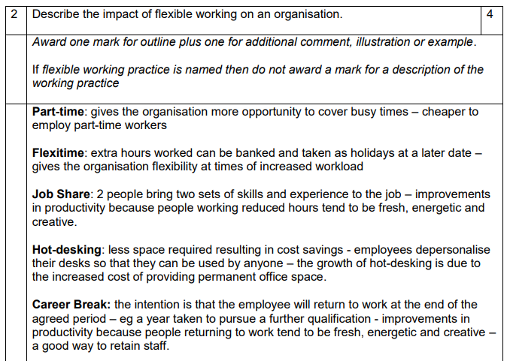
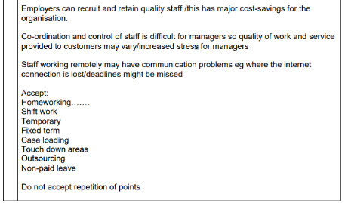

Slide 93
2012 2/1b
Describe how developments in ICT have had an impact on workflow. (6)

Slide 94
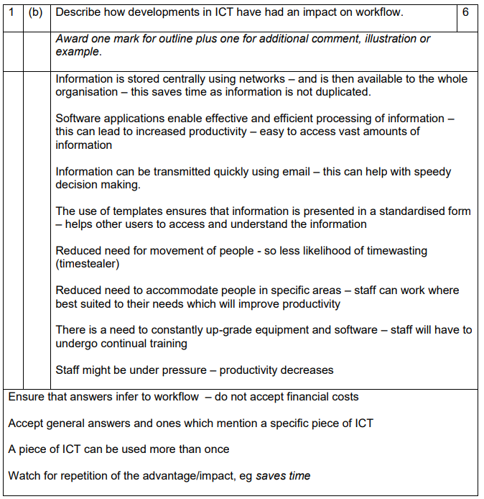

Slide 95
2012 2/2d
Describe ergonomic features that would ensure a good working environment. (6)

Slide 96
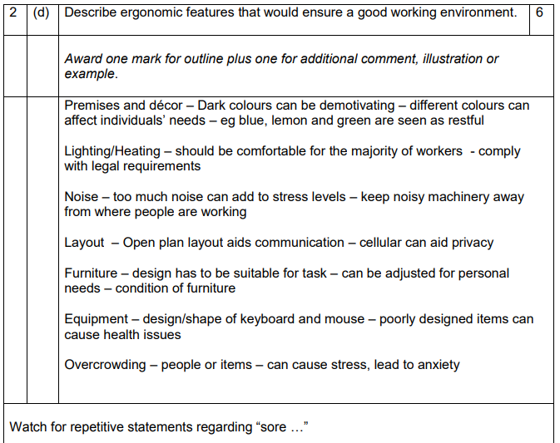

Slide 97
2012 2/3c
Discuss ways in which an organisation can deal with an employee who breaches the conditions of their employment. (8)

Slide 98
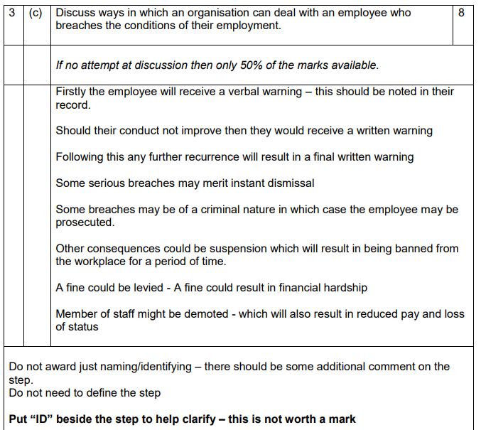

Slide 99
2013 2/1b
Describe 3 working practices that could be introduced to reduce staff turnover. (6)

Slide 100
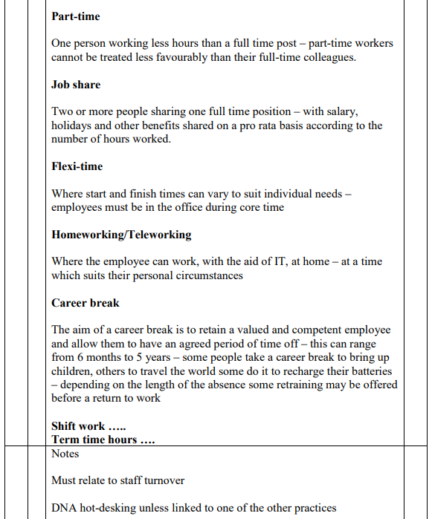

Slide 101
2013 2/4d
Justify the introduction of a centralised IT Department. (2)

Slide 102
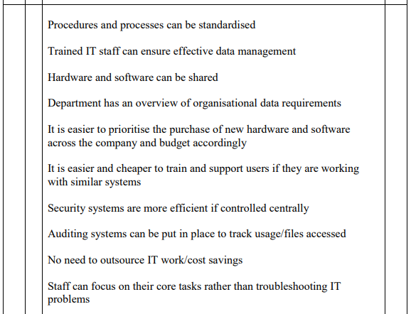

Slide 103
2014 1/5
Justify the decision to employ an Administrative Assistant on a fixed term contract. (2)

Slide 104
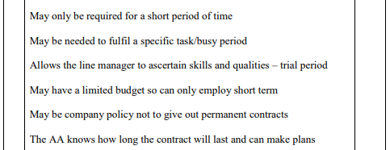

Slide 105
2014 2/2a
Outline the benefits of out-sourcing administrative services. (4)

Slide 106
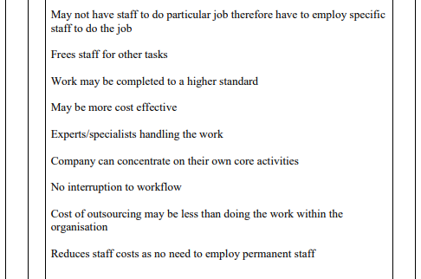

Slide 107
2014 2/2d
Justify the expense to an organisation of introducing an intranet. (2)

Slide 108
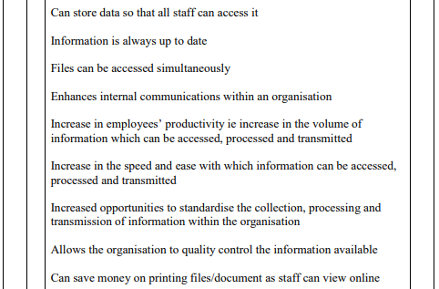

Slide 109
2014 2/4c
Discuss the positive and negative effects of using email in an organisation. (8)

Slide 110




Slide 111
2014 2/4d
Justify the decision to change to an open-plan office. (2)

Slide 112


Slide 113
2014 2/5c
Discuss the impact of flexible working practices on employee well-being. (8)

Slide 114


Slide 115
2015 1/1
Outline 4 advantages for employees of working from home. (4)

Slide 116


Slide 117
2015 1/2
Discuss the factors regarding IT that need to be considered for employees who want to start working from home. (6)

Slide 118


Slide 119
2015 2/1c
Justify the need for an organisation to monitor the work/life balance of its employees. (2)

Slide 120


Slide 121
2015 2/2d
Justify the need to track staff absences. (2)

Slide 122


Slide 123
2015 2/4d
Discuss how the physical environment can affect staff morale. (8)

Slide 124


Slide 125
2015 2/5b
Describe the benfits of flexi-time to the organisation and the individual. (6)

Slide 126


Slide 127
Now use the
SQA CfE Past Papers
from 2015 – Present Day
for further revision.

Slide 128









SQA 2015-2019

Slide 129
Higher Administration & IT
Administrative Services
Outcome 1.4

