Slide 1
Higher Administration & IT
Administrative Services
Meetings

Slide 2


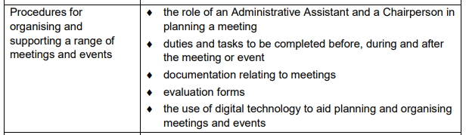
The Arrangements Document

Slide 3

Purpose of Meetings
The main purposes of meetings are:
To discuss and generate ideas
To consult on issues and solve problems
To motivate and for teambuilding
To set targets and objectives
To plan and make decisions

Slide 4

The Effective Meeting
If run poorly, meetings can be a waste of time…
Plan the meeting first – is it necessary?
Make sure it has a clear purpose
Prepare and circulate an agenda
Set a time limit eg 30 minutes
Delegate responsibilities, keep control and agree actions
Follow up on agreed actions

Slide 5

The Chairperson
Must have:
Personal skills/qualities to control the meeting
Respect from other members of the team
Tact and diplomacy
Fairness in judgement and casting vote

Slide 6

Chairperson Responsibilities
The Chairperson is responsible for:
Compiling the agenda
Ensuring that previous minutes are correct
Ensuring that a quorum is present
Starting and ending the meeting on time
Keeping control of the meeting
Giving everyone a chance to speak
Explaining complex issues
Deciding when it is time to vote, and summarising the discussion
Declaring the results of the vote and recording the results
Making decisions
Closing or adjourning the meeting formally

Slide 7

Chairperson (Afterwards)
After the meeting the chairperson will:
Liaise with the secretary regarding the preparation of the draft minutes and the agenda for the next meeting
Take follow-up actions from the discussions as required
Make any necessary decisions between meetings, usually in consultation with the secretary

Slide 8

The Secretary
Before the meeting:
Book the venue
Make sure that the layout of the room is correct
Order refreshments
Book equipment required
Inform reception and arrange parking permits
Note the meeting in relevant diaries
Make extra copies of agenda/previous minutes
Note any apologies received
Prepare name badges for attendees
Inform the press (if the meeting is a public one)

Slide 9

The Secretary
On the day of the meeting:
Give names of those attending to reception
Check the room is as expected (light/heat/layout/equipment/refreshments etc)
Signs and Directions to the meeting room
“Meeting in progress” sign on the door
Attendance register ready
Greet attendees

Slide 10

The Secretary
During the meeting:
Sit next to Chairperson – passing relevant papers and general assistance
Read the minutes and take apologies for absence
Chairperson has to sign the minutes (and alterations)
Ensure the attendance register is complete
Take minutes: actions, by whom and when
Distribute expense claim forms

Slide 11

The Secretary
After the meeting:
Tidy the room
Inform reception that the meeting is finished
Draft minutes and give a copy to the chairperson
Note when the agenda for the next meeting should be ready
Follow up any action points (inc writing letters etc)
Note the date of the next meeting
Prepare the agenda and Chairperson’s agenda for the next meeting

Slide 12

Failing to Plan…
Consequences of poor meeting organisation:
Meeting may be postponed
Longer meeting – if agenda badly designed
Lack of discussion – if documents haven’t been read
Attendees feeling uncomfortable – water necessary
Embarrassment/Anger – if no vegetarian option
Misdirected attendees – if reception is not informed
Late attendees – parking not arranged (inc disabled access)
Invalid decisions – incorrect procedures followed.

Slide 13

Notice of Meeting and Agenda
Sent some time before a meeting - to give attendees time to prepare
But not usually longer than 2 weeks before!
Some of the items in the agenda are standard items and appear for every meeting.

Slide 14
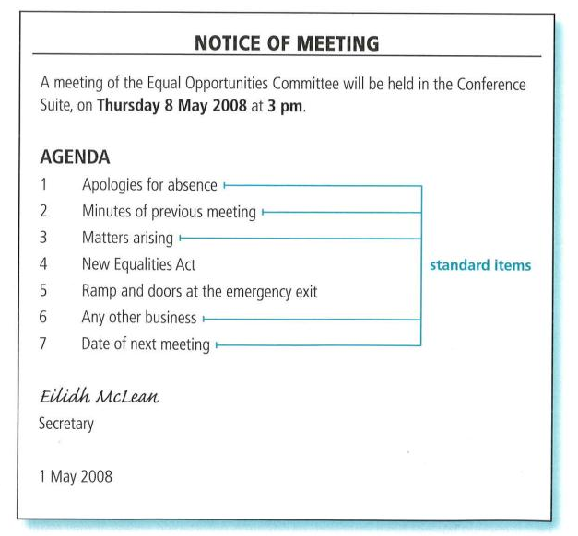

Slide 15

Standard Agenda Items
Apologies – allows the secretary to forward any documents issued and for the chairperson to establish if a quorum is present
Minutes – opportunity to discuss the accuracy of previous minutes
Matters Arising – up-to-date position on matters since the last meeting
AOCB – other items requiring discussion not on agenda (usually brief)
Date of next meeting – ensures general agreement before the close of the meeting

Slide 16

Formal Minutes
An official record of the meeting taken by the secretary
Written in the past tense and third person
eg (Caitlin Broadfoot reported on the positive achievement of Eilha Craig)
Not everything is recorded, but details of proposals, resolutions, motions, decisions and actions will be recorded
Recorded in the same order as the agenda
Once agreed, signed by the chairperson and are filed

Slide 17


Slide 18

Action Minutes
Less formal meetings adopt action minutes.
They concentrate on:
  What has to be done
  Who is responsible for doing it
  When it has to be done by

Slide 19
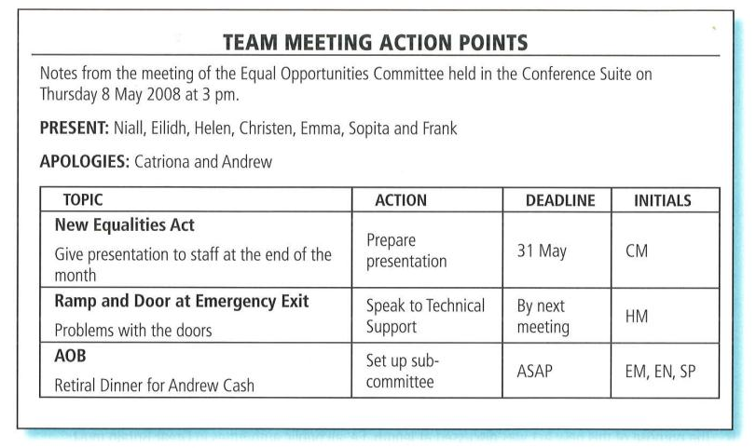

Slide 20
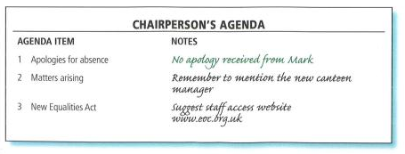
Chairperson’s Agenda
This gives additional space on the right hand side of the agenda for the chairperson to make notes.
Used in a formal meeting, or if the chairperson is new to the job.

Slide 21
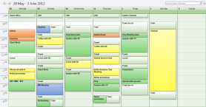
Electronic Diaries
The secretary needs access to various diaries in order to schedule meetings when participants are free (date/time)
Invitations can be sent by email, e-Diary then automatically updates when confirmed
Recurring appointments entered once
Can use reminder function eg confirming room bookings or ensure appropriate documents have been sent out

Slide 22

Email
Send Notice of Meeting and Agenda to multiple participants at once (using attachments)
Documents could be accessed electronically during a meeting
Avoids the need for the use of paper (eco-friendly/space-saving)

Slide 23

Intranet
Private computer network
Used to access the most up-to-date policies, procedures and templates
Minutes of meetings will be stored on a LAN Server.

Slide 24

Audio-Conferencing
Conducted via loudspeaker telephone
Not easy to identify the person speaking unless they give their name first
Lack of facial expressions/body language
Problems holding confidential discussions
Useful for a brief meeting between a few people

Slide 25
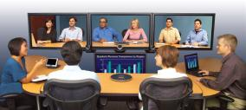
Video-Conferencing
Using large television/plasma screen, computer network and relevant software
Ability to communicate visually across the globe avoiding travel/accommodation costs (and time)
Can hire the service from other companies if not available in-house

Slide 26

Video-Conferencing
Advantages
Disadvantages
Communication over long distances
More personal than telephone call
Avoids pollution through travel (time and saving)
Facilities at (or close to) normal place of work
Can be recorded and played back
Allows demonstrations
Hardware/software – expensive setup
Time differences – international meetings
Fast broadband connection required (no longer an issue usually)
Network fault/crash – meeting postponed (frustration)
Participants may not like being filmed

Slide 27

Mobile Phones
Text messaging may have a negative effect on proper business language
Reminders of Meetings – SQA send text alerts for events that you have signed up to (the day before the event)
Ability to take photographs and short videos to use in a discussion later
Some difficulty with reception in some areas especially 3G/4G
People may not turn off in meetings and other public places
Personal calls during working hours can be an issue

Slide 28

Interactive Whiteboards
A ‘virtual’ whiteboard
All writing/annotations can be saved electronically for later reference eg brainstorming sessions
Notes can be printed or emailed to colleagues not present at the meeting

Slide 29

Presentation Software
Speakers Notes – prompt/reminder
Slides can advance automatically – improving interaction
Handouts – allows reference later
Animation (step-by-step) – progress at own pace
Integrated packages – import charts/tables/video/graphics/sounds
Hyperlinks – linking to different documents/websites
Action buttons – various features available
Master slides – set up templates for the presentation

Slide 30

Other Forms of Technology
Instant Messaging
Discussion Groups
Blogs
Wikis
For all forms of technology you must be able to give specific examples of how ICT has improved the efficiency of meetings

Slide 31

Meeting Evaluation
Since meetings consume so much of our time, it's worth trying to improve them.
The leader's perception of how a meeting has gone can be quite different than participants' experiences of the same meeting.
Evaluating how meetings are going, discussing results together, and making improvements are a powerful way to use people's time wisely and respectfully.

Slide 32

You can evaluate the meeting yourself or ask members to complete a paper evaluation and share results.
Evaluation can be some informal questions such as, "Do you feel like we accomplished what we needed to today?
The meeting leader can ask the questions with group members answering in turn, round-robin style, or the questions can be asked for anyone to answer.
Other questions from which the leader might select include:
  Are we starting on time? Ending on time?
  Are we staying on topic?
  Are all our members participating in discussions and decision-making?
  Are we addressing the most important issues in our meetings?
  Do we follow through on our decisions?

Slide 33

The committee or group as a whole should generate solutions for any items that received a "No" response.
Brief paper surveys are another option and the group results should be aggregated and shared. Focus on any weak spots identified in the evaluation at the next meetings.
A very different approach is to ask:
  "What went well at this meeting (or recent meetings)?
  Why did it go so well?
  What can we do to make all our meetings this effective?"

Slide 34
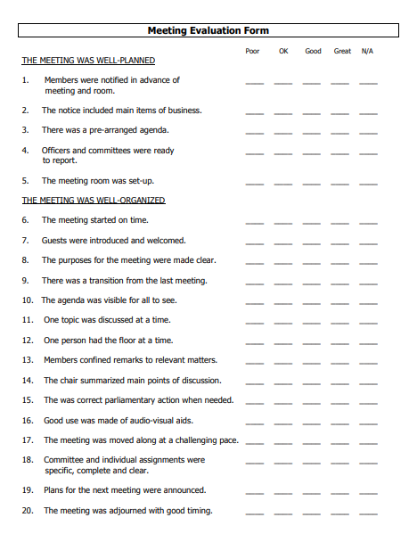
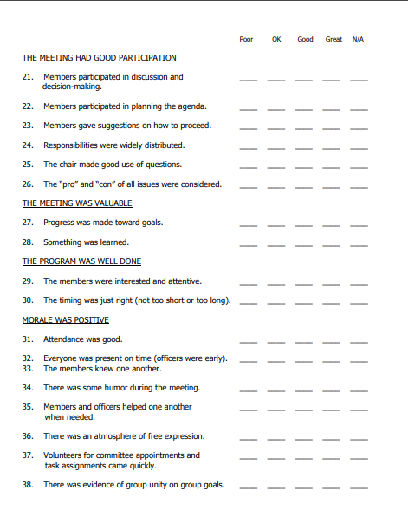
Not necessarily the best layout, but good examples of questions…

Slide 35

Actual Examination Questions

Slide 36
2006 Specimen 2/2a
TERMINOLOGY
NO LONGER REQUIRED
During a meeting a motion is proposed. Using meeting terminology, outline the process from proposal to conclusion. (6)

Slide 37
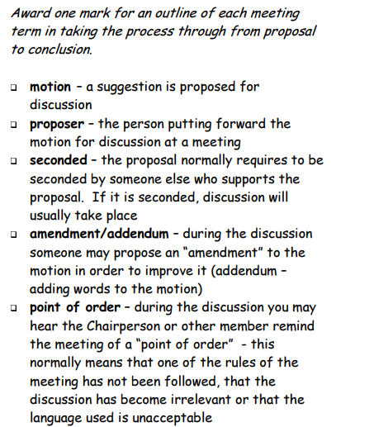
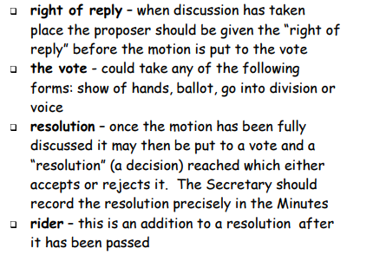

Slide 38
2006 Specimen 2/2b
Describe the use of a computer network to support remote meetings. (8)

Slide 39
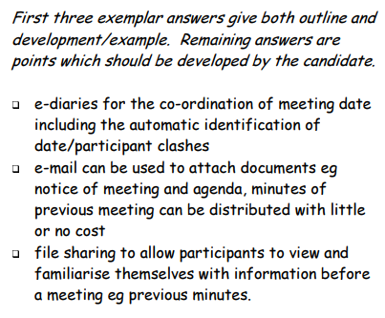
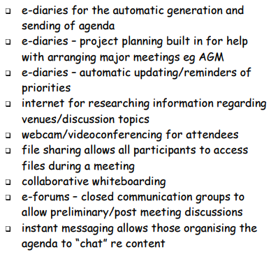

Slide 40
2006 Specimen 2/2ci
Compare the use of presentation software with a paper-based handout for communicating information to participants during a meeting. (4)

Slide 41
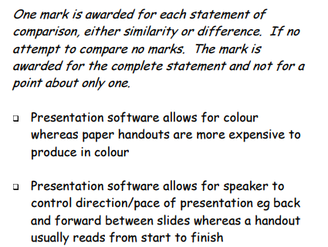
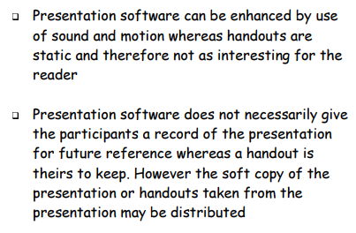

Slide 42
2006 Specimen 2/2cii
Justify the provision of training for speakers who use presentation software. (2)

Slide 43
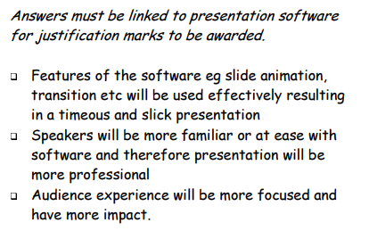

Slide 44
2006 2/1a
Discuss the benefits to a Senior Administrative Assistant of using an eDiary to plan and organise a meeting (6)

Slide 45
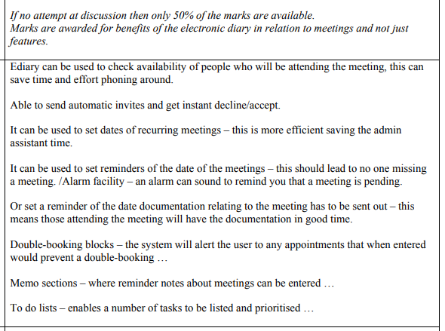
NO LONGER PERMITTED AS AN ANSWER – ITS WRONG

Slide 46
2006 2/1b
TERMINOLOGY
NO LONGER REQUIRED
Outline the purpose of an:
AGM (2)
EGM (1)

Slide 47
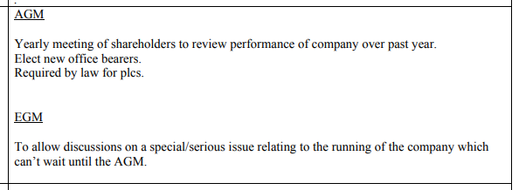

Slide 48
2006 2/4a
Describe the tasks an administrative assistant could undertake in organising a customer focus group meeting. (6)

Slide 49
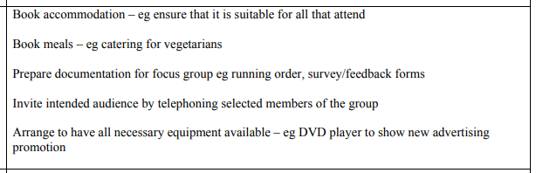

Slide 50
2006 2/4b
Describe the use of ICT to communicate effectively at a customer focus group meeting. (4)

Slide 51
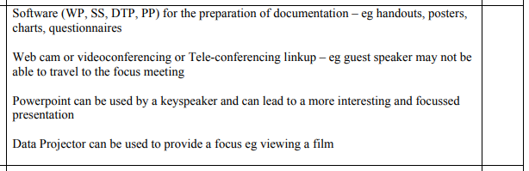

Slide 52
2007 2/5a
TERMINOLOGY
NO LONGER REQUIRED
Many decisions are taken at meetings by voting. Outline the meaning of the following voting terms. (4)
Ballot
Majority
Abstain
Casting Vote

Slide 53
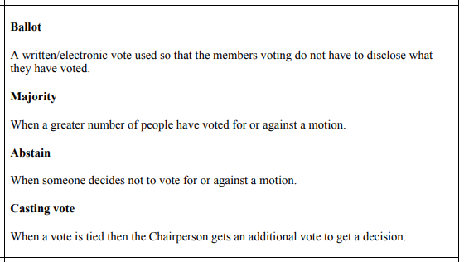

Slide 54
2007 2/5b
Compare the role of the Chairperson and the Secretary in planning and organising a meeting. (4)

Slide 55
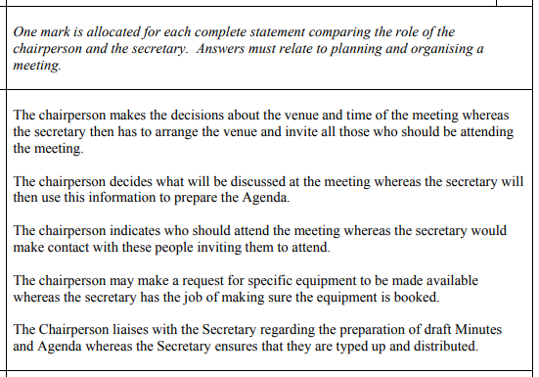

Slide 56
2007 2/5c
Discuss how technology has had an impact on the conduct of meetings. (6)

Slide 57
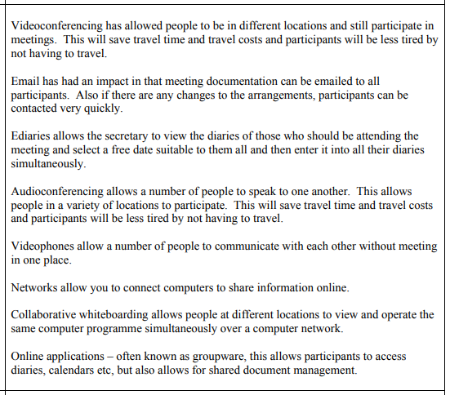

Slide 58
2008 2/2a
Describe 3 consequences and their implications to an organisation of inadequate preparation for meetings. (6)

Slide 59
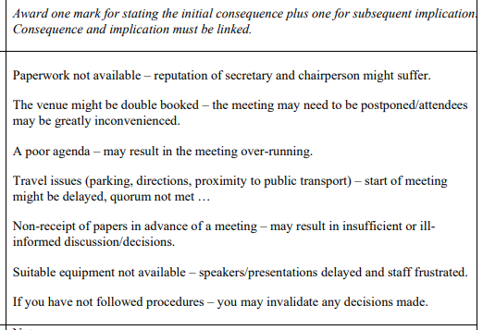

Slide 60
2008 2/2b
An Administrative Assistant will use a variety of software when planning a meeting.
Discuss the use of at least 3 software packages for this purpose. (8)

Slide 61
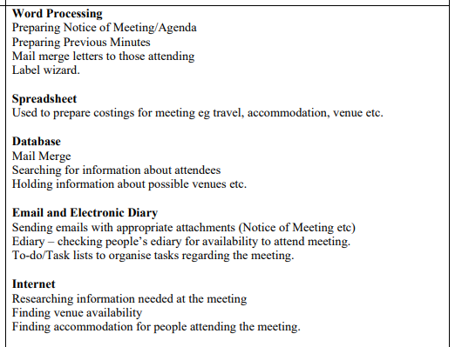

Slide 62
2008 2/2c
Justify why some teams use Action Minutes. (2)

Slide 63
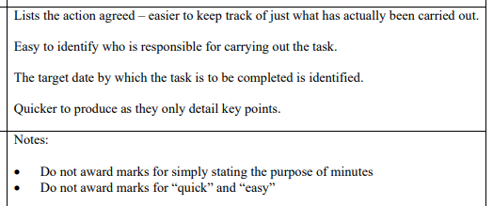

Slide 64
2009 1/4
Describe features of presentation software which may be used to enhance the delivery of a training session. (4)

Slide 65
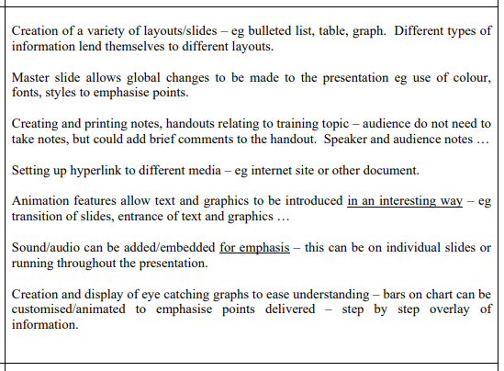

Slide 66
2009 2/2ci
TERMINOLOGY
NO LONGER REQUIRED
Describe 2 methods of voting at meetings. (4)

Slide 67
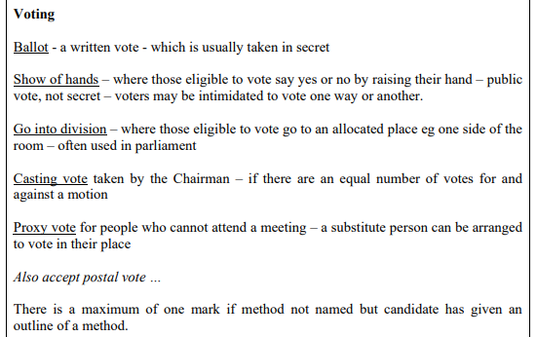

Slide 68
2009 2/2cii
Describe 2 documents related to a formal meeting. (4)

Slide 69
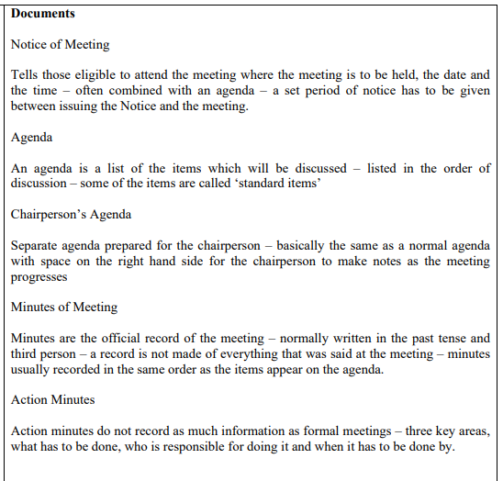

Slide 70
2010 2/4a
Outline 2 standard items in an agenda and justify their inclusion. (4)

Slide 71
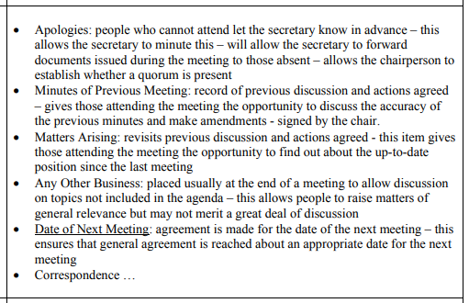

Slide 72
2010 2/4b
Discuss the use of an e-Diary in the planning and organisation of a meeting. (6)

Slide 73
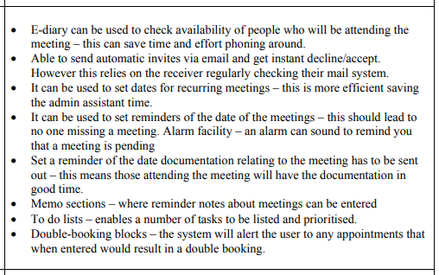

Slide 74
2010 2/4ci
Justify the use of Action Minutes. (2)

Slide 75
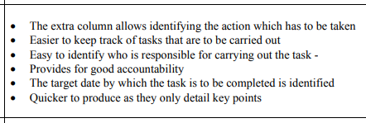

Slide 76
2010 2/4cii
TERMINOLOGY
NO LONGER REQUIRED
Select and outline 2 of the meeting terms given below: (2)
Abstain
Casting Vote
Ballot
Unanimous

Slide 77
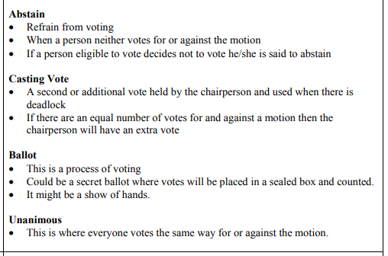

Slide 78
2011 2/2d
Suggest and justify 3 features of presentation software which a speaker would find useful. (6)

Slide 79
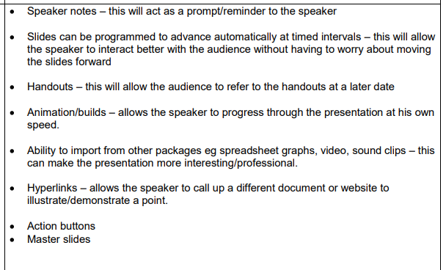

Slide 80
2011 2/3c
Discus the impact of technology on the organising and running of meetings. (8)

Slide 81
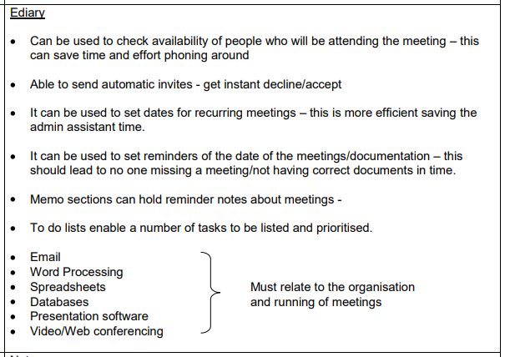

Slide 82
2011 2/3d
Justify the need for an effective Chairperson at a meeting. (2)

Slide 83
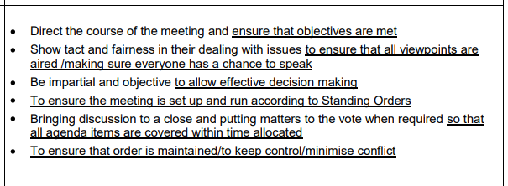

Slide 84
2011 2/5d
Outline the use of 2 documents relating to a formal meeting and justify their importance. (4)

Slide 85
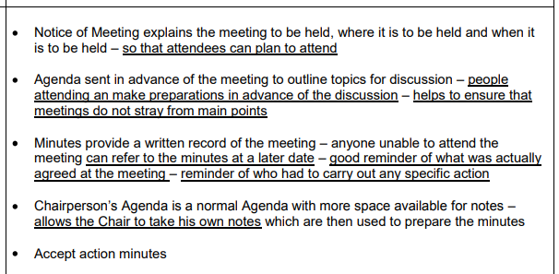

Slide 86
2012 2/2a
TERMINOLOGY
NO LONGER REQUIRED
Outline the following meeting terms: (4)
Point of order
Amendment
Adjournment
Verbatim

Slide 87
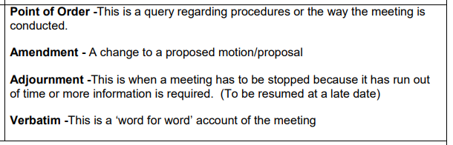

Slide 88
2012 2/2b
Discuss the role of both the secretary and the chair in planning and organising a meeting. (8)

Slide 89
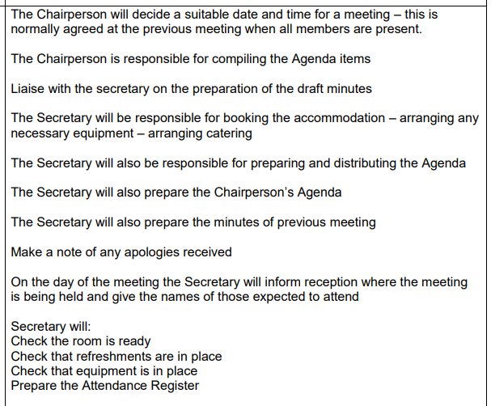

Slide 90
2012 2/5d
Justify the use of remote meetings. (2)

Slide 91
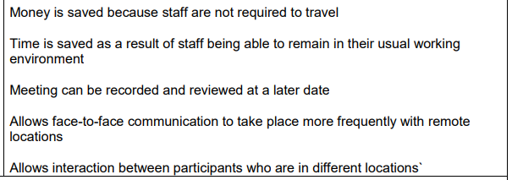

Slide 92
2013 1/1
Outline ways in which a chairperson can ensure that meetings are effective. (4)

Slide 93
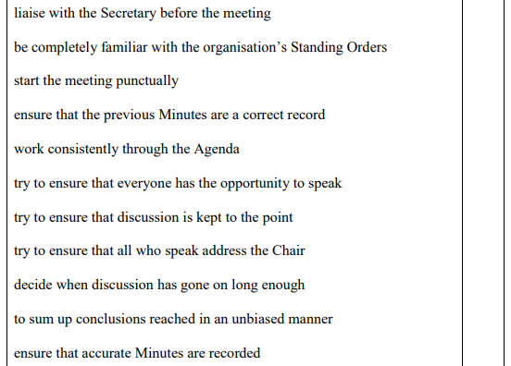

Slide 94
2013 1/2
Discuss the consequences of failing to plan and organise effectively for a meeting. (6)

Slide 95
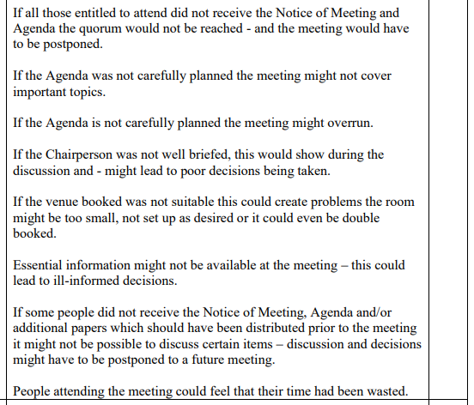

Slide 96
2013 1/5
Compare Action Minutes and Formal Minutes. (2)

Slide 97
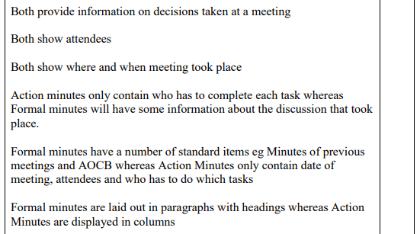

Slide 98
2014 1/4
Compare audio conferencing with video conferencing. (2)

Slide 99
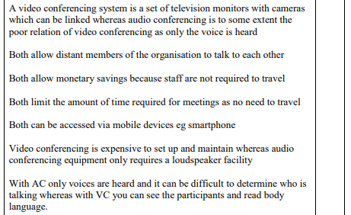

Slide 100
2014 2/3b
Describe the following 3 documents
Notice of Meeting
Agenda
Minutes of Meeting

Slide 101
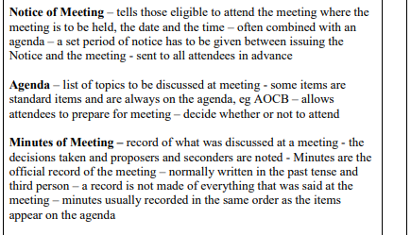
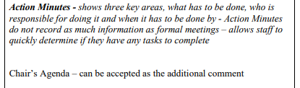

Slide 102
2014 2/3c
Discuss the use of technology during a meeting. (8)

Slide 103
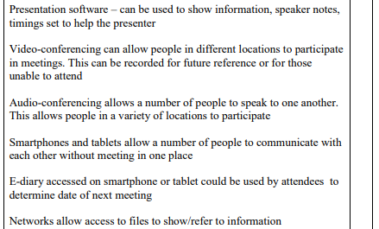
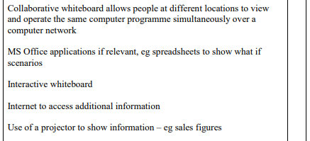

Slide 104
2014 2/5a
Outline 4 features of presentation software. (4)

Slide 105
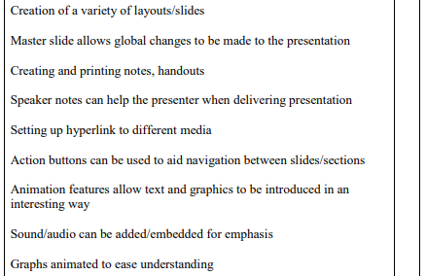

Slide 106
2015 2/2a
Outline the factors which would be considered when choosing an external venue for a team meeting. (4)

Slide 107
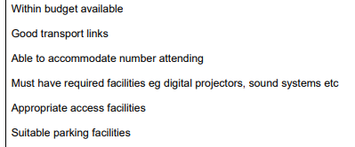

Slide 108
2015 2/2b
Describe 3 features of presentation software that a team leader may use when training staff. (6)

Slide 109
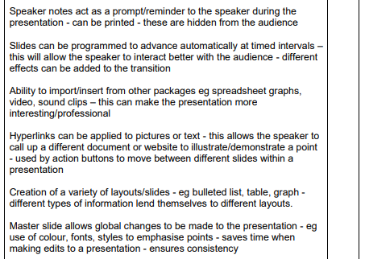
continued…

Slide 110


Slide 111
2015 2/3c
Discuss the role of the Chair and Secretary prior to a meeting taking place. (8)

Slide 112

continued…

Slide 113


Slide 114
2015 2/3d
Justify the need for an effective chairperson at a meeting. (2)

Slide 115


Slide 116
Now use the
SQA CfE Past Papers
from 2015 – Present Day
for further revision.

Slide 117







SQA 2015-2019

Slide 118
Higher Administration & IT
Administrative Services
Meetings

