Slide 1









…..your future this Summer!
Facebook – @KickstartSummer17
Twitter- @KickstartSummer
The Kickstart Summer Programmes are funded by
East Lothian, Midlothian and West Lothian Councils

Slide 2


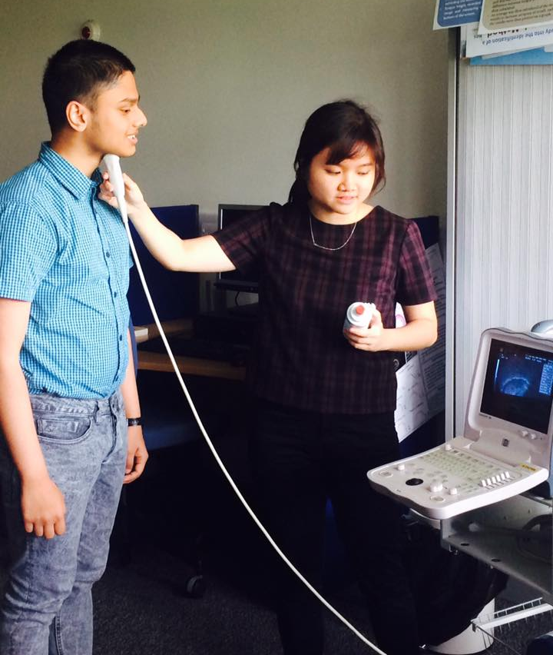

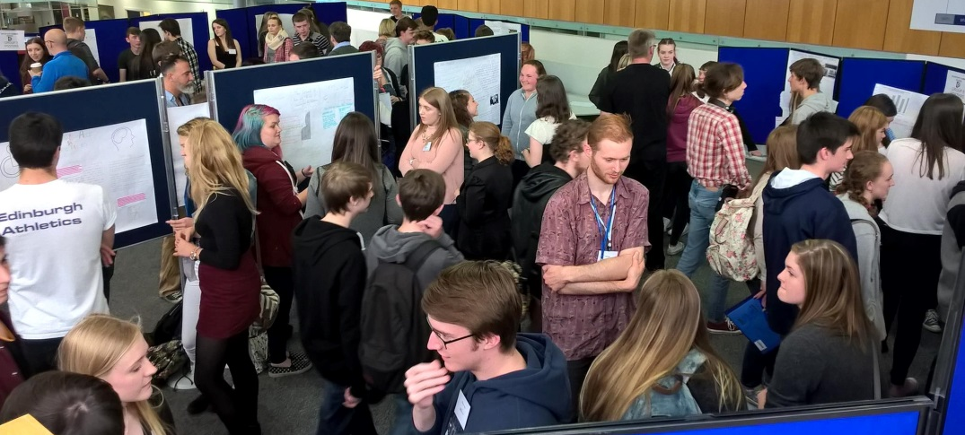


2017
Monday 10th – Friday 14th July 2017
University experience subject workshops
Open to current S4 and S5 student
Includes:
Invaluable University skills
Subject workshops
Contact with current University students

Slide 3
Subject Workshops
Just some of the subjects involved in past Kickstart programmes*:
Accounting Law Events Management
Anatomy Sociology Biological Sciences
Engineering Sport Science Journalism
Midwifery Psychology Politics
Anatomy Russian Plant Science
Games Development Social Work Social Anthropology
Physiotherapy Drama Business Management
Psychology Finance Chemistry
Nursing Acting PR
Speech Therapy Sociology Nutrition
All students do different subjects during the week.
These workshops will give you an intensive (but interactive and fun!) introduction to the subject.
*Subjects for Kickstart 2017 will be finalised in May 2017

Slide 4






Possible week on Kickstart*…
Kickstart Proposed Programme 2017 |  | Pupil Version
choice of: | 8 workshops | 12 workshops | 12 workshops | 24 workshops | 2 lectures
Time | Monday 9th July | Tuesday 11th July | Wednesday 12th July | Thursday 13th July | Friday 14th July
Main Campus: |  |  |  |  | Napier
08.30 - 09.00 | Registration
09.00 - 09.30 | Welcome | Edinburgh Napier University Workshops | Workshop | University of Edinburgh & SRUC Workshops | Workshop
09.30 - 10.00
10.00 - 10.30
10.30 - 11.00 | Break | Break | Break | Break | Break
11.00 - 11.30 | 8 x Edinburgh Central | Edinburgh Napier University Workshops | Queen Margaret University Workshops | University of Edinburgh & SRUC Workshops | Edinburgh Napier University Lectures
11.30 - 12.00
12.00 - 12.30
12.30 - 13.00 | Lunch | Lunch | Lunch | Lunch | Lunch
13.00 - 13.30 | Review Session | Travel | Review Session | Review Session | Graduation
13.30 - 14.00
14.00 - 14.30 | University Skills | University Skills | Queen Margaret University Workshops | University of Edinburgh & SRUC Workshops
14.30 - 15.00
15.00 - 15.30
15.30 - 16.00

Slide 5
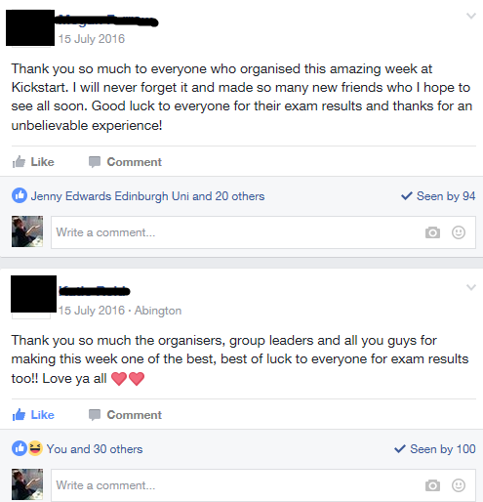
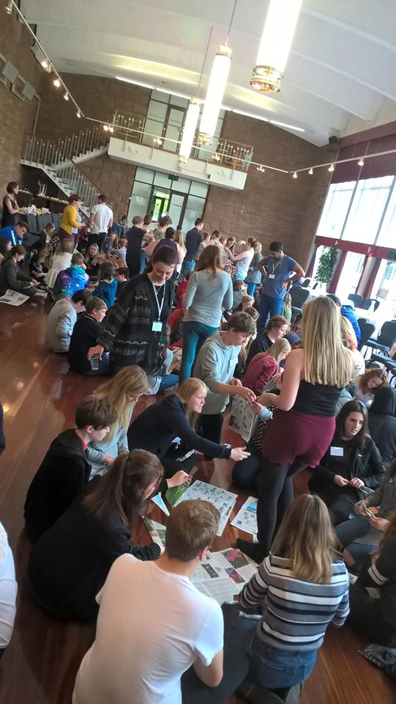
Why do it?
“ I will never forget it and made so many new friends”

Slide 6
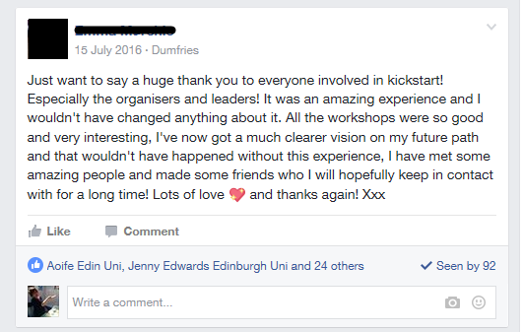
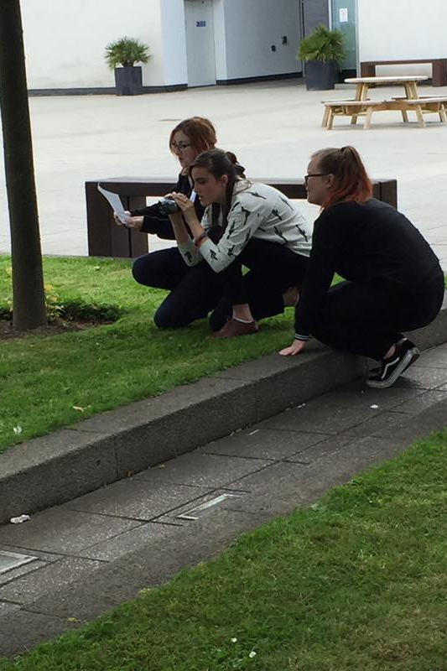
Why do it?
“ it was an amazing experience and I wouldn’t have changed anything about it”

Slide 7
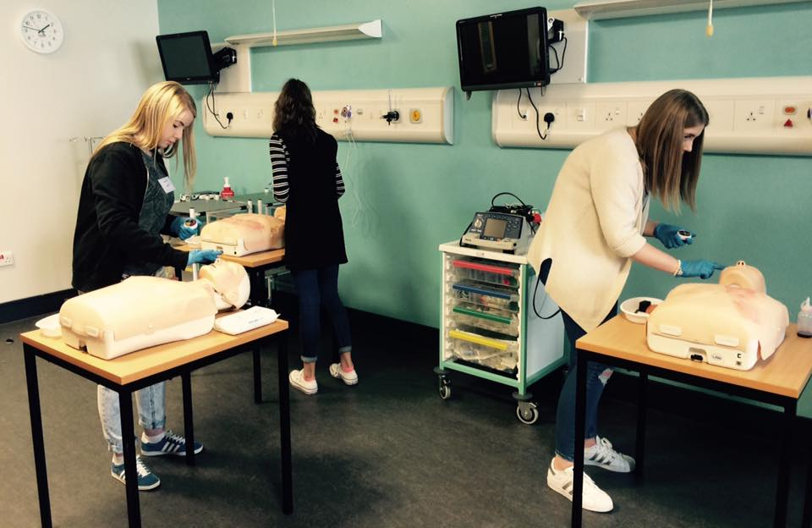
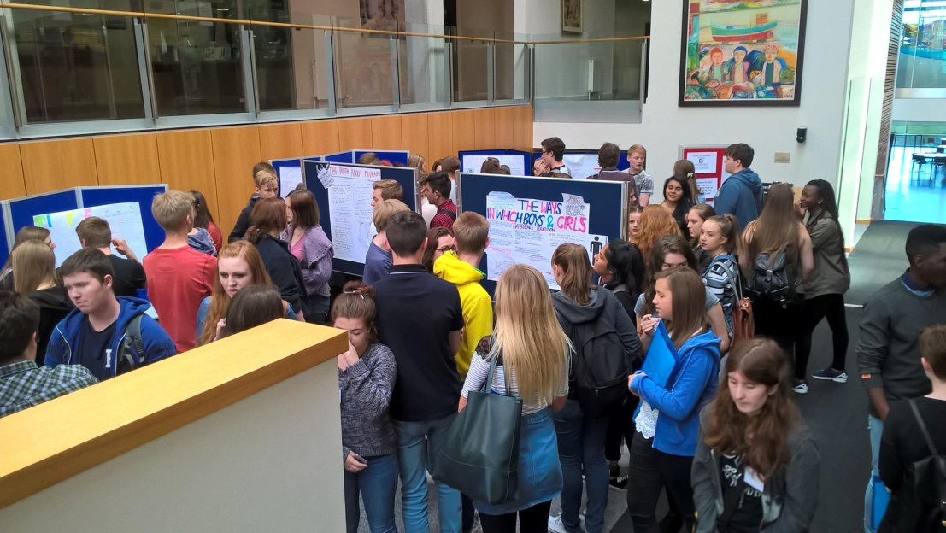

What Happens Next?
Complete an application form by 21st April
Email: kickstart@ed.ac.uk

Slide 8
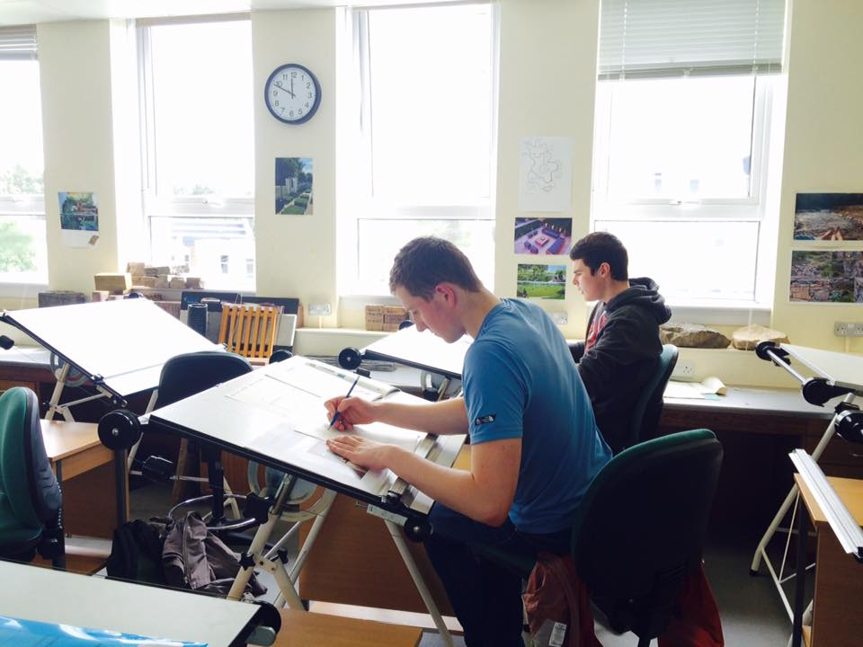

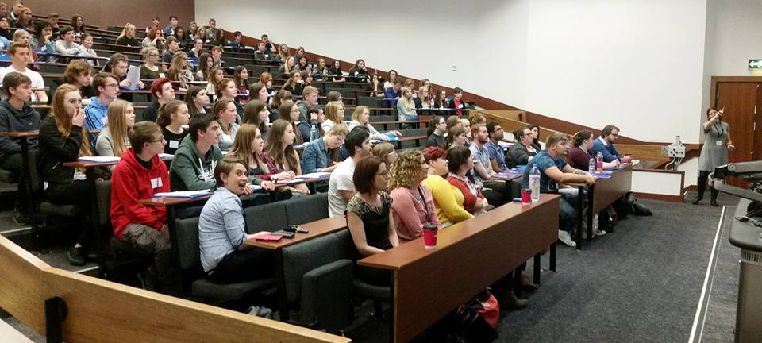
What Happens Next? (cont.)
Mid-May: Confirmation of place
Choose your subjects
Mid-June: Info about the week sent to you
10-14 July:
August: Return to school
Stay in touch – we can help you!

Slide 9


…..your future this Summer!
Any questions?
kickstart@ed.ac.uk Tel: 0131 651 1755
Facebook – @KickstartSummer17
Twitter- @KickstartSummer

